Slide 1
Python Stock Tracking
By
Jason Nguyen-Duran

Slide 2

Introduction
The project has provided me with experience creating applications in Python. After completing this project the I am able to use object-oriented techniques to develop a stock tracking application. This project will have both console and GUI (Graphical User Interfaces). By processing the historical stock data, profit/loss reports can be generated. The system will use the Python libraries to create charts and get historical stock data from web sites.

Slide 3
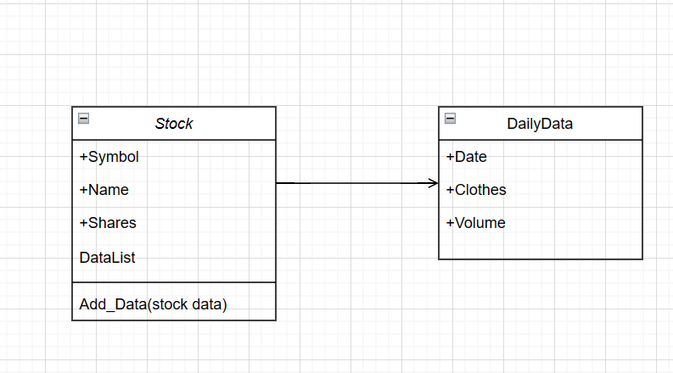
Creating a class
Before starting a major project it is always good to plan and have a general diagram before starting. Utilizing Vizio is always helpful and a great place to start.
I have inserted a small example of Visio showing the creation and relationships of the “stocks” class.

Slide 4
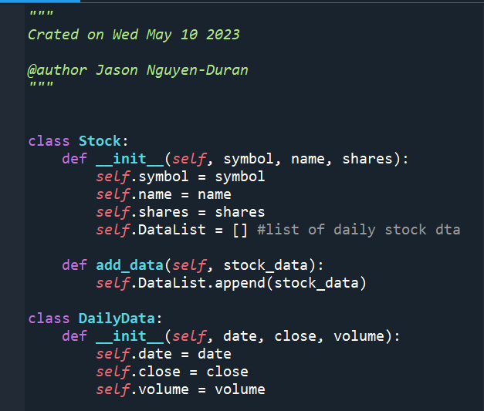
Creating a Class
In this example I have created the class “Stock” and “DailyData”.
In Python the __init__ method is a special method called when an object is created from a class. It is used to initialize the attributes of the class.
The self parameter refers to the instance of the class that is being created.

Slide 5
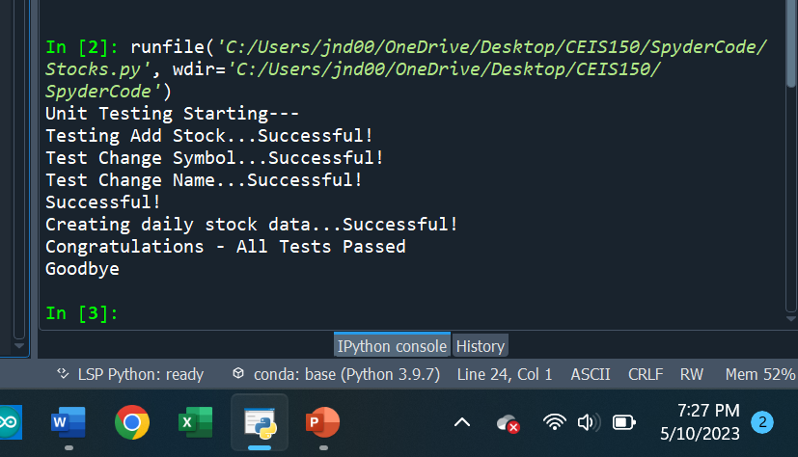
Testing Code
Anytime we create or define something in Python, it is always a good habit to check your work as you go.
If you don’t you check as you go you can potentially waste time by having to go back to something that should already be done.

Slide 6
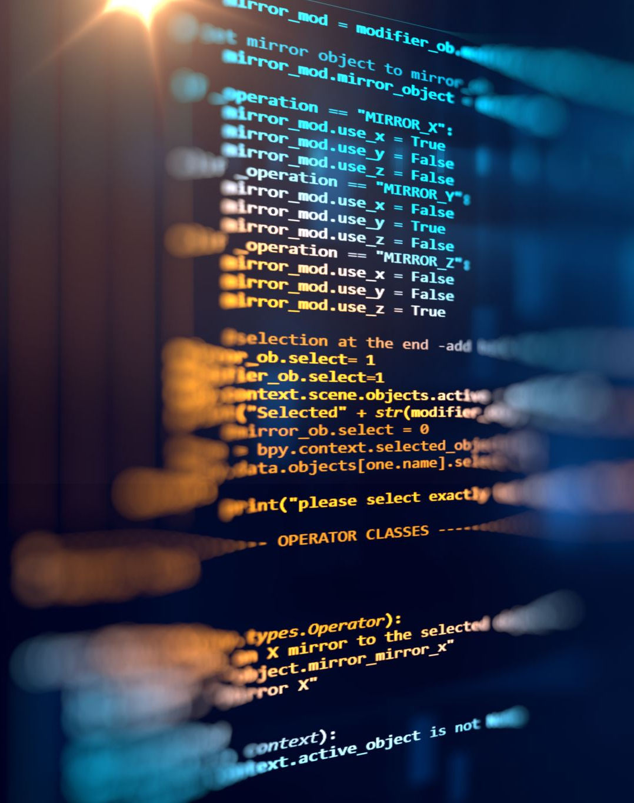
Text-Based User Interface
In these slides we will be looking at a text based user interface.
These interfaces are great to check your work as you go, we are able to write code and see how it will look when it is being executed.
The Text-based User Interface is a great way for us to make sure our code is working properly and to see what the user is going to see in the finished product.

Slide 7
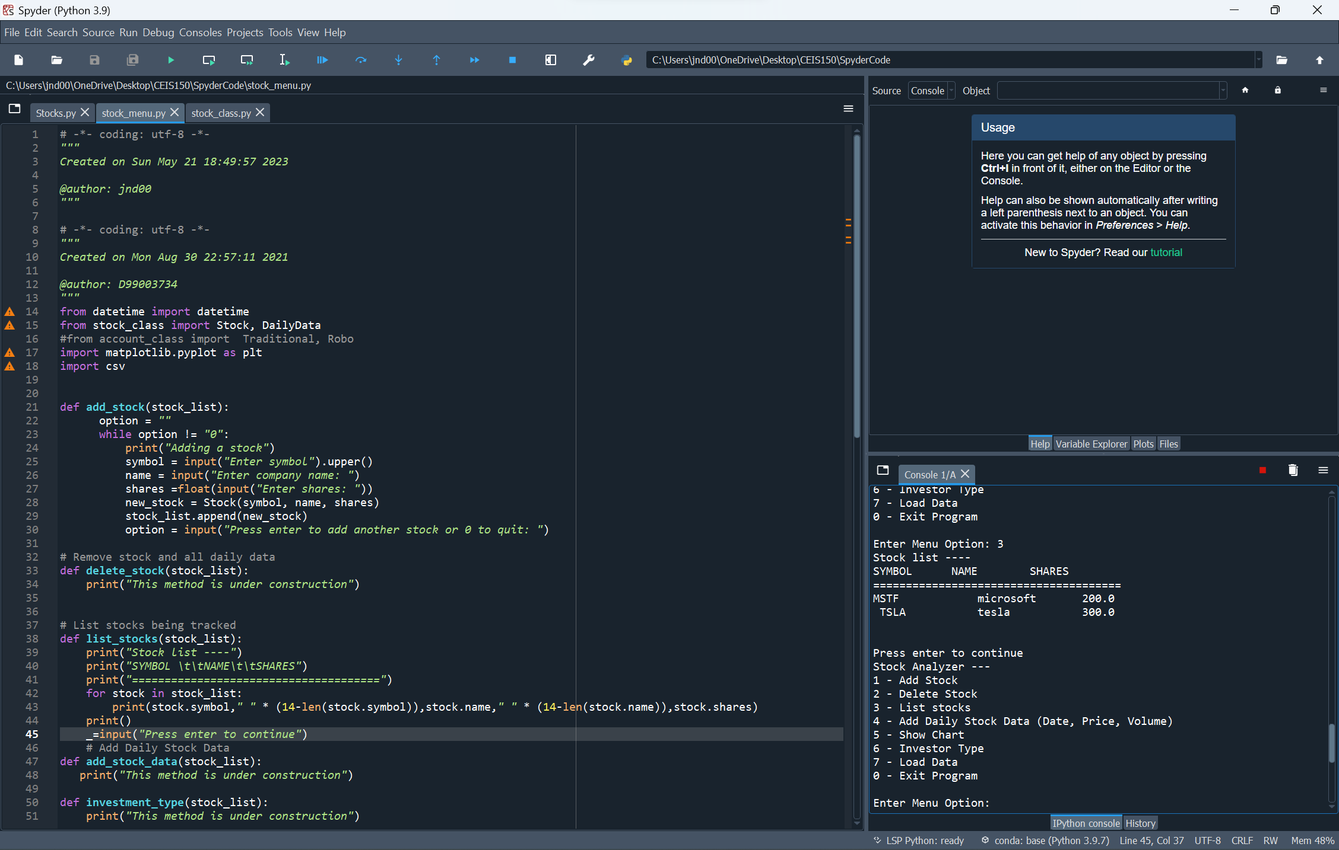
Text-Based User Interface Cont.
In this example I have finished my code and should be able to add stock and list the stock I have added to my interface.
This screenshot shows I can add stock and my code is working properly.

Slide 8
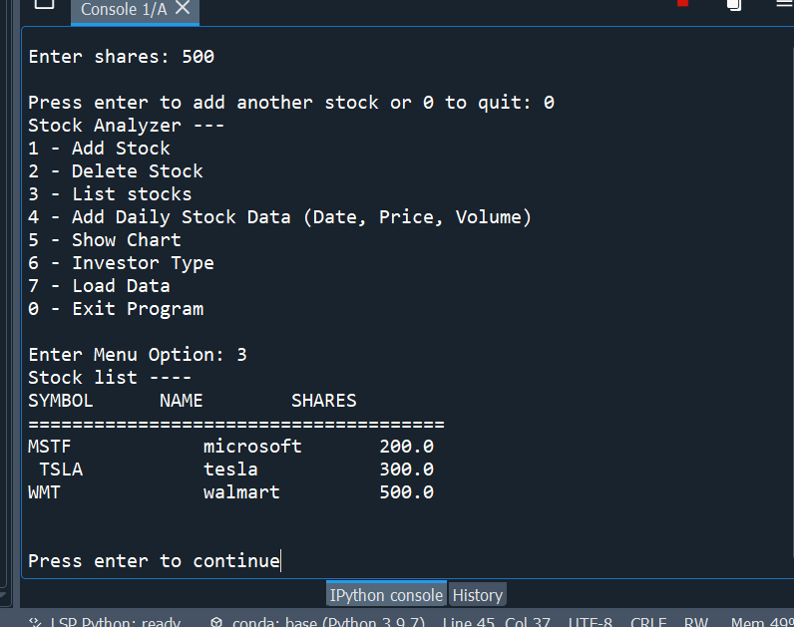
Text-Based User Interface Cont.
Utilizing the Text based interface, I can test my code and show that the “List stock” function is working properly.
This is a key component of stock tracking and will benefit the user to list the stock that they have.

Slide 9

Inheritance
Inheritance allows us to define a class that inherits all the methods and properties from another class.
Utilizing inheritance makes it easier for us to create classes that are going to have similar attributes. Instead of writing the same code over and over we can use inheritance.

Slide 10
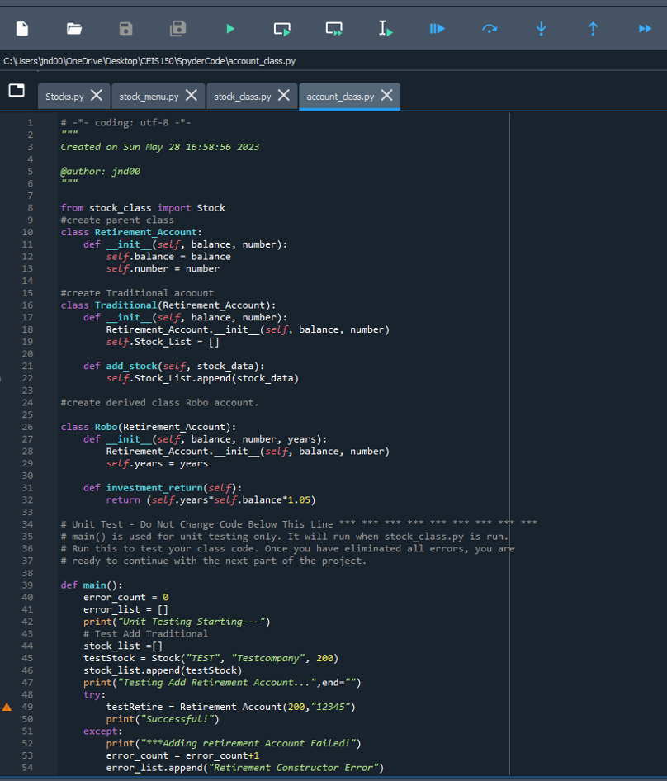
Inheritance Cont.
In this example, we are creating the parent class “Retierment_Account” and using inheritance for the classes to follow.
All these accounts are crucial to someone who has stock and wants to track what is going on in different accounts.
We can use inheritance because all of these accounts just like in real life are similar and have some of the same attributes.

Slide 11
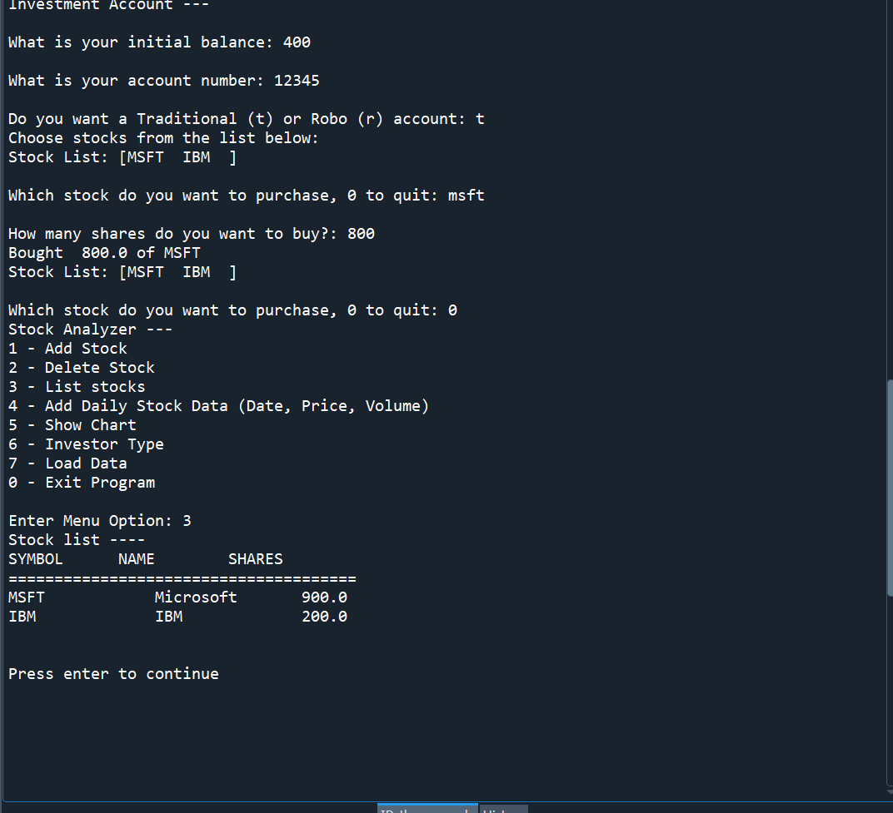
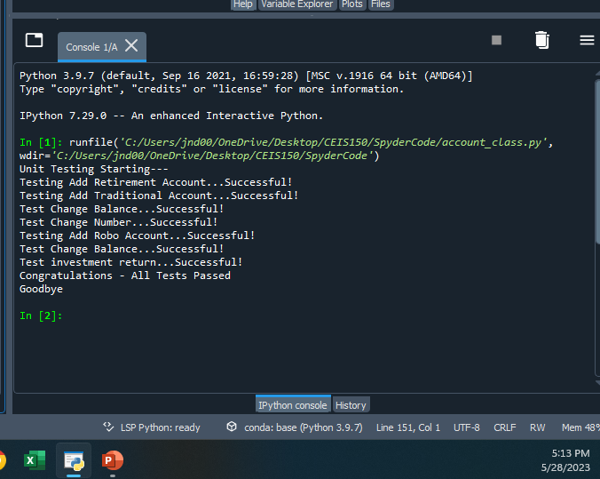
Inheritance Cont.
After creating and defining anything while coding it is always good to check your results and make sure the code is working properly.

Slide 12
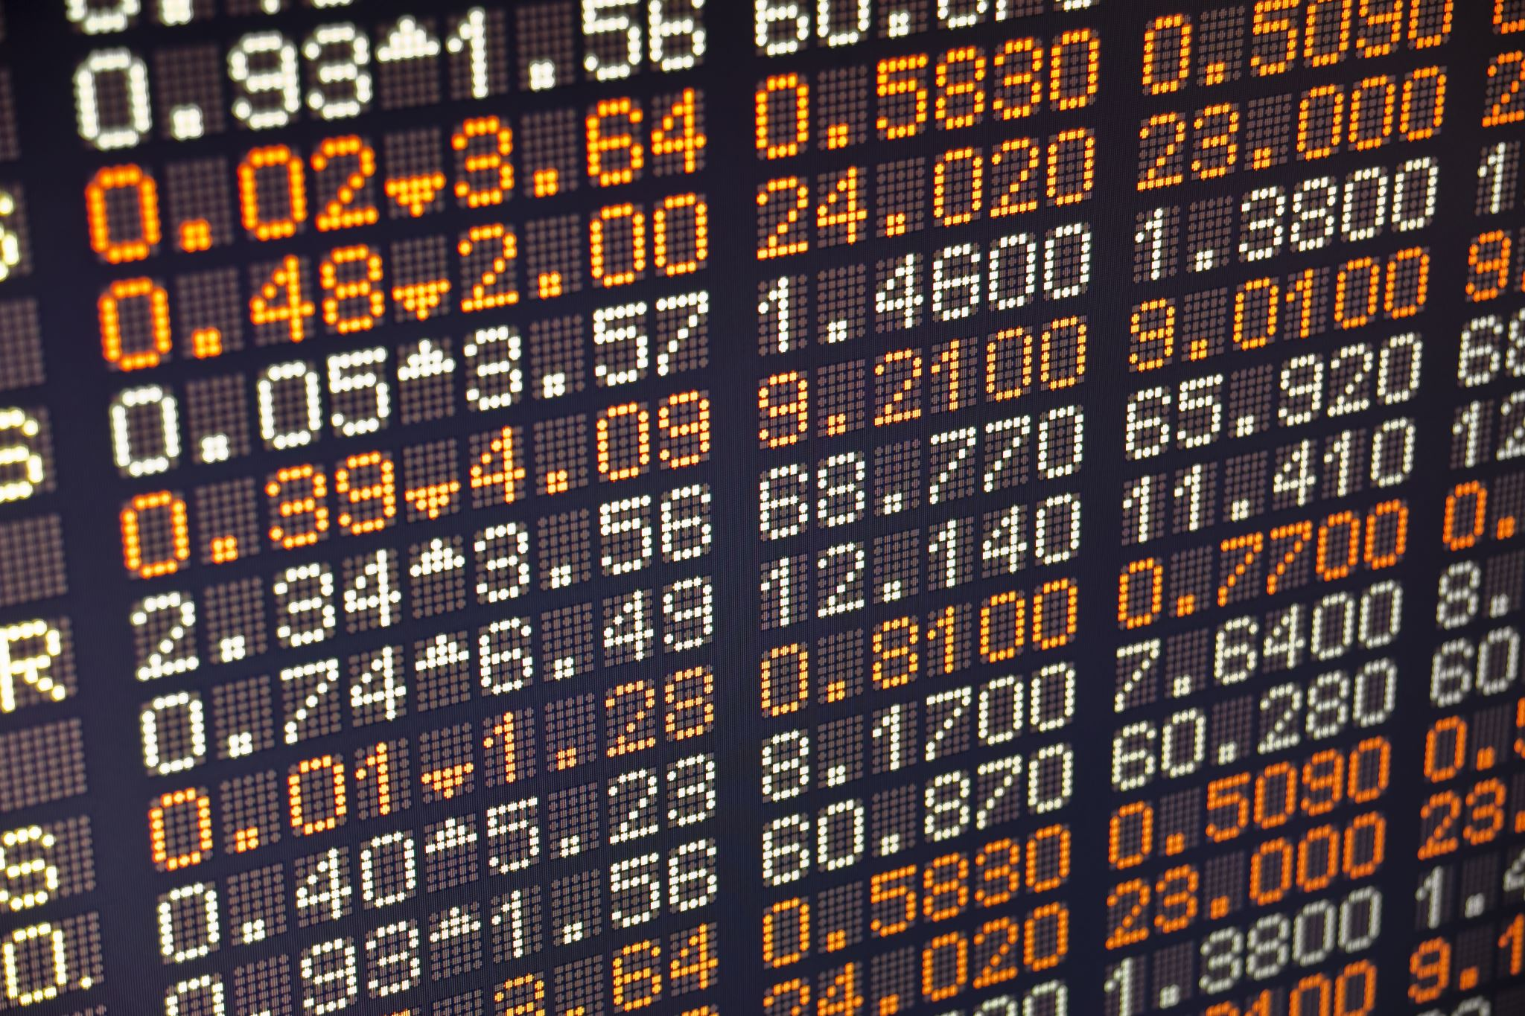
Importing Data
Once our code is finished it is time to use real world data.
Using historical data from the stock we might want to investee in is very crucial for investors.
Within our code we can import data and have it made into a historical graph.
Having visualization of the data can help investors make a decision on a stock.

Slide 13
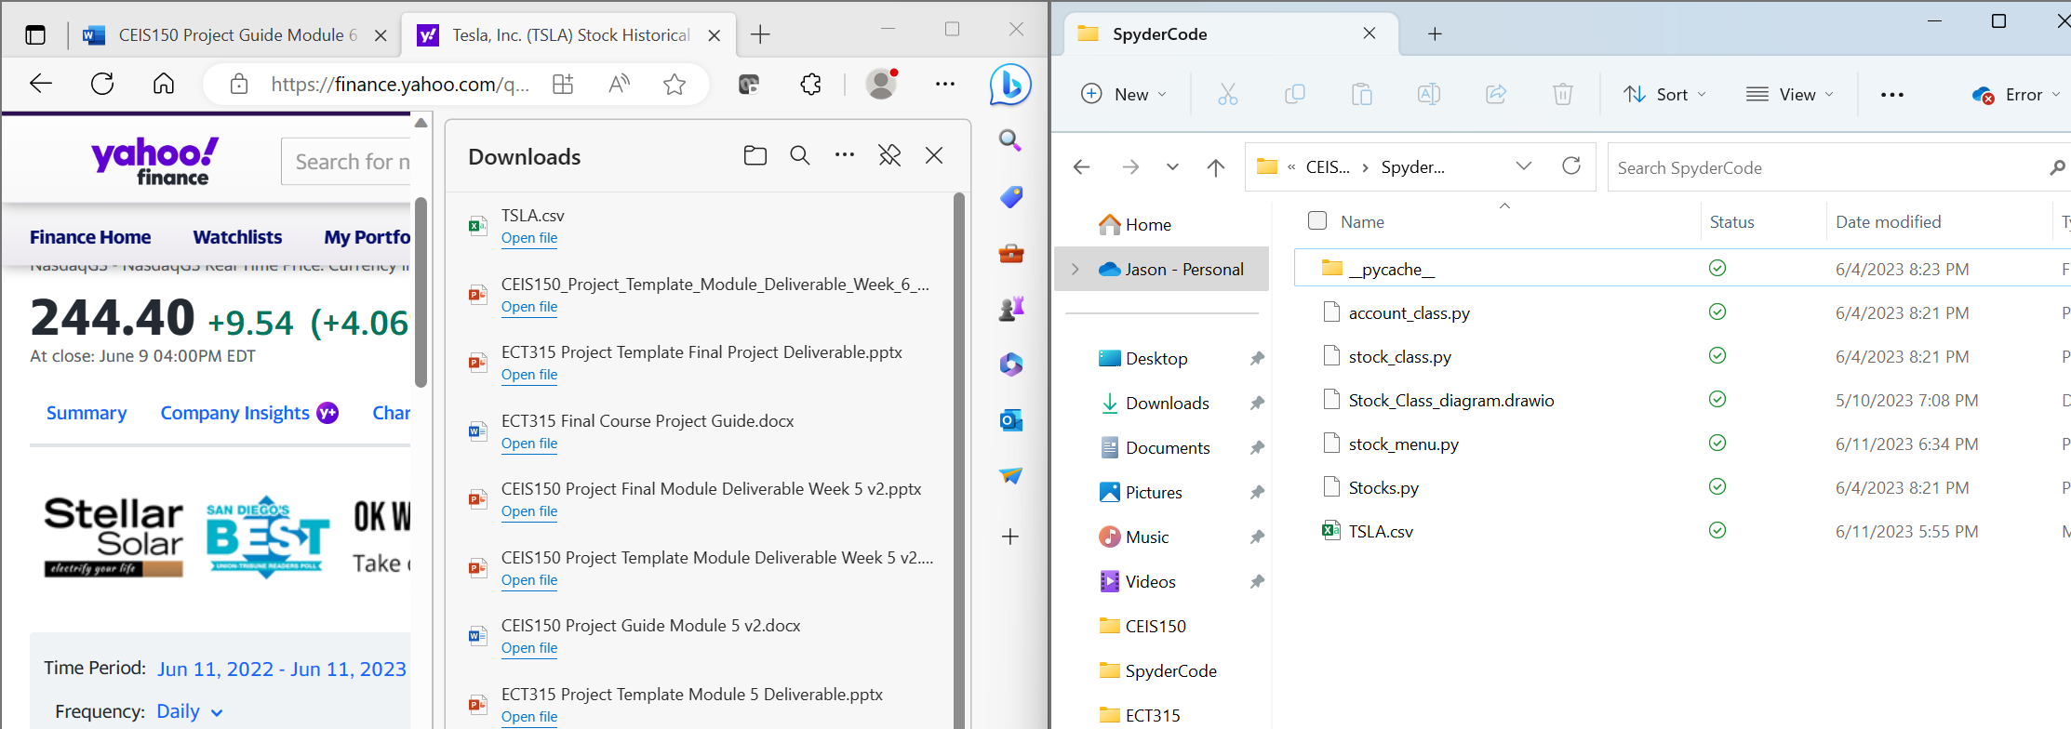
Importing Data Cont.
We can go onto any web browser and download the csv file of the historical data we want to use.
It is very important to keep this data saved to the same folder our code is being saved so that we can import the data.
I have an example of the data for Tesla being downloaded and added to the proper folder for future use.

Slide 14
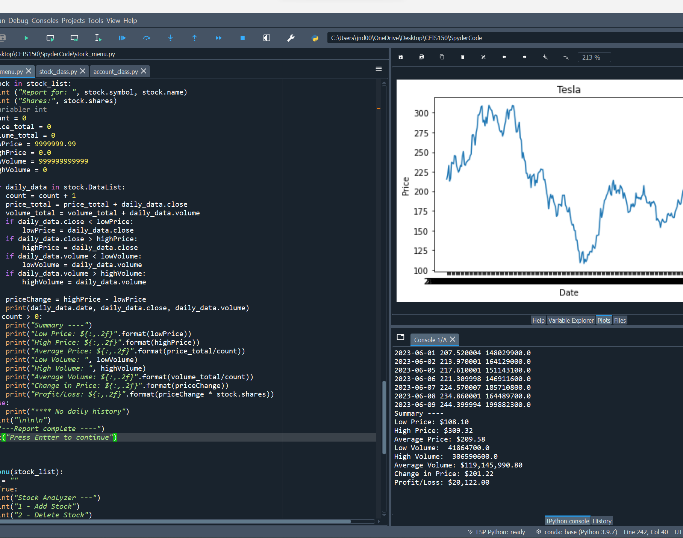
Importing Data Cont.
Once we have our csv file and it is saved in the proper location we can use it to hand in hand with our code to get a visual representation.
This example shows the same Tesla csv being imported and used to create a graph.

Slide 15

Implementing a GUI
A GUI or Graphical user interface is a digital interface in which a user interacts with graphical components such as icons, buttons, and menus.
We wouldn’t want the user to have direct access to our code so we would create a GUI for them to interact with and make the changes they need.
A GUI basically just ask for inputs from the user and our coding will have a desired output, so the user doesn’t need to do anything.

Slide 16
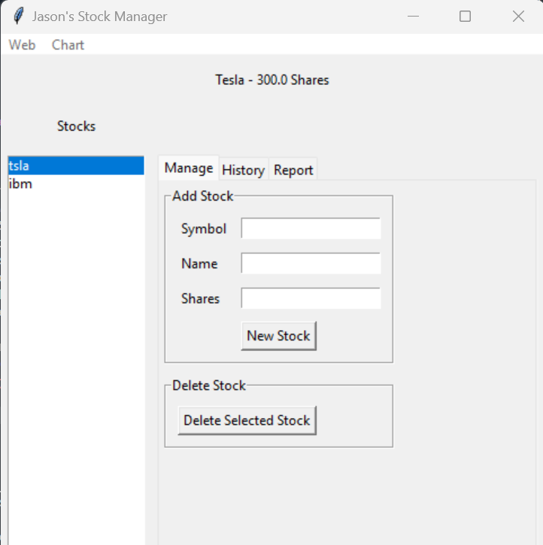
GUI Cont.
A GUI can be as simple or as complex as we want to make it. The GUI we have created allows users to input their stock, how many shares, and historical data.
This simple design allows us to track all stock the user has, the historical data, pull reports and even show future predictions.

Slide 17
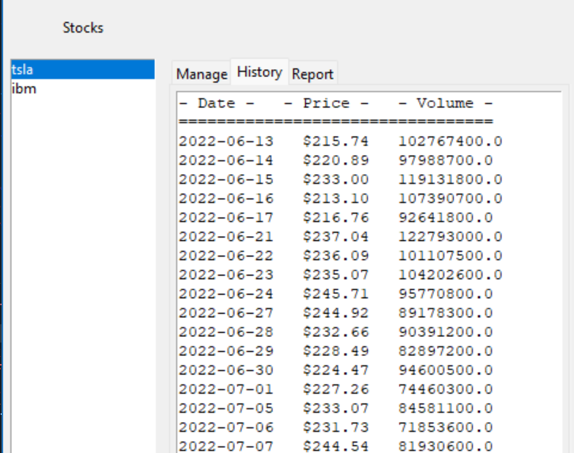
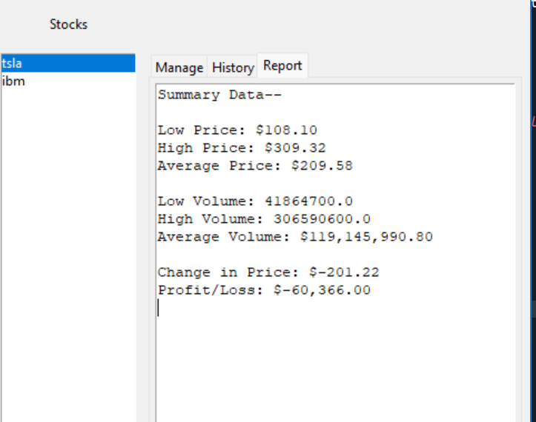
GUI Cont.
The interface is simple and easy for the user to follow and input and wanted data.
The History and Report tabs allow the user to dive deeper into the stock they have in order to track all changes and help make future predictions.

Slide 18

Career Skills developed
Throughout the course of this project, I have gained a profound appreciation for the criticality of meticulousness and attention to detail. Within our code, even minor syntax errors possess the potential to halt the entire program's execution, while the outcomes can be influenced by factors as seemingly inconspicuous as spacing and precision.
Furthermore, this project has afforded me invaluable opportunities to expand my skill set. I have acquired proficiency in class creation, inheritance implementation, GUI design, code testing, and an array of other essential techniques and practices. The depth and breadth of knowledge gained through these experiences have proven instrumental in my professional growth.

Slide 19

Conclusion
The coding and design process encompasses various interconnected components, each playing a crucial role in achieving success. Effective planning through the utilization of Entity Relationship Diagrams (ERDs) and meticulous testing throughout the development stages are pivotal factors for ensuring the desired functionality and outcome in object-oriented programming.
Furthermore, stock tracking serves as a mere illustration of how object-oriented programming can streamline our daily routines, thereby simplifying our lives significantly.

