Slide 1
Cloud Computing
By
Jason Nguyen-Duran

Slide 2

Introduction
Cloud computing is a technology that enables users to access computing resources such as storage, processing power, and applications over the internet without needing to own and manage the physical infrastructure. Instead of purchasing and maintaining their own hardware and software, users can leverage cloud services offered by third-party providers.

Slide 3

Deploying, Connecting, and Deleting
VMs play a critical role in cloud computing by enabling users to leverage the benefits of virtualization, scalability, and resource efficiency while minimizing the costs and maintenance associated with physical infrastructure.
Being able to deploy, connect and delete a virtual machining are the basic functions in order to use cloud components.

Slide 4
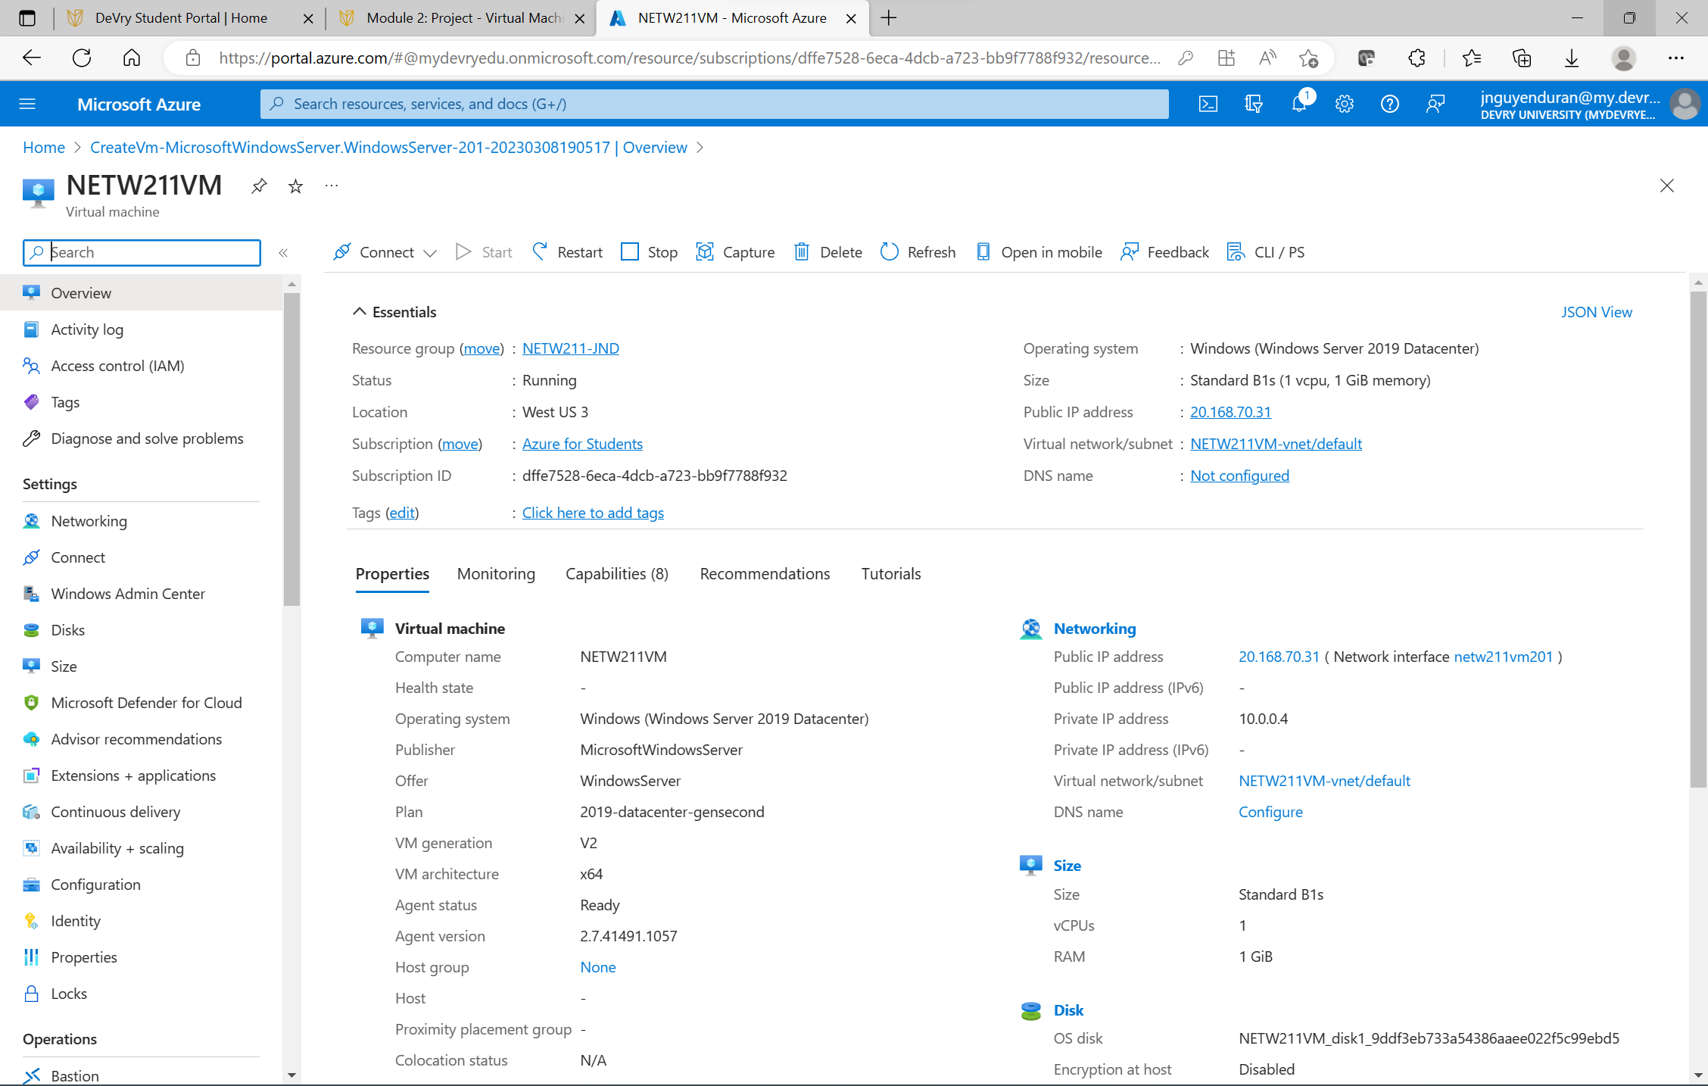
Deploying
When deploying a VM it is always important to check pertinent information such as Resource group, the status, and the location.

Slide 5
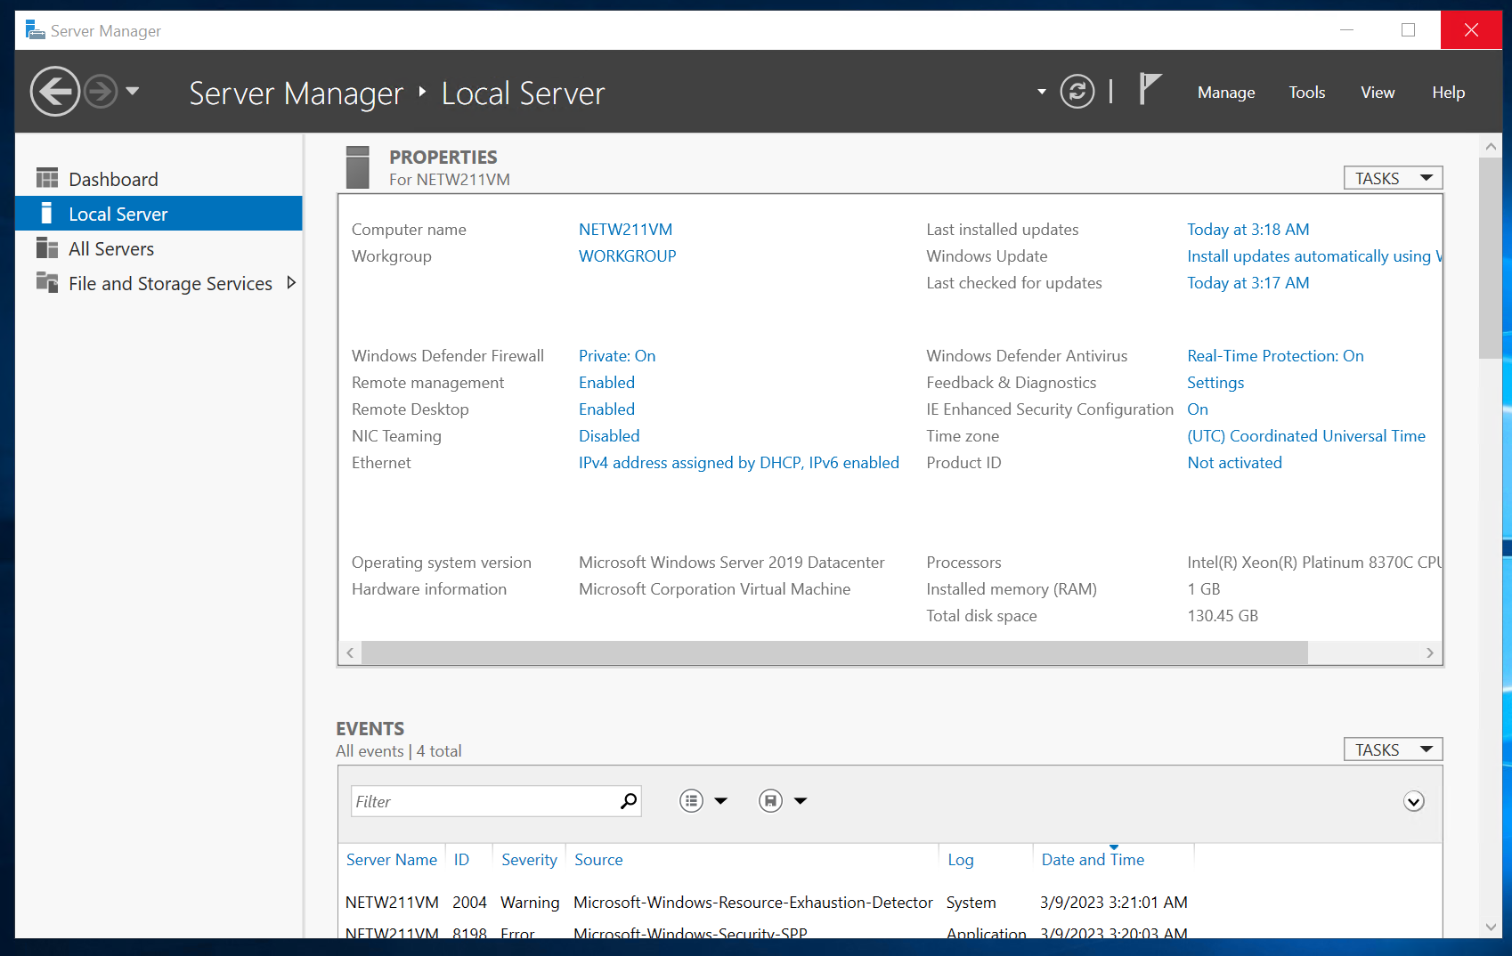
Connecting
When you have successfully Deployed a VM you have to properly connect to it.
In this example, it shows…………………

Slide 6
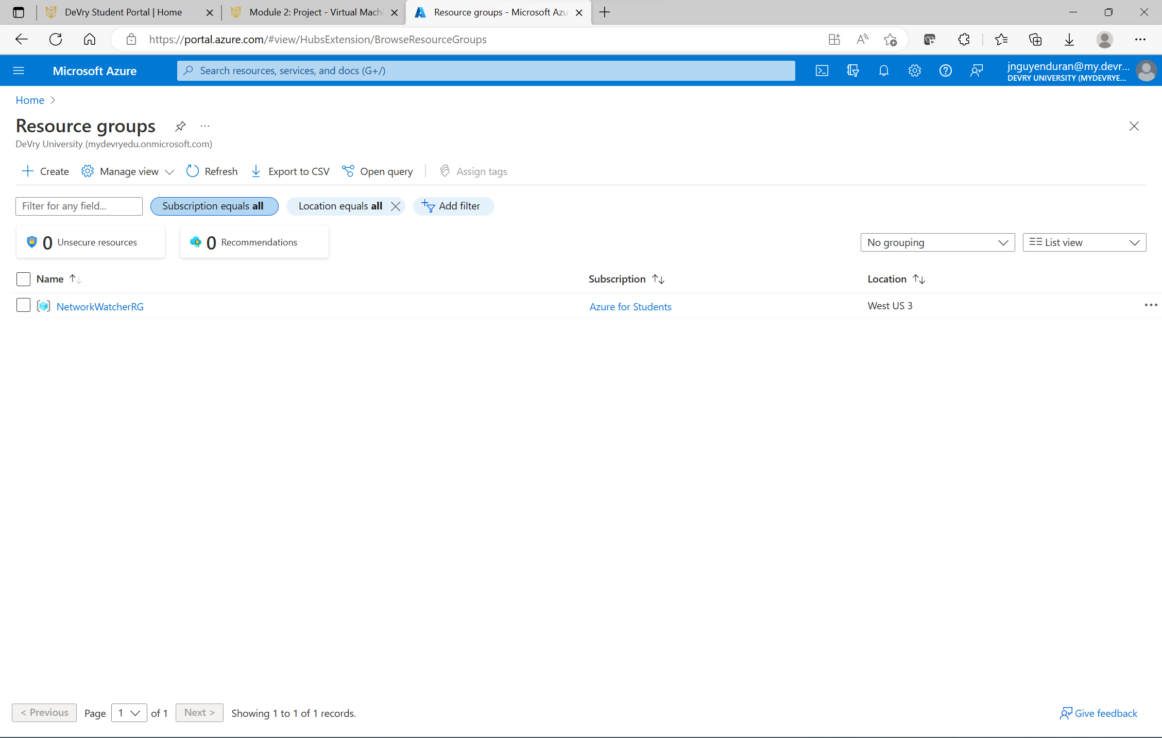
Deleting
Once you are done with your work on the VM it is always a good idea to delete the VM. It is like logging out of your bank account so no one can get in.

Slide 7
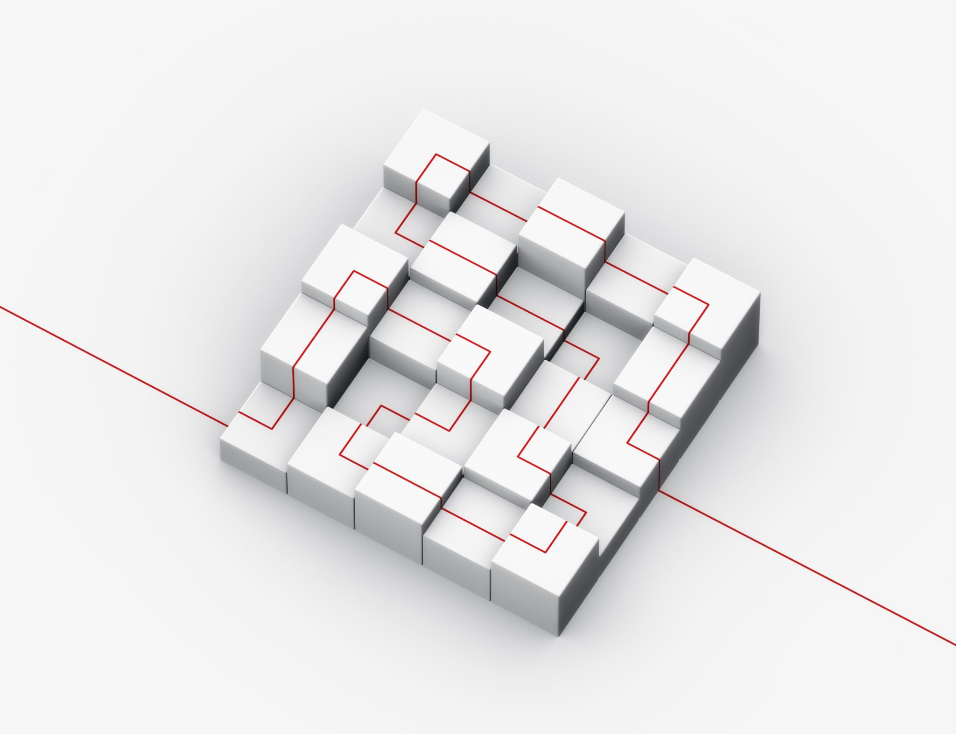
Deploying VM’s with subnets
Deploying VMs into multiple subnets provides organizations with flexibility and control over their network architecture, allowing them to meet their specific needs for security, availability, performance, and compliance.

Slide 8
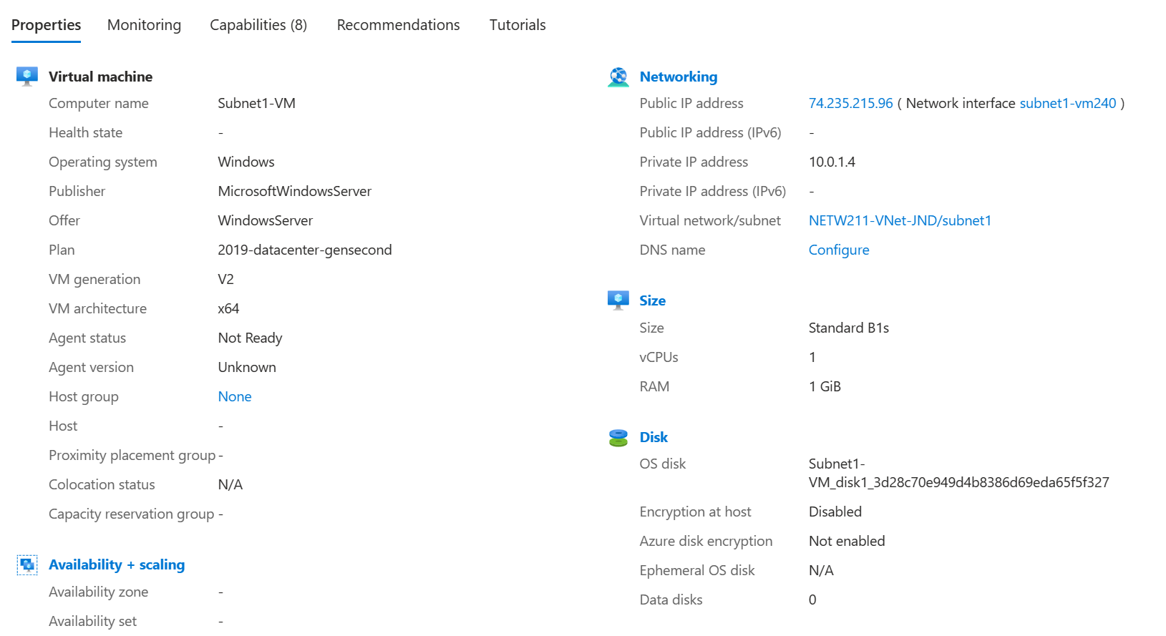
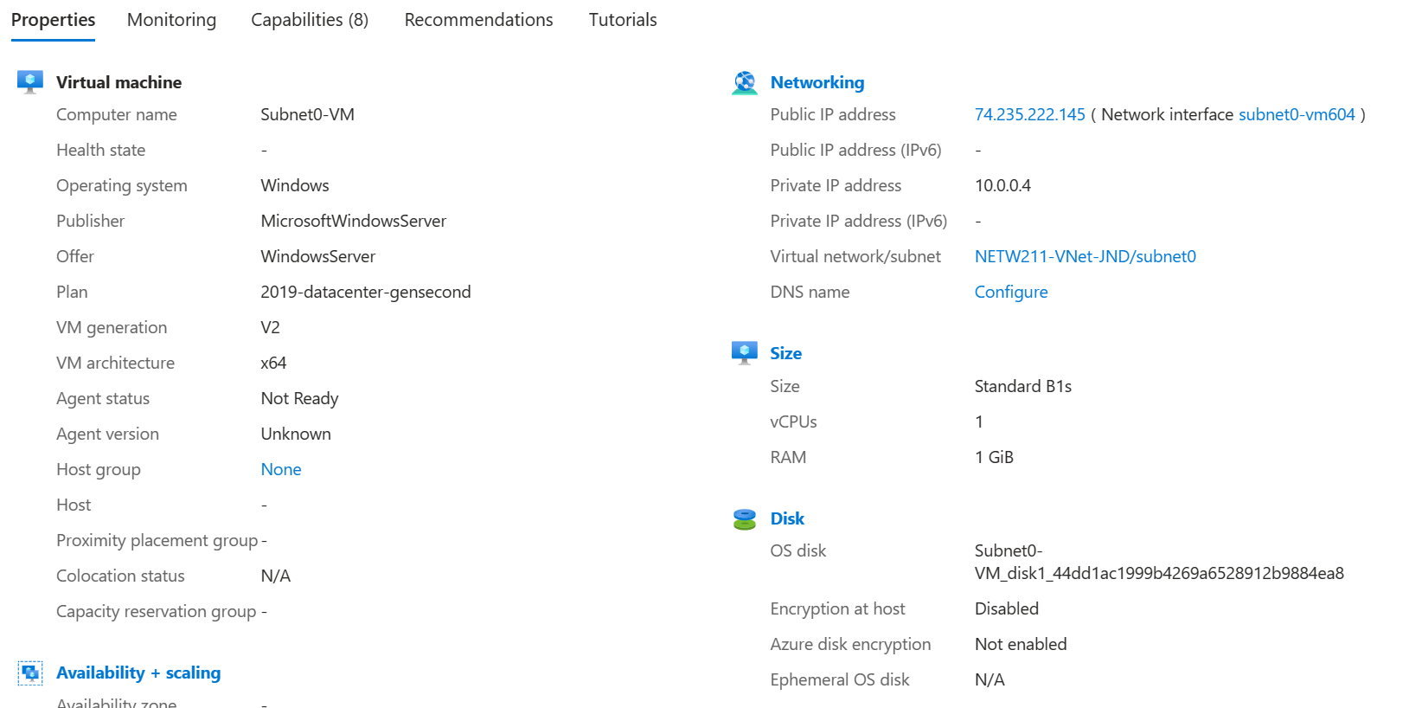
Deploying VM’s with subnets Cont.
When you have multiple VM’s with subnets you need to look for the IP addresses and any other information you need to be able to control and talk to all the machines on the network.

Slide 9
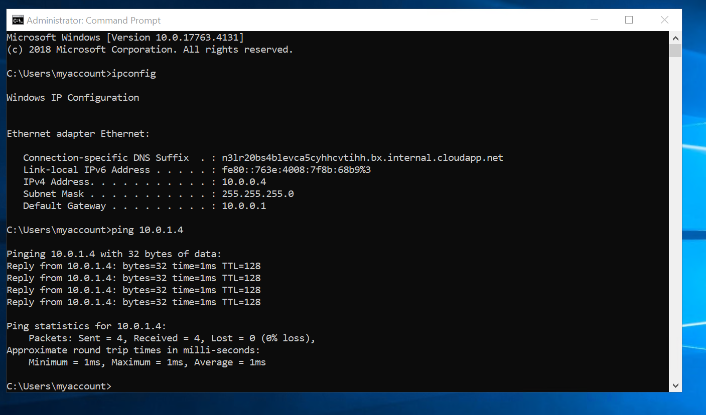
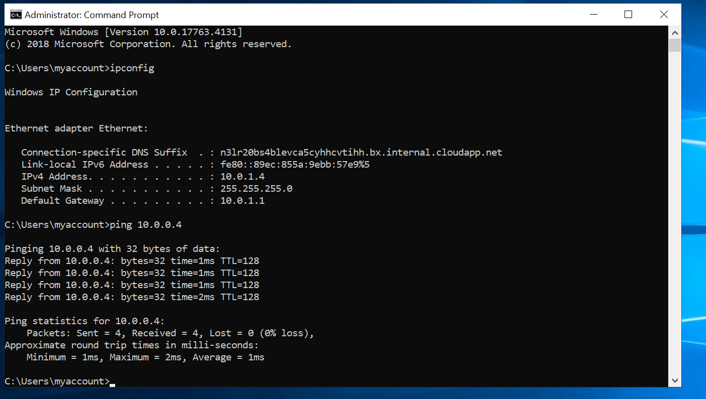
Deploying VM’s with subnets Cont.
When you have multiple VM’s it is necessary to make sure everything to “talking” utilizing the ping command. Use the Ping command followed by the IP address of the other machine you are wanting to talk to.

Slide 10

VM Security
Being able to deploy and use a VM from a separate location is very important in Cloud computing but security is probably more important than any other aspect.
Setting up extra security in your VM can be as simple as setting some rules for added security.

Slide 11
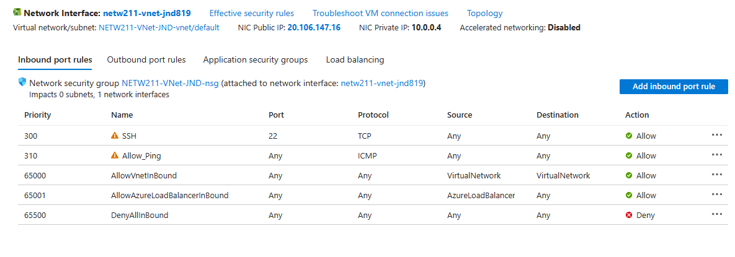
VM Security Cont.
Going into your setting on the VM you can set rules as need be. This screenshot shows rules being set for different ports being able to have data transmitted.

Slide 12
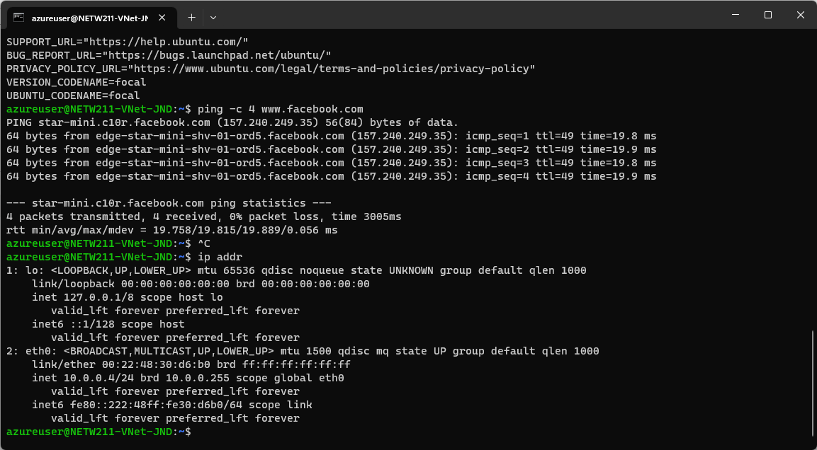
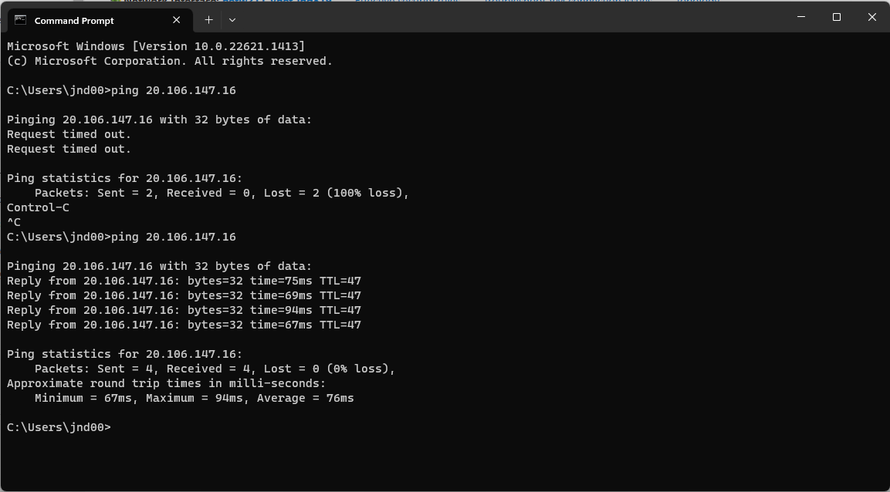
VM Security
After you set the rules it is always good to double check if the rules are working.
A simple way is to use the Ping command to see if the proper channels are communicating or blocked off.

Slide 13
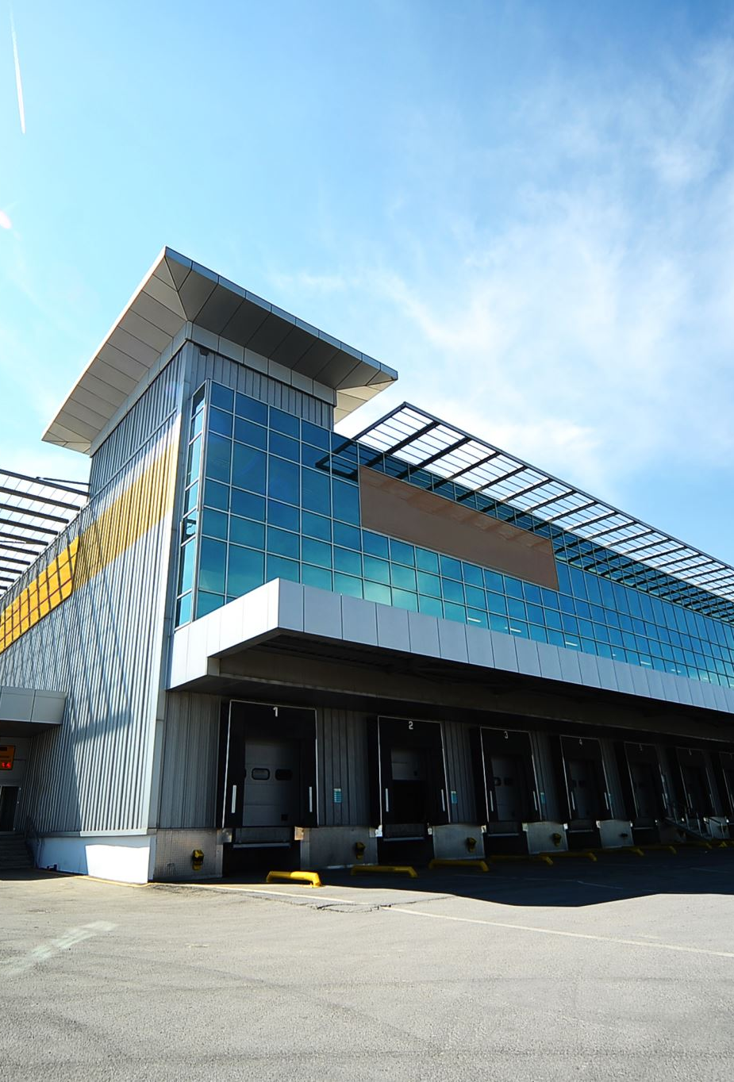
Cloud Storage
When transitioning to the cloud it Is very important to asses your needs for storage.
Different services may have different tier or types of storage.
Once you have selected the proper storage needs we need to be able to access upload and store our information.

Slide 14

Azure blob storage.
What does the access tier setting do? What are the Azure blob storage access tiers?
Access tier allows users to set their uploaded data in to the cloud into a specific “tier”. These tiers store your data in different blocks depending on how often it is needed to be accessed. These different tiers help define how much you pay to store data.

Slide 15
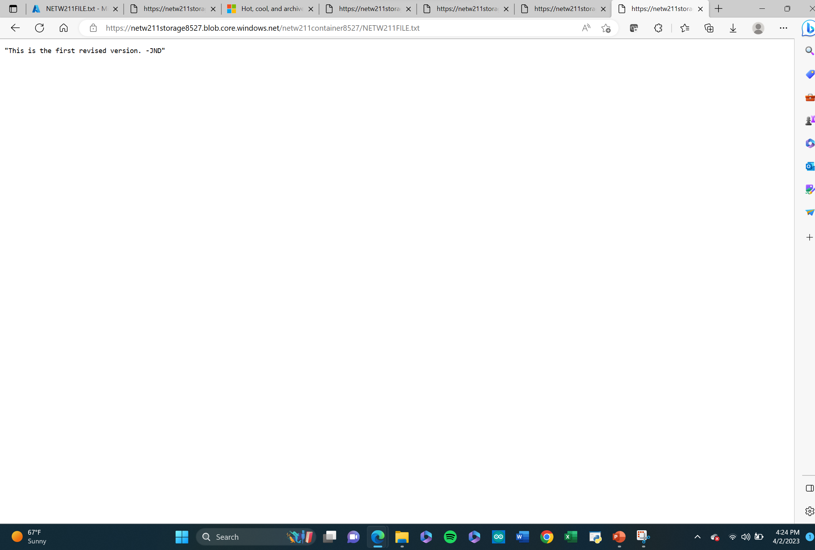
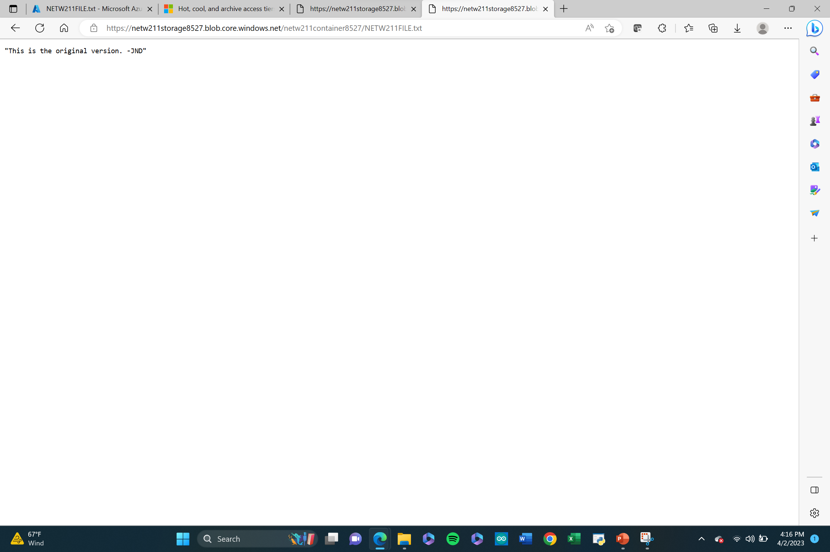
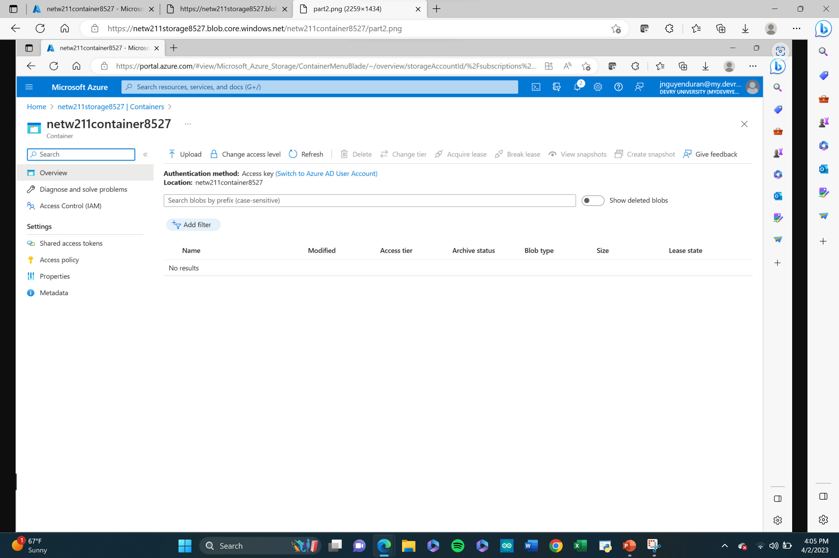
Blob snapshots
Once you have uploaded your files you can see the original, make edits, and see all changes that have been made with snapshots.

Slide 16
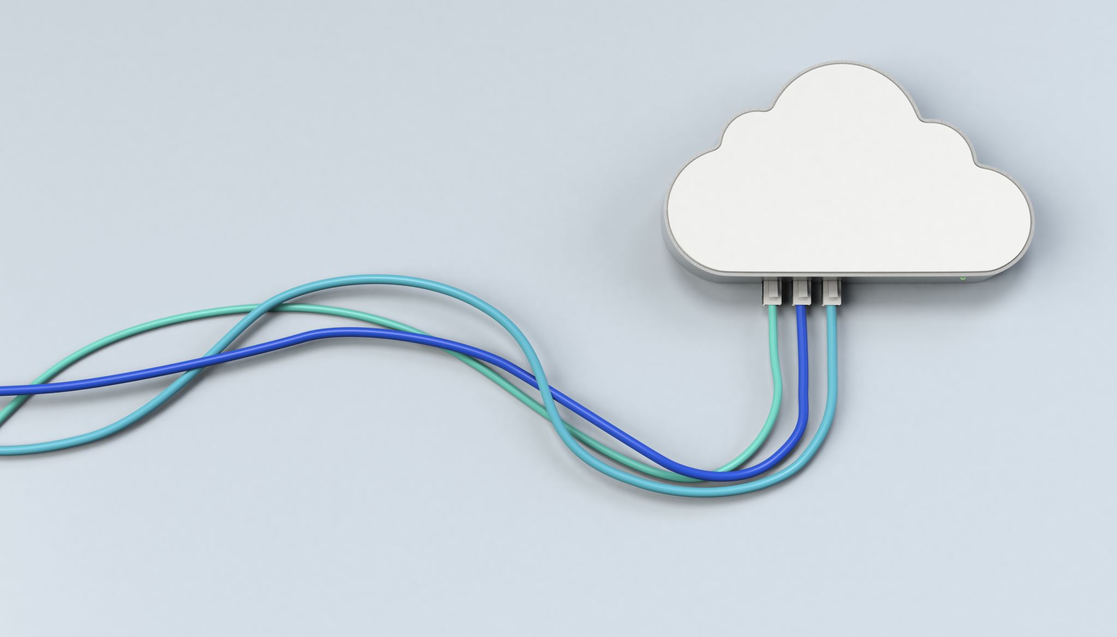
Cloud Monitoring
Now that we have properly set up our VM, security, data uploads, and everything we might need for our success in cloud computing it is importtnat to set alerts.
Instead of watching our cloud services 24/7 we can set up alerts to be sent to our phone or email for any change we want.

Slide 17
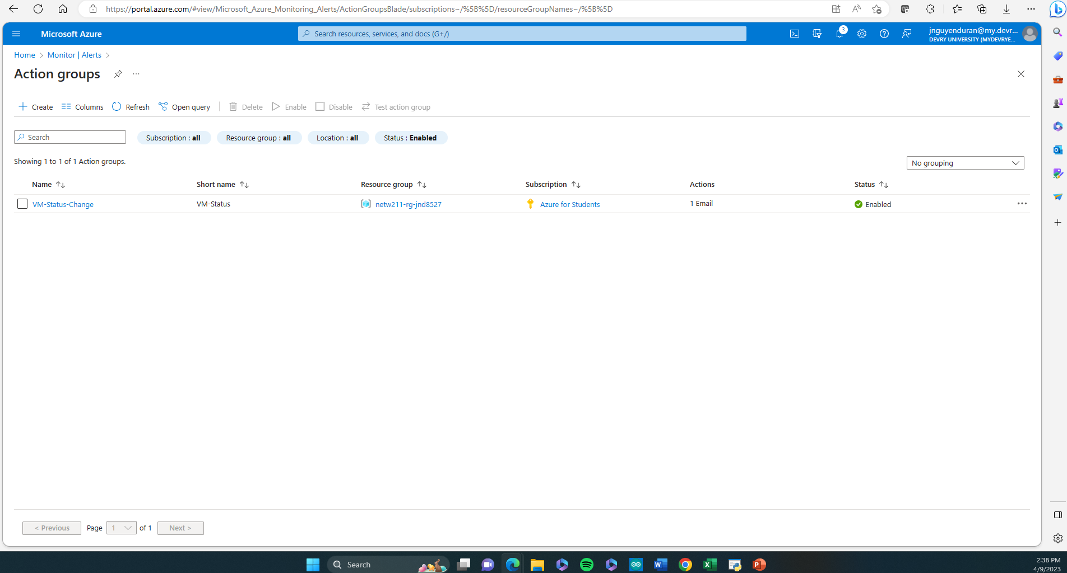
VM status change alert
We can get alerts for any change in our VM in the VM settings under manage actions.

Slide 18
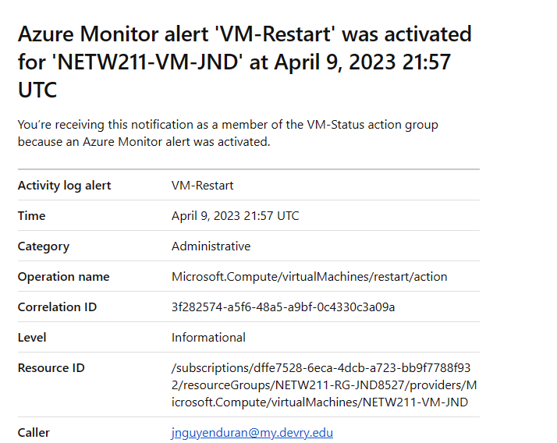
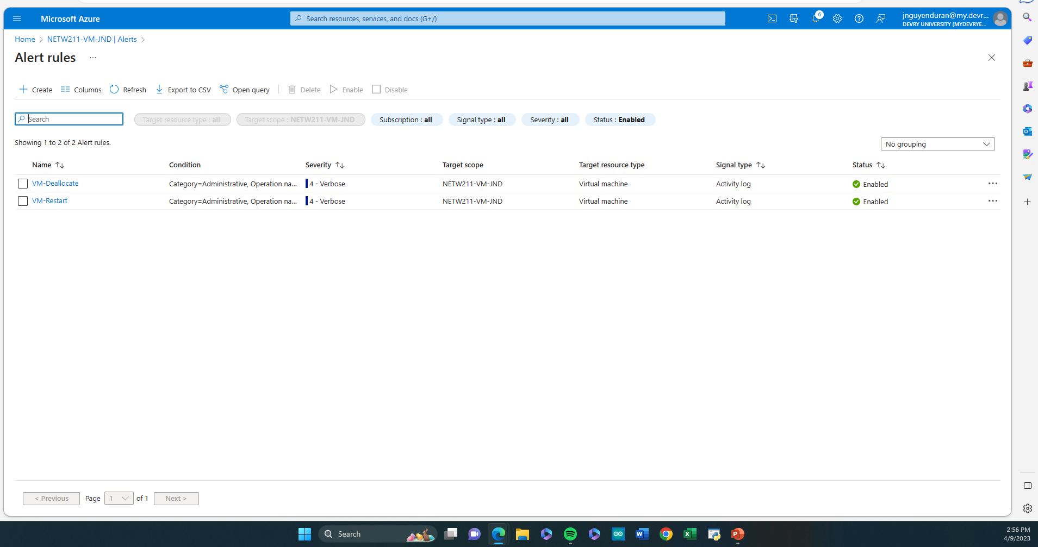
Alerts and Rules
We can basically get an alert for just about anything in the VM. Every time a VM gets restarted, turned on, changes have been made and so on.

Slide 19
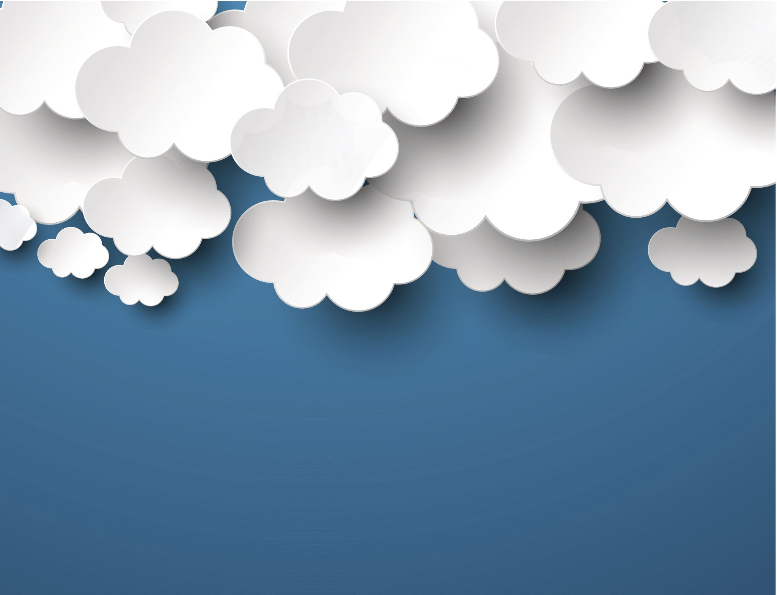
Challenges faced
During this course I Struggled learning the terminology since Cloud computing is new to me it was hard learning all the different terms, but as time went on and I got more familiar with the content It became easier to understand the different topics.

Slide 20

Career skills obtained
Cloud Computing Concepts: Familiarity with cloud computing concepts such as Infrastructure as a Service (IaaS), Platform as a Service (PaaS), and Software as a Service (SaaS), as well as an understanding of cloud deployment models (public, private, hybrid) is essential.
Networking: An understanding of basic networking concepts such as IP addressing, subnets, routing, and firewalls is important for working with cloud infrastructure.
Security: Basic knowledge of cloud security concepts, such as access controls, encryption, and network security, is essential.

Slide 21
Conclusion
Overall, cloud computing provides organizations with the flexibility, scalability, and agility to innovate and grow their businesses while reducing costs and improving efficiency.
Being able to utilize Cloud computing has a lot of different benefits and depending on the provider and plan you go with you won’t have to worry about anything except what ever your business needs.
Cloud computing is the future and being able to run the basics is a good benefit for anyone to understand.

