Slide 1
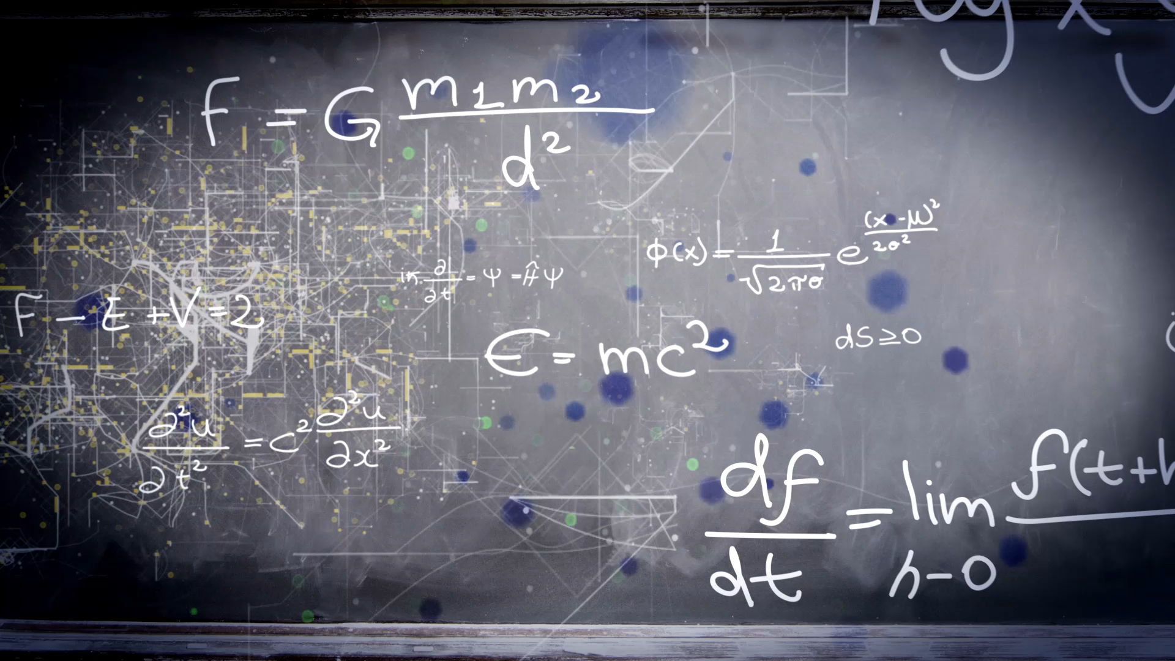
CEIS 110
Intro to Programming
By
Jason Nguyen-Duran

Slide 2

Introduction
Utilizing different software to be able to gather data using Python and analyze it in multiple formats.
With a cloud-based system, we are able to gather data such as Temperature and humidity in a region of choice.
Being able to analyze this data and format it in a way anyone can understand is very useful to ensure success of any data querying.

Slide 3

Software and inventory
Before being able to start querying and analyzing data it is important to know what software you are going to need.
Once you know what software will be needed for a certain project it is crucial to download and make sure it runs properly

Slide 4
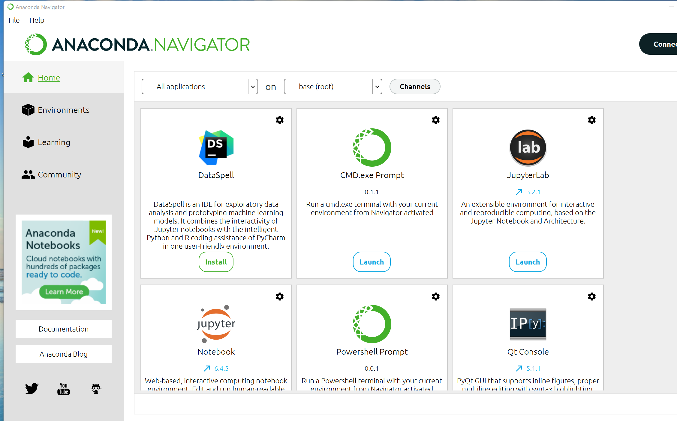
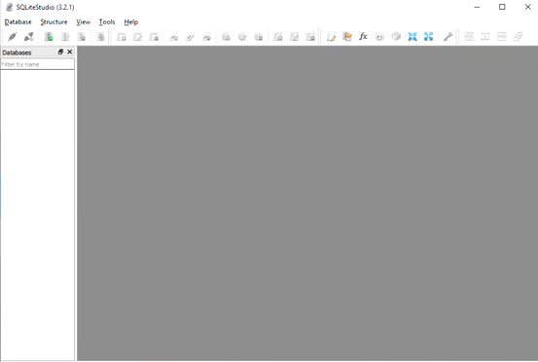
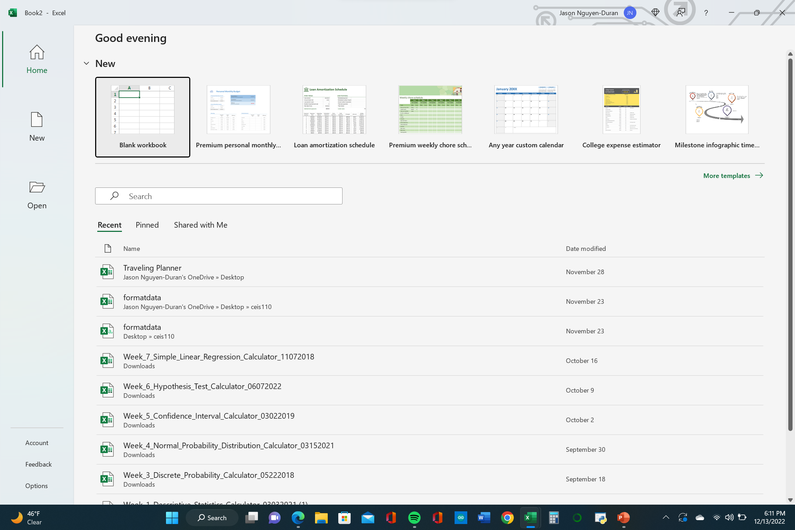
Software needed for this project.
Microsoft excel, SQLite, and Anaconda with Spyder

Slide 5

Planning and design
Planning a project is critical to make sure everything is done properly and in a timely manner.
A flowchart is a excellent key to make to see every step of the project.

Slide 6
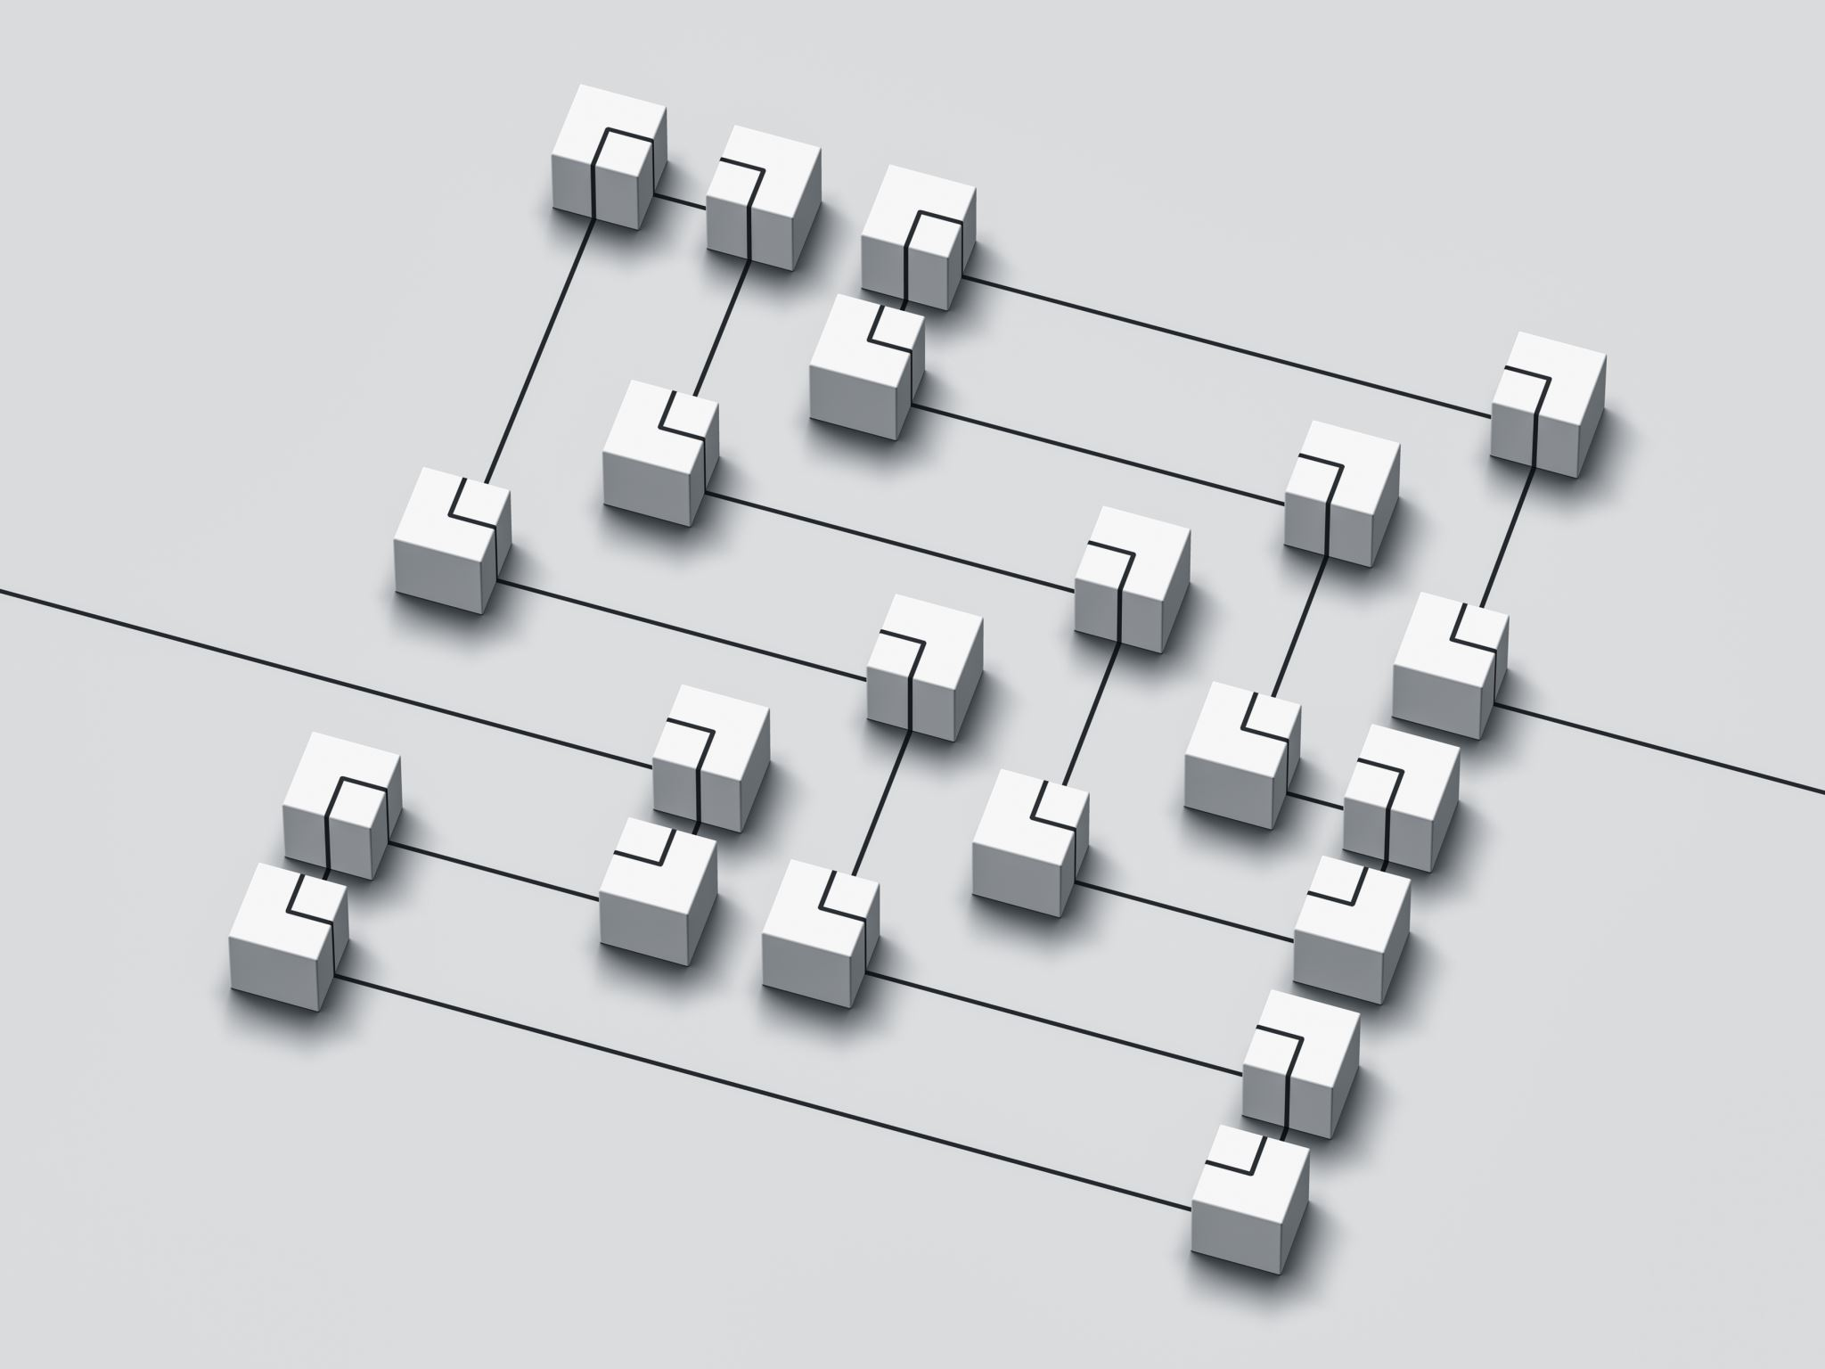
Flowchart explanation
A flowchart is a graphical representation of a process or workflow.
It is common to see flowcharts to easily guide someone in the procedures or steps in the correct order to ensure a task is done correctly.

Slide 7
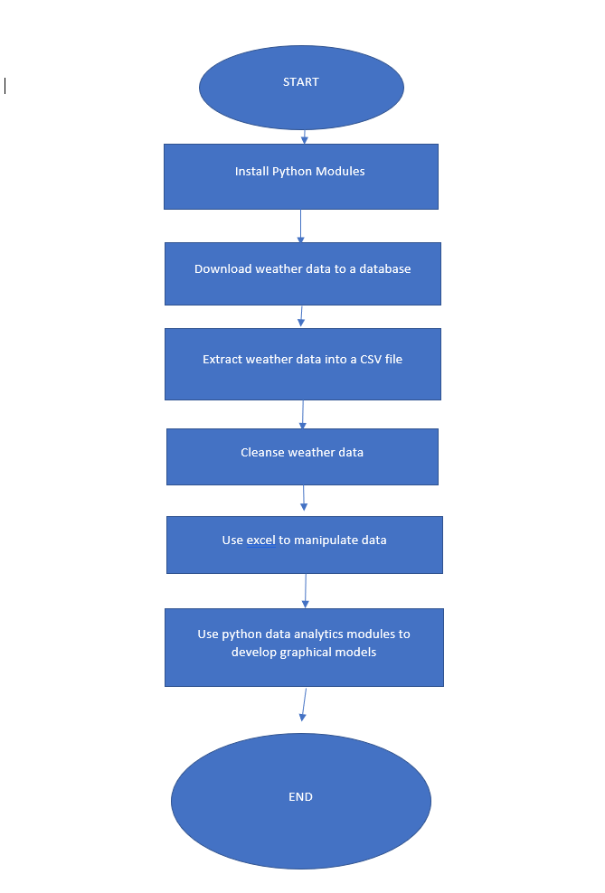
Flowchart
Include the following processes:
Install python
Download weather data to a database.
Extract weather data from database into a comma separated file with python
Cleanse weather data
Use Excel to manipulate data
Use python data analytics modules to develop graphical models

Slide 8
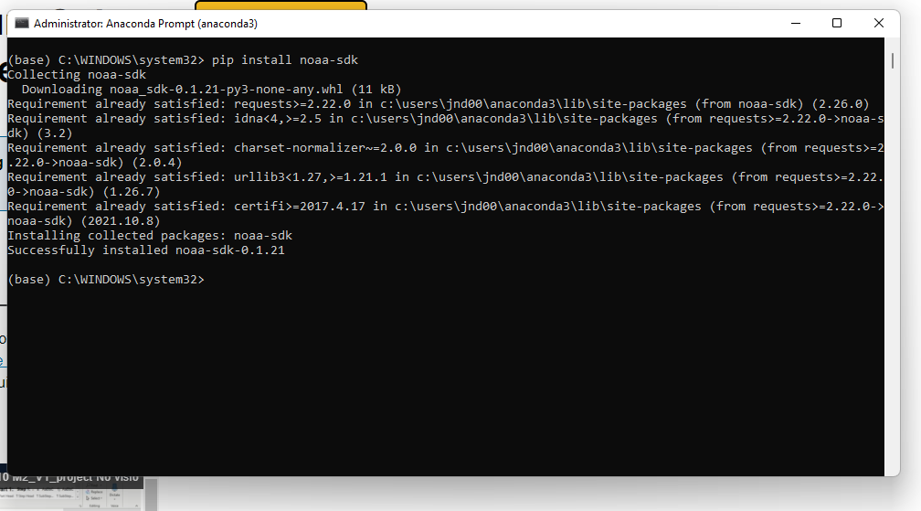
Adding a library
When using Python, it is necessary to add a library to collect data in a cloud-based program.
In this project we are accessing the NOAA (National Oceanic and Atmospheric Administration) which will provide us with accurate data for temperature and humidity in a specified region.

Slide 9

Gathering data
After everything has been planned and ready to execute, it is time to develop code to download a set of weather observations of our region.
The code allowed us to download the information onto a database for analysis.

Slide 10
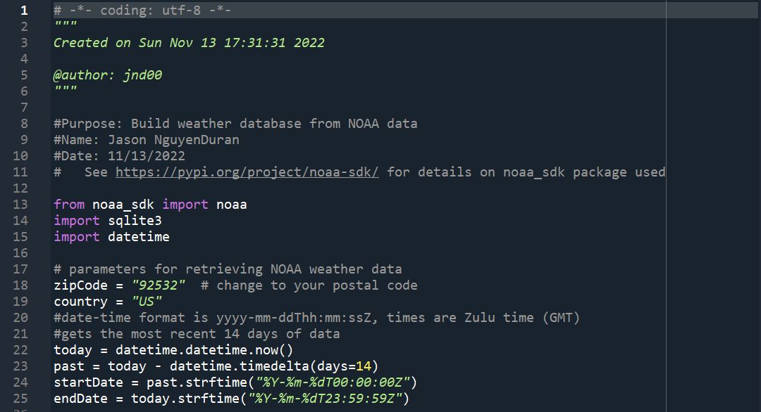
BuildweatherDb.py
The code in this screenshot created a table with different fields of data such as Time, temperature, humidity, wind and text description.
This code will store our database in a directory with our code-named Weather.db.
It is crucial to store all data and code in the same directory, so the data is always pulled from the same database.

Slide 11
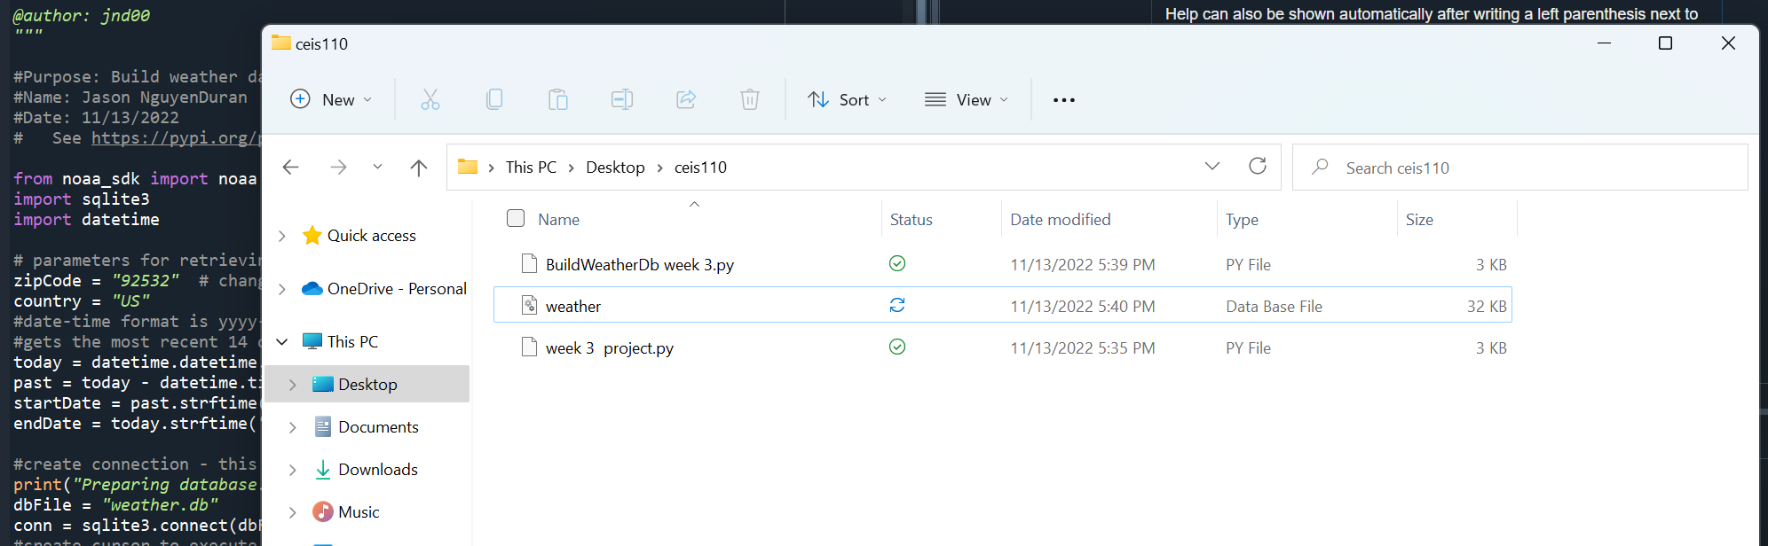
Weather.db file
Make sure all data and documents are saved in the same appropriate folder.

Slide 12

Querying the database
SQL or Structured Query Language is a language used for working with relational databases.
SQLite is used in this project to query the database and view all results we have requested in our code.

Slide 13
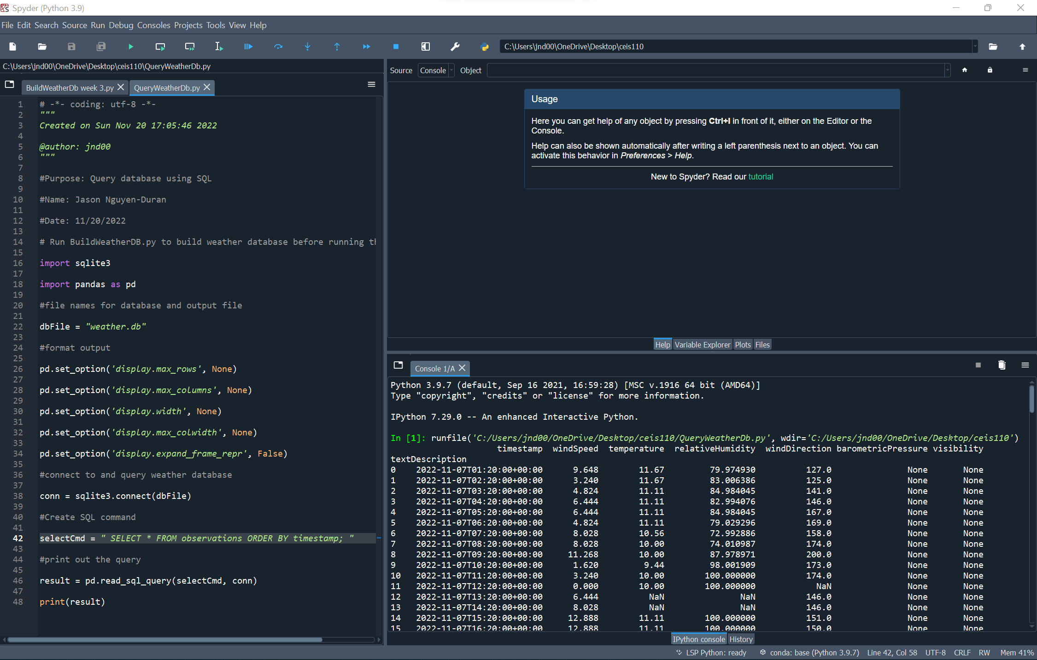
Query to retrieve all columns/rows
First query to get all lines of data so then you can decide what you will need to continue.

Slide 14
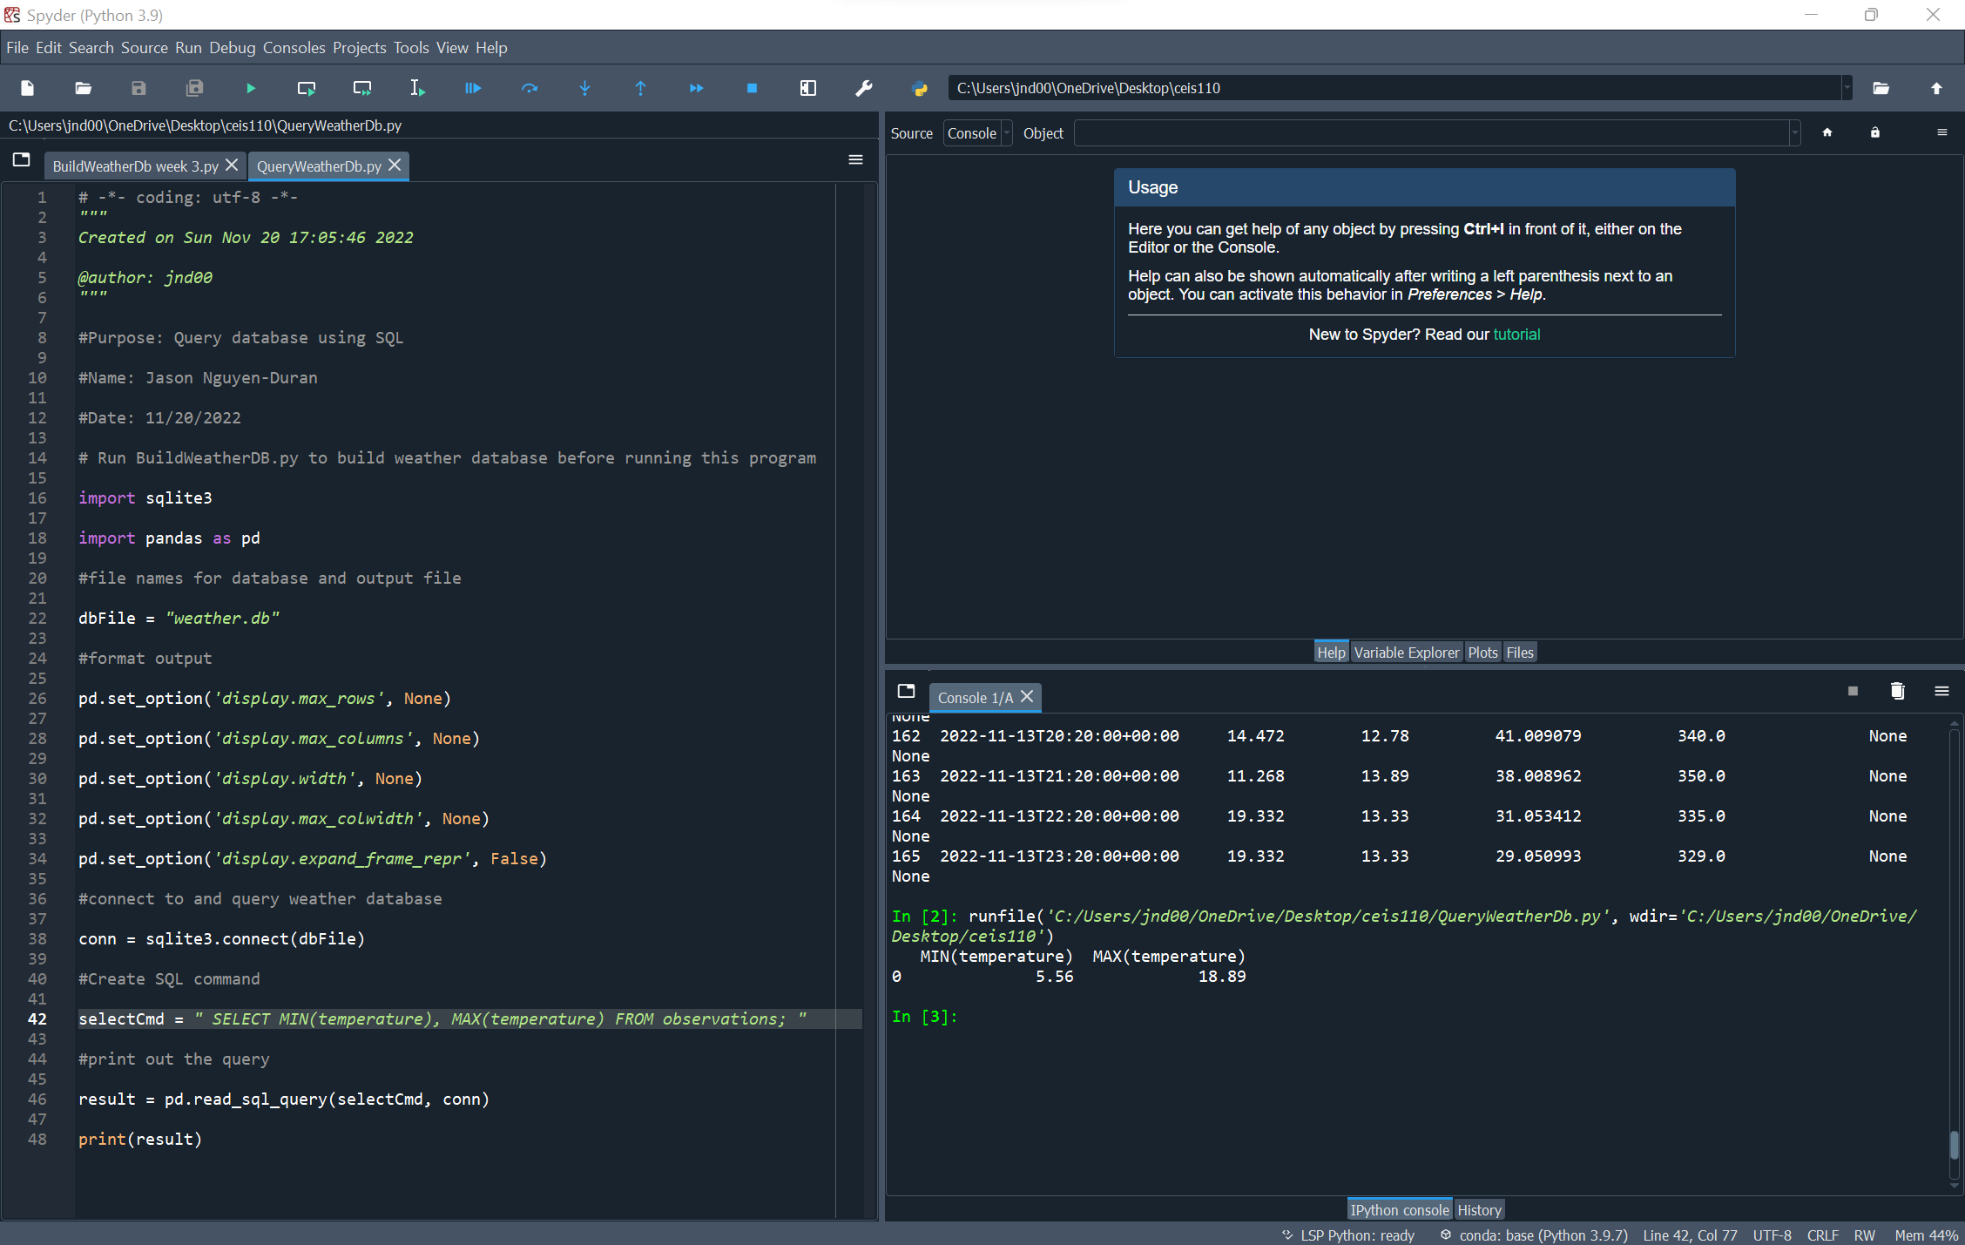
Query to retrieve lowest and highest temps
Query to find specific information such as the max and min temperatures of our data.

Slide 15
Query to retrieve min and max humidity
Query to find specific information such as the max and min humidity values of our data.

Slide 16
Data cleansing
It is very important to go through your data in order to make sure and data that is not important or wrong is deleted.
This can be null values or values of 0.
Cleansing your data before analysis is important to make sure the data isn’t skewed and is as accurate as possible.
If you do not cleanse before you put it into excel or a graph the data you are looking at might not be correct.

Slide 17
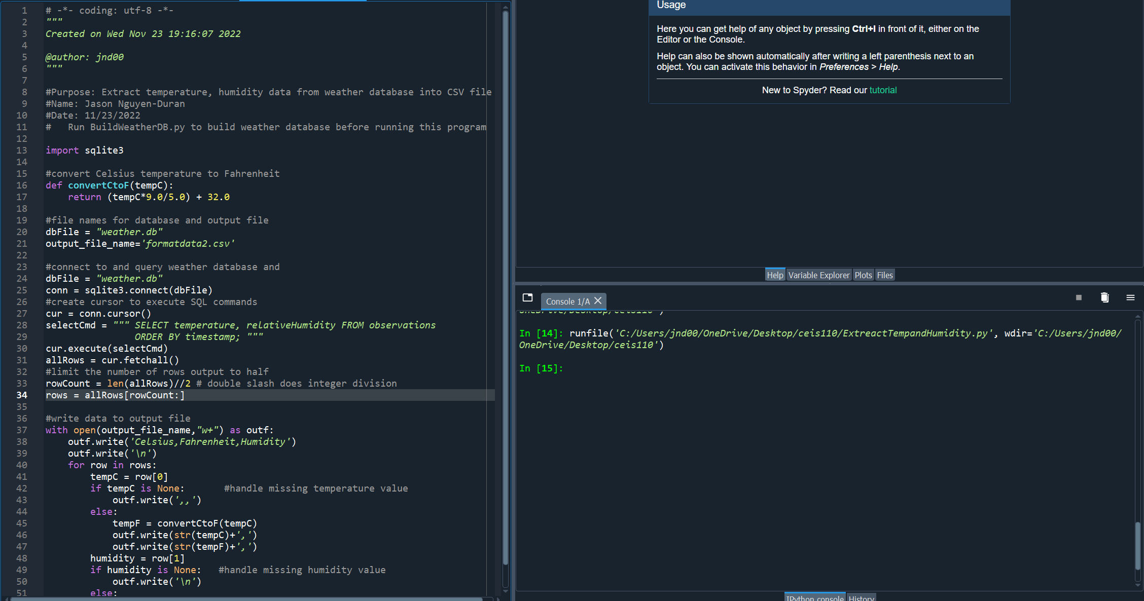
Extracting temp. and humidity using python
After we get all our data and cleanse it, it is time to pull the important data that we are looking for. In this case it is Temperature and Humidity.
Using the code in this screenshot retrieves the relative data we are looking for.

Slide 18
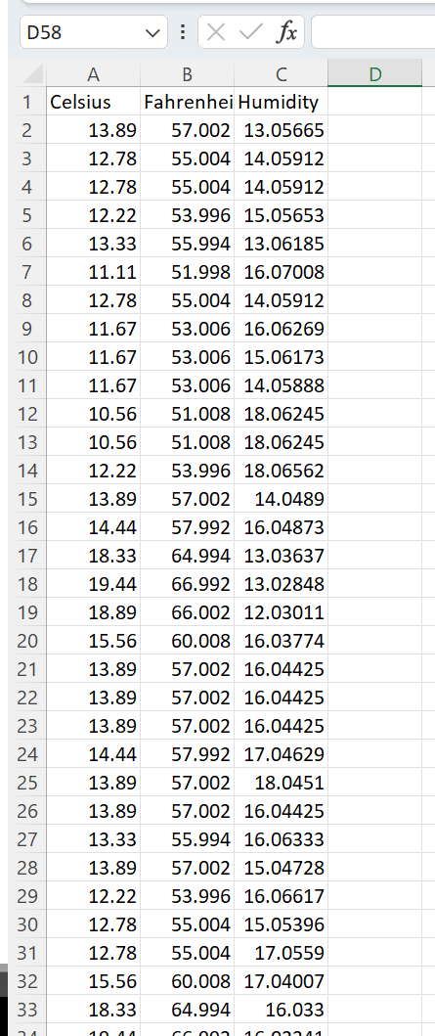
Data formatted in excel
Python created excel sheet with 3 columns
Insert data screenshot of excel.

Slide 19
Data visualization chart
A line chart was created to show the data we found into a visual representation.

Slide 20
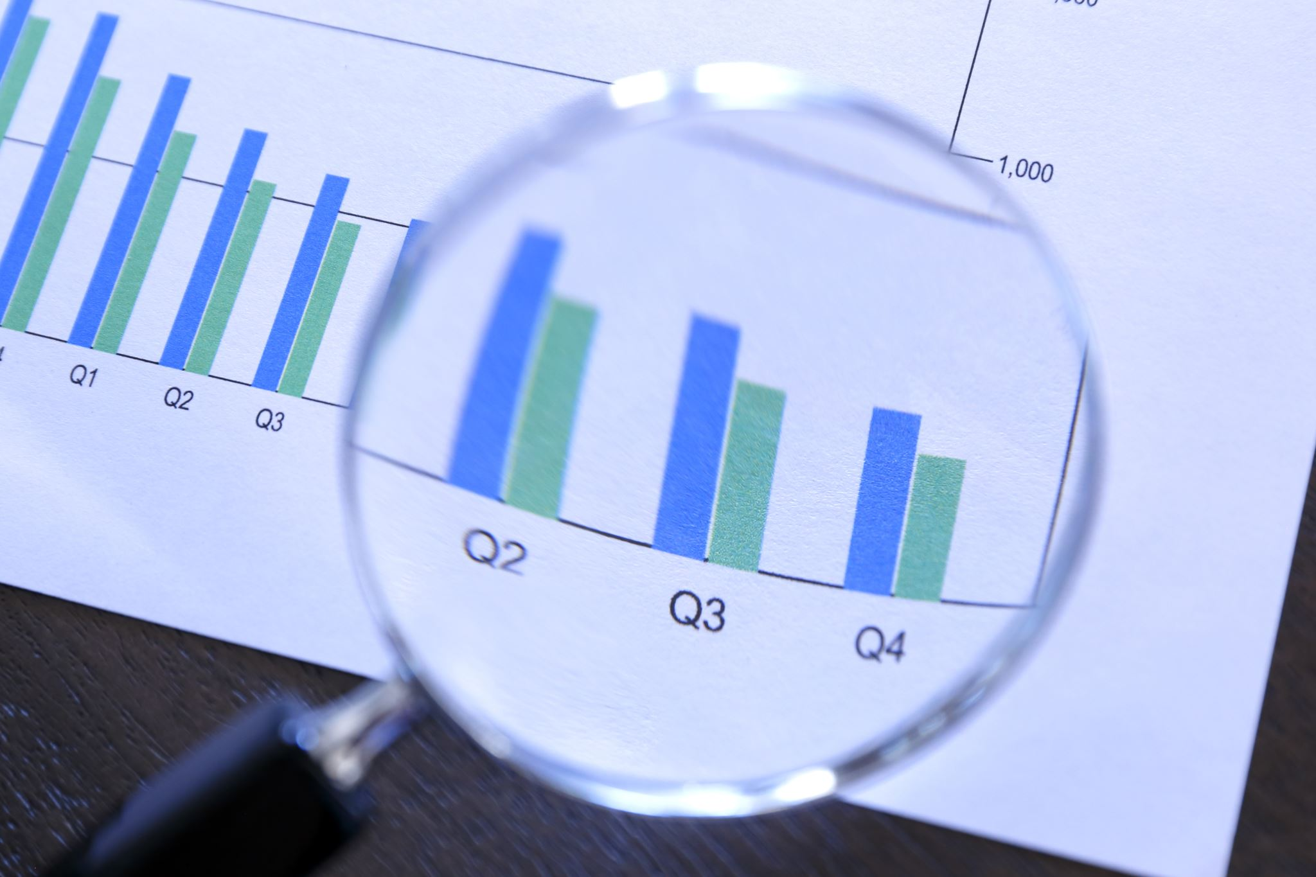
Data analytics
Analyzing our data allows us to put our data into any format we see fit such as graphs or charts.
Several different graphs and plots were created to fully understand the data and see it from different points of view.

Slide 21
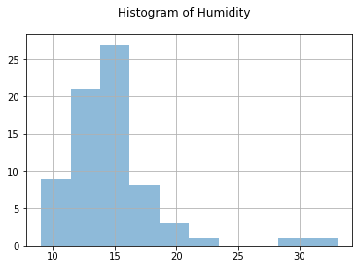
Histogram of humidity
Screenshot of Histogram of humidity and explanation

Slide 22
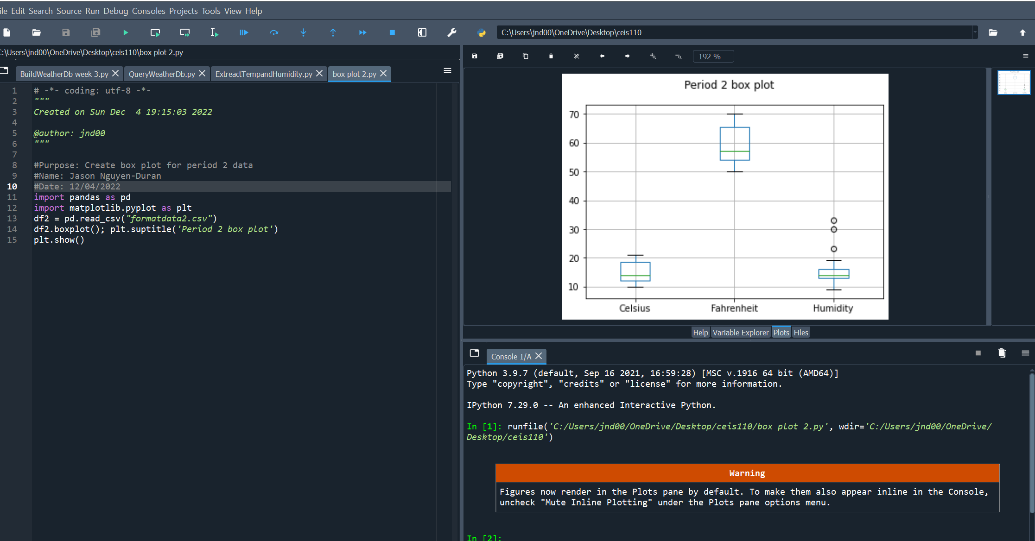
Period 2 box plot
Screenshot and explanation

Slide 23

Analysis
While we are trying to understand and analyze our data it is important to ask questions and make different asssumptiont about the data.

Slide 24

Code
The code to create Fahrenheight plot:
import pandas as pd
import matplotlib.pyplot as plt
df1= pd.read_csv(“formatdata.csv”) #data for period 1
plt.figure(); df2.Fahrenheit.plot(label= ‘Fahrenheit’); df2.Humidity.plot(label= ‘Humidity’); pltlegend(loc=‘best’);

Slide 25

Prediction
Based on the information and data for the past few weeks I can say that as temperature goes up humidity tends to follow.
Due to this I predict that on any given day the higher the temperature is the higher the humidity will be on that given day.

Slide 26

Challenges
While typing code it is important to look out for syntax errors.
Keeping everything in the same directory in order to have a successful data query.

Slide 27

Career skills
Communication skills in different aspects such as flowcharts and procedures.
Database development
Programming utilizing python
Troubleshooting errors within code.
Organization with different data and information.
Time management and being able to run multiple software's at once.

Slide 28

Conclusion
While conducting this project I have learned the basic skills in order to gather data from a cloud service and perform data analytics, as necessary.
On hand learning with code and different types of software was a big take away and lessen from this project.
Being able to analyze data and explain what it means is essential in any job which I have learned over the course of this project.

