Slide 1

Security and mobile devices
By
Jason Nguyen-Duran

Slide 2

Intro
Through the duration of this project, I will demonstrate my knowledge on how to use the Android Emulator app in order to explore app development, reverse engineering, and traffic analysis.

Slide 3

Set up
Preparation is key in any project or task at hand.
For this project my preparation included downloading and understanding different software such as a VM, Android Tamer 2, and Android Emulator.

Slide 4
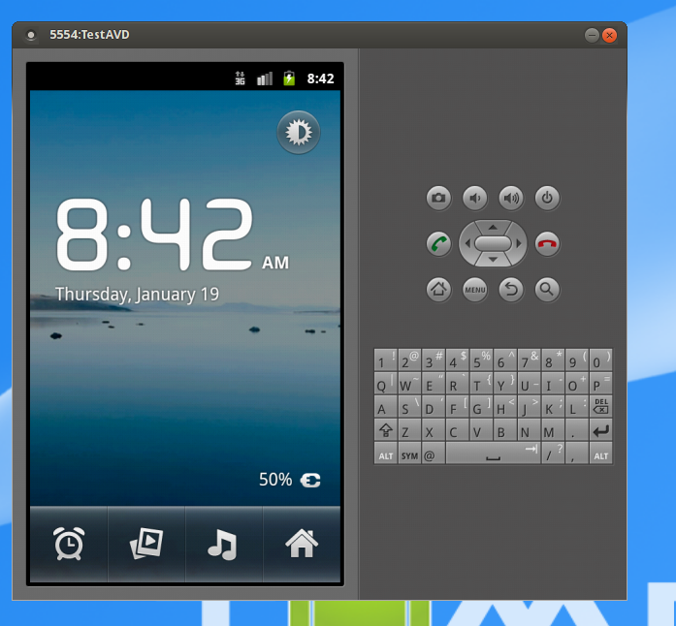
Android SDK
What is Android SDK? What is it used for?
An Android SDK is an app developed by google that allows users to create Apps for the Android platform.
This screenshot shows that my software and VM are running properly and the set up was done correctly.

Slide 5

Step 1 after Preparation
After set up and downloading of the proper programs/software, I will show how to use the Android Debug Bridge (ADB), and how to gain access to the android emulator phone.
This will allow us to have Root access to an android device in order to share, upload, delete, and modify any thing such as files on the device.

Slide 6

Understanding processes
What does the com.android.phone process represent?
-This is a process on android phones that deal with communicating.
This process is one of many a device can be running, understanding what a process is doing on a cellular device is key. This knowledge allows us to see if there is anything wrong or malicious on the device

Slide 7
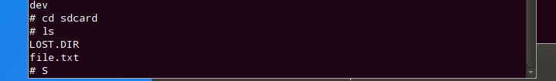

Understanding process cont.
These screenshots show the commands on how to create a file and “pull” or copy them into the device and specific folder.

Slide 8

Downloading/ checking
Once we can properly pull files into our target area we can move on to downloading or pulling apps from a target destination.
Once we pull files or apps we can check the physical device to see if it worked.

Slide 9
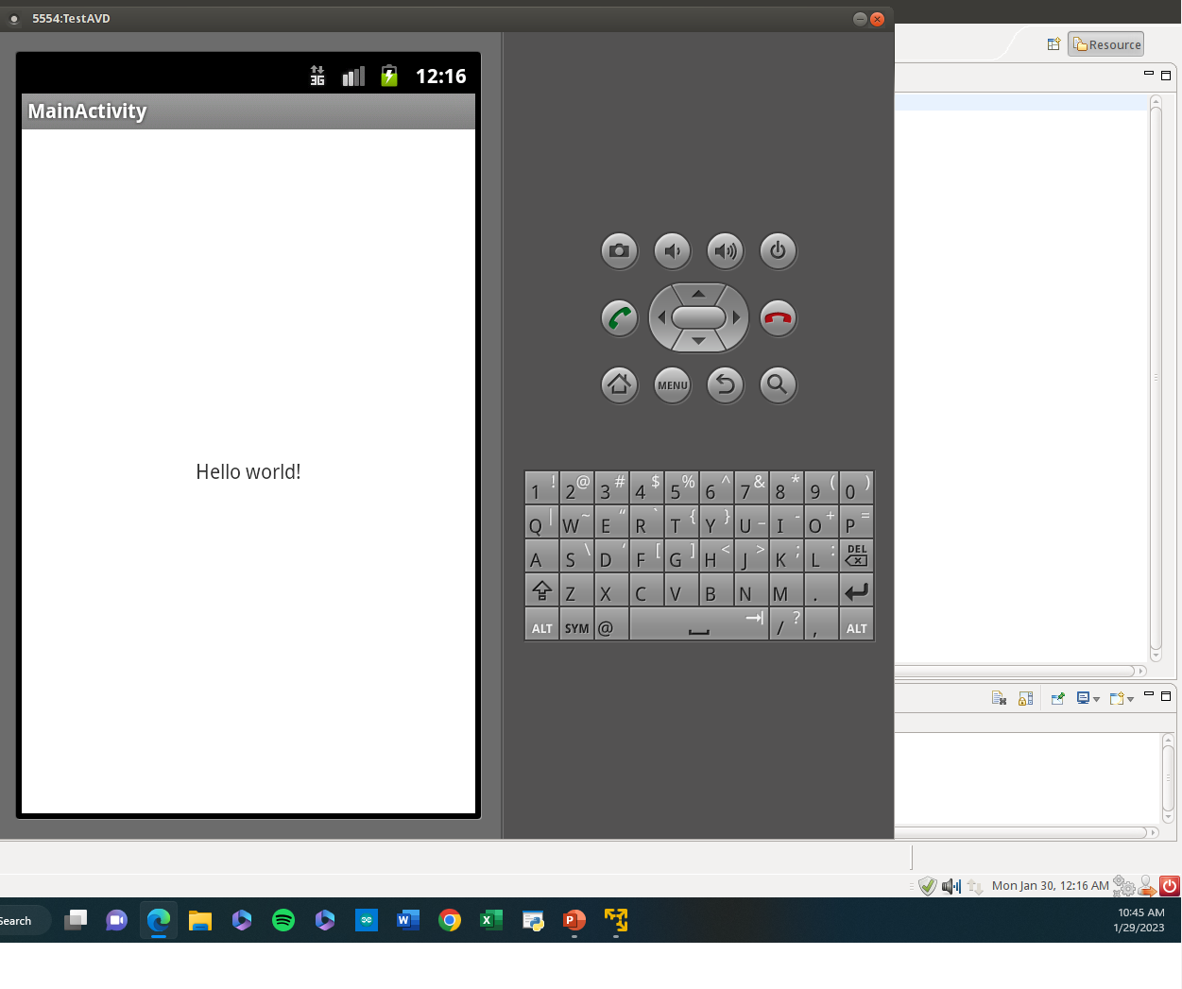
Checking
This screenshot shows that the hello world file that we pulled worked and is in operation on this device.

Slide 10
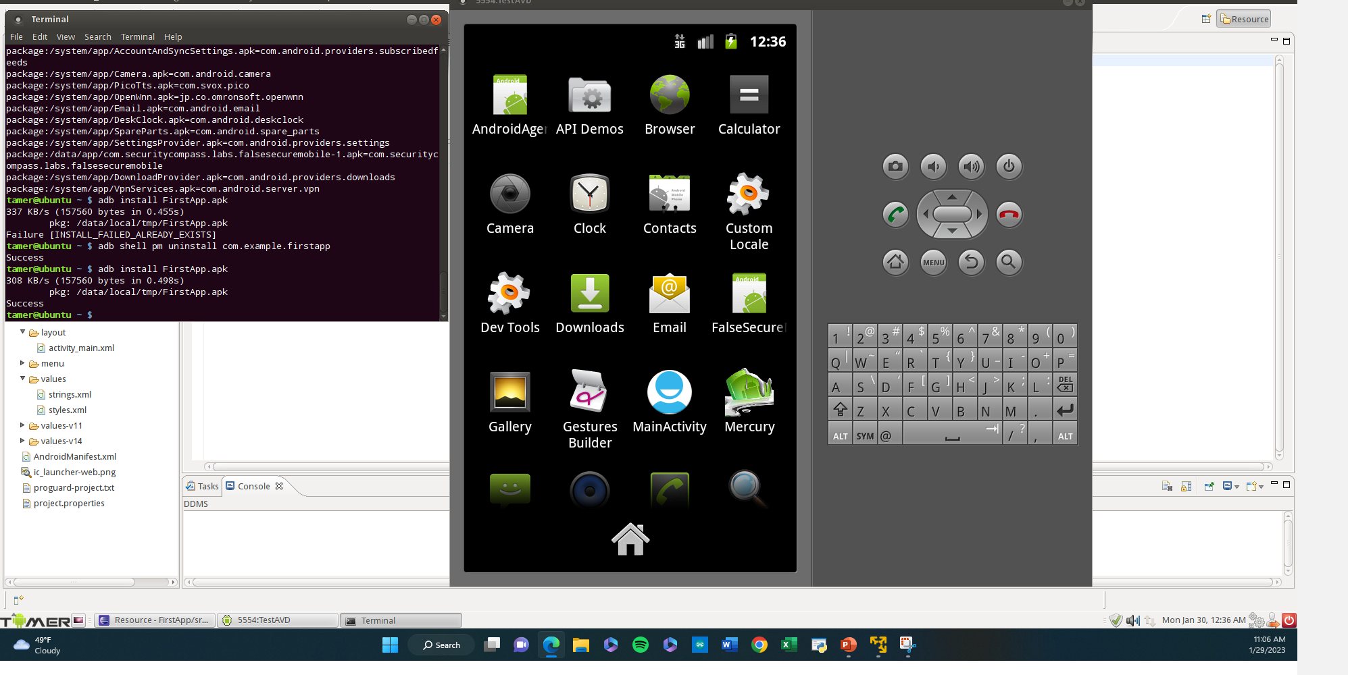
Downloading
This screenshot shows the commands on how to install a certain app and the app installed on the phone screen.

Slide 11

Security of apps
Once we have apps downloaded it is always easy just to start using the app.
It is always best practice top make sure the app is up to date and has all security protocols in line.
Apps can potentially bring malicious software onto our devices.

Slide 12
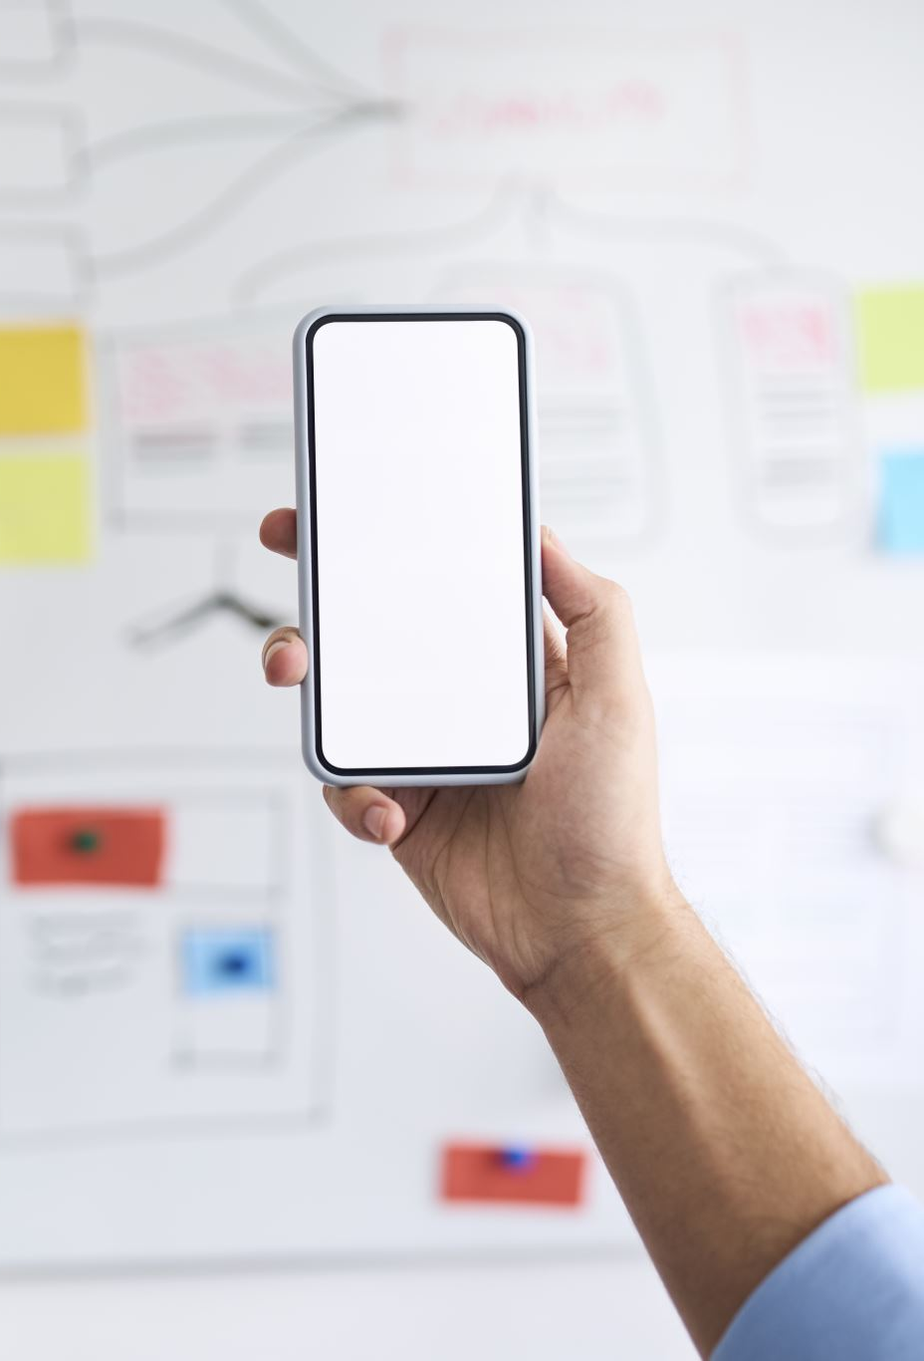
Checking apps
If we have an app installed, we can use reverse engineering in order to find the source code, see and download files from the app.

Slide 13
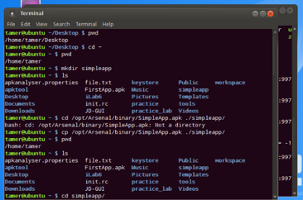
Reverse engineering.
From the command window we can see the files from within any app, this allows us to use commands to enter or download these files on that app.

Slide 14
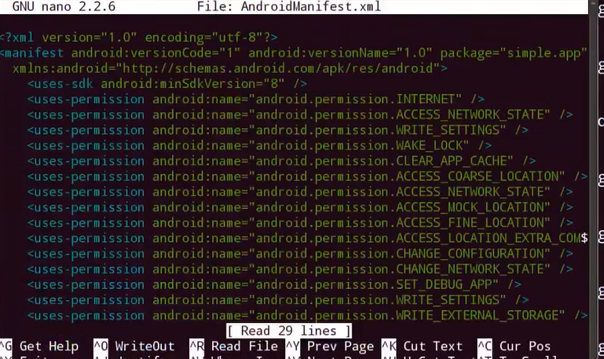
Reverse engineering
This is an example of what the “xml” files look like on an app from a command prompt.

Slide 15
Security
Before and after installing an app it always important to know that security is one of the most important aspects.
Protecting your personal information is crucial especially with the constantly growing tech industry.
Be mindful of malicious websites. Such as websites whos domains look similar but have a typo in the spelling.
Never click random adds or downloads on websites.

Slide 16
Security (Web Headers)
What is the role played by Web headers in a hacker’s attempt to mount a cyber attack?
Answer: Web headers can be used as click bate for users. A hacker can get a website with a header similar to the website we usually use. If we click on the wrong header or have a typo and enter the wrong website it can open a lot of avenues of approach for a hacker.

Slide 17
Security tips.
There are a numerous number of ways to keep yourself protected.
Websites/programs such as burb suite online or any security software can help prevent, detect, and help protect against any virtual threats.
Be careful not to click on web headers which are websites that seem similar to your trusteed website but contain viruses or malicious code.
Always use a VPN when necessary, and change your passwordsoften.

Slide 18
Challenges
Learning new terminology and diving deeper into the industry was challenging because its almost like learning a new language.

Slide 19
Career skills obtained
Attention to detail skills have been obtained due to always constantly looking for small typos in commands, websites, or just anything online that can potentially cause harm.
I learned the importance of security and managing my apps and websites I use actually matter in protecting my personal information.

Slide 20
Conclusion
It is easy to download apps or access the web especially since tech is a growing industry but we it is important to know what we are doing.
Having security apps or programs that scan for viruses are a must in protecting your data and personal information.
Having a security program is just a small step in security, we have to watch what we download, the websites we access, and realize that anything on the web can potentially be harmful.

