Slide 1
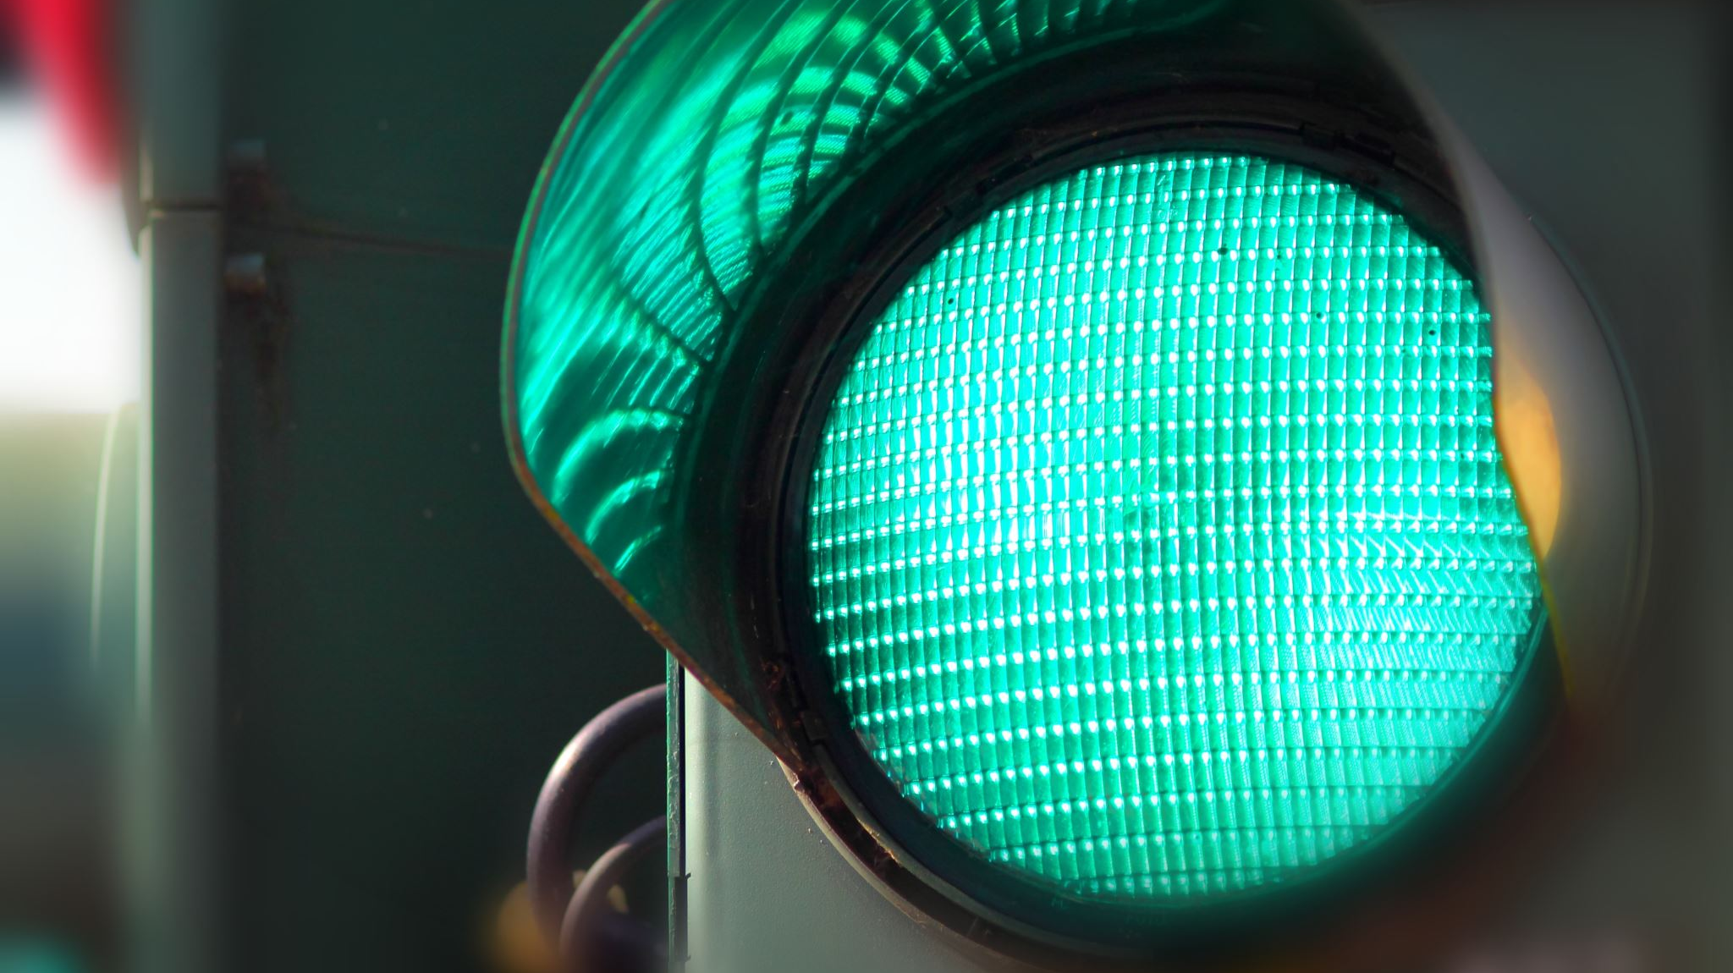
Ceis114 IoT streetlights.
By Jason Nguyen-Duran

Slide 2
Getting started
In the next 3 slides I have added pictures of how to get started with any project
It is always important to get an inventory of parts to see what you have and what you might need.
Once you have everything together it is important to do a functions check to see that everything is working properly.
Once everything is running to your liking it is a goof time to check what networks are available to you in order to get started.

Slide 3
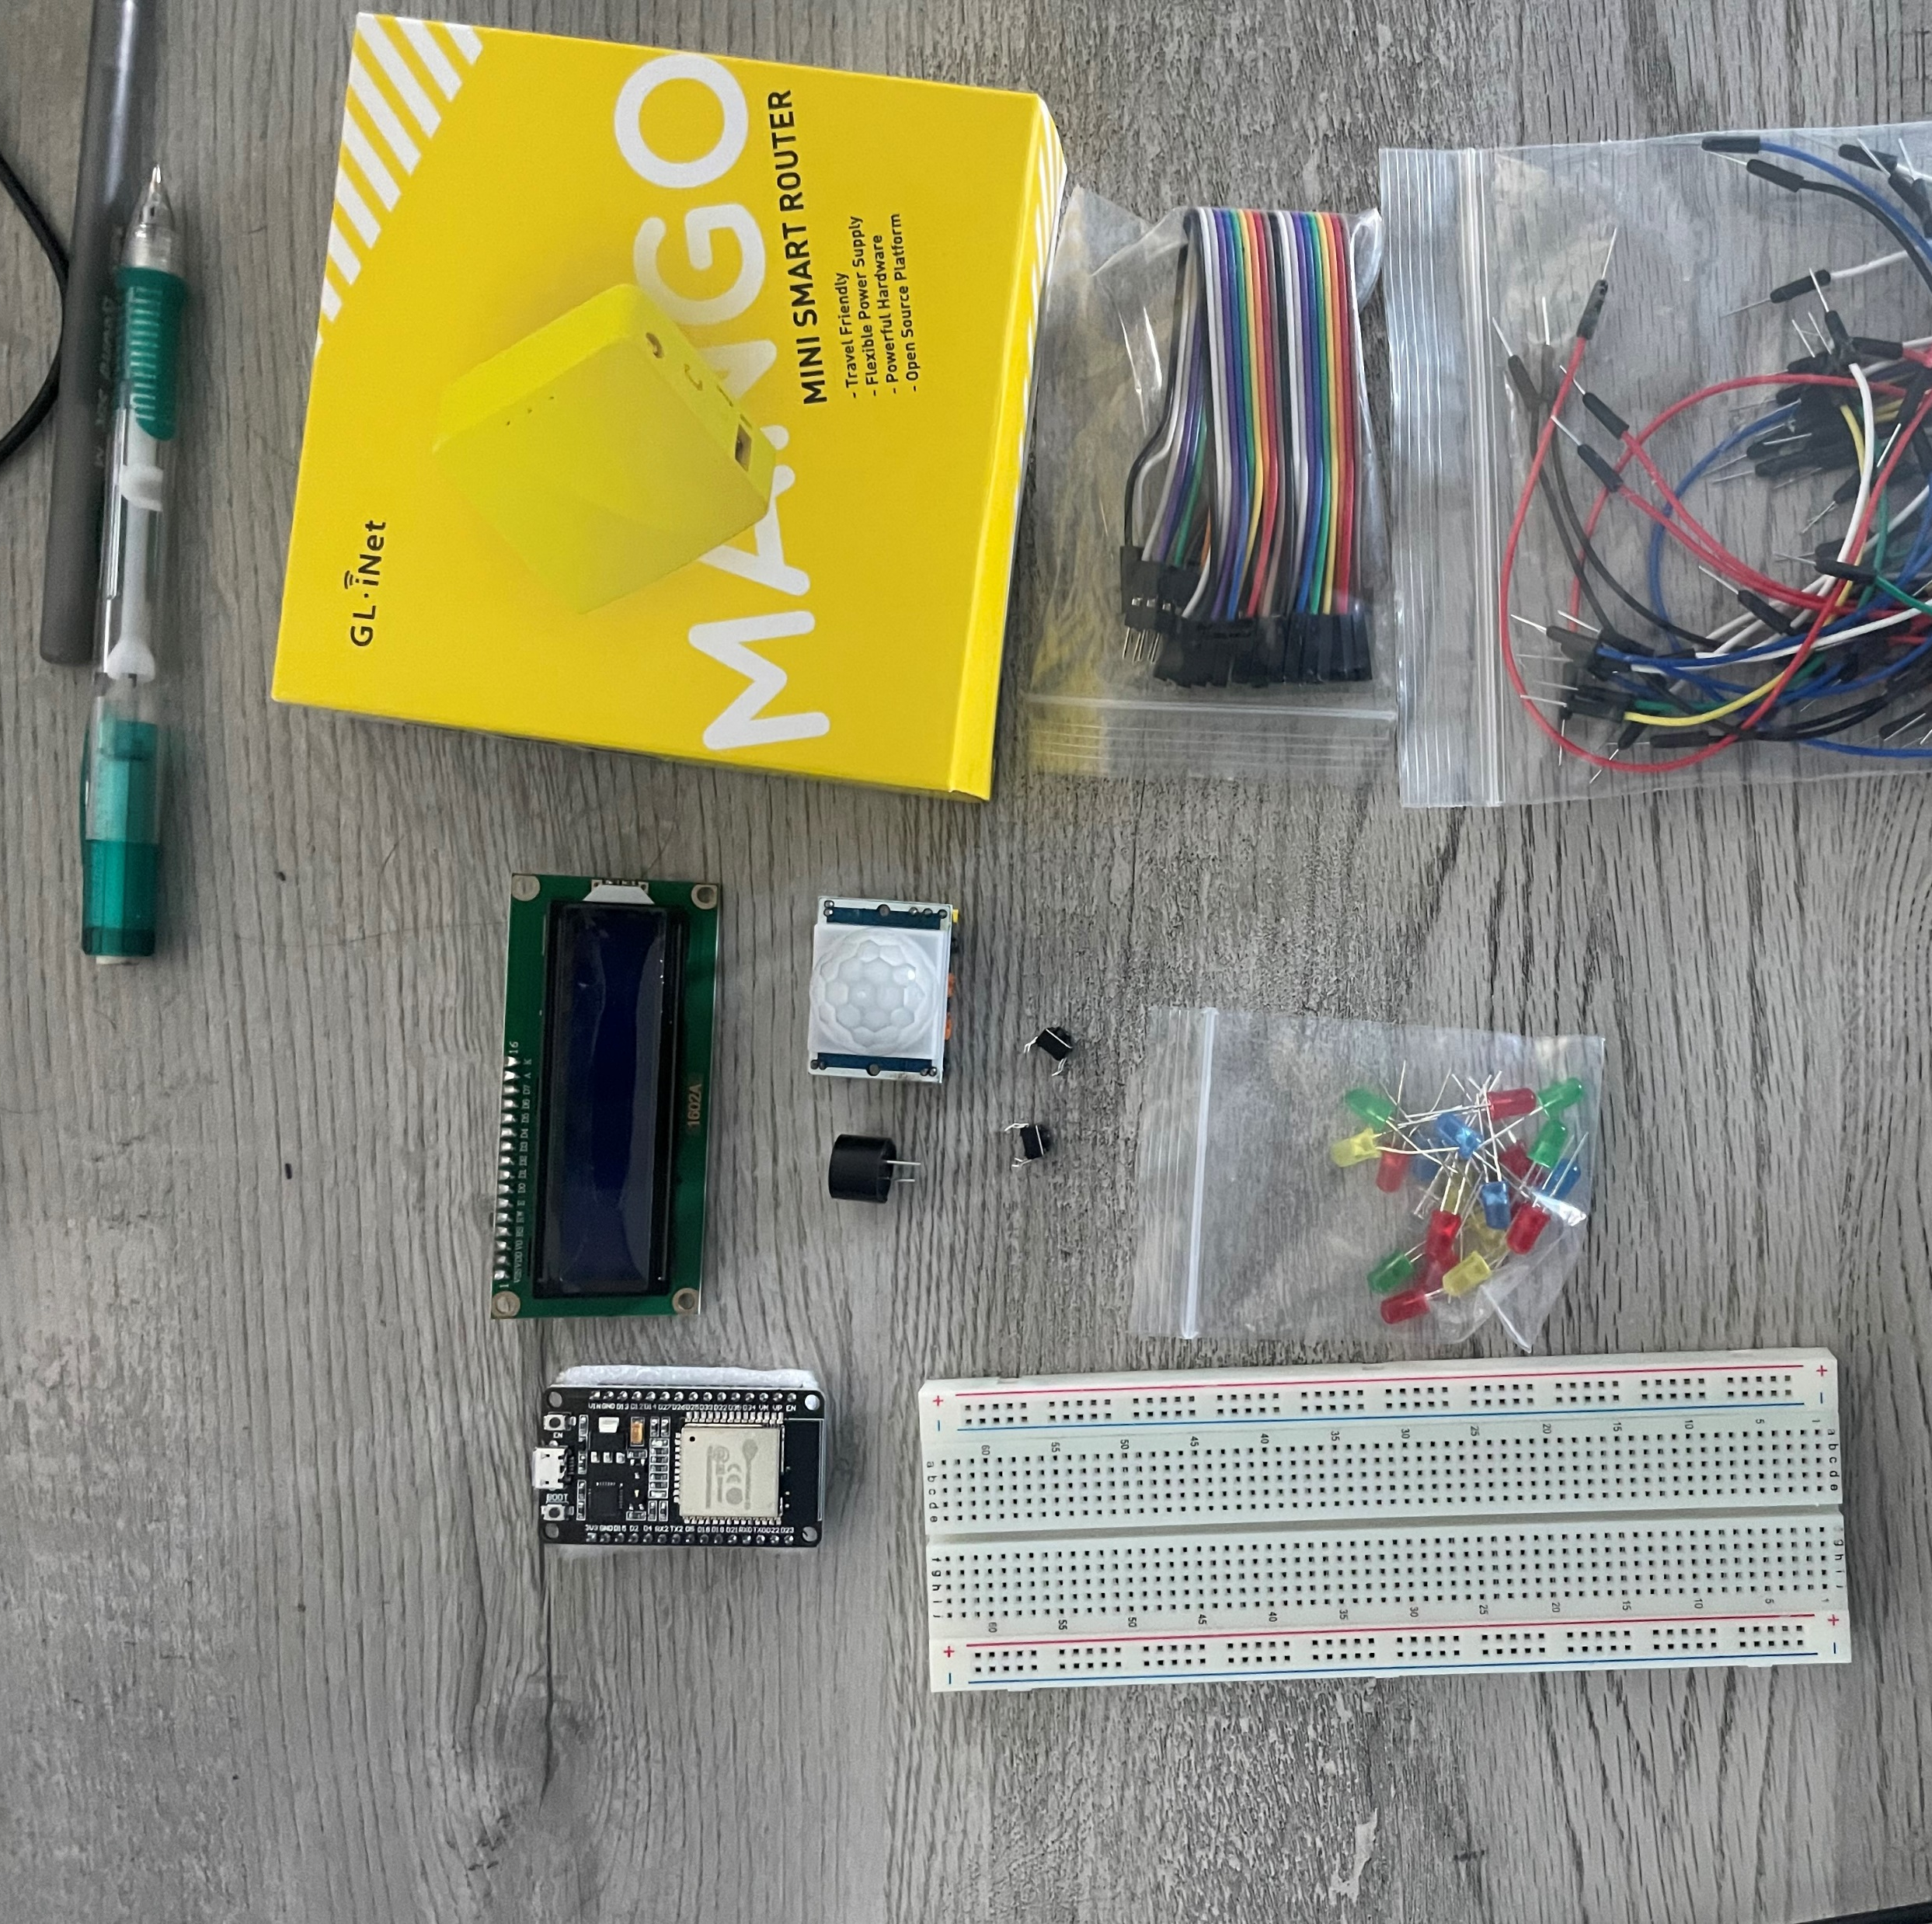
Inventory (Picture)
-ESP 32 Board,Colored LEDs: Red, Yellow, Green, and Blue, 220 Ohm Resistors (optional),Wires, (2) Breadboard(s), LCD Unit with I2C Adapter, Active Buzzer, Mini Router, Push Button(s), and PIR Motion Sensor.
-While keeping organized there is no right or wrong way but I always do it in a manor that suites myself.

Slide 4
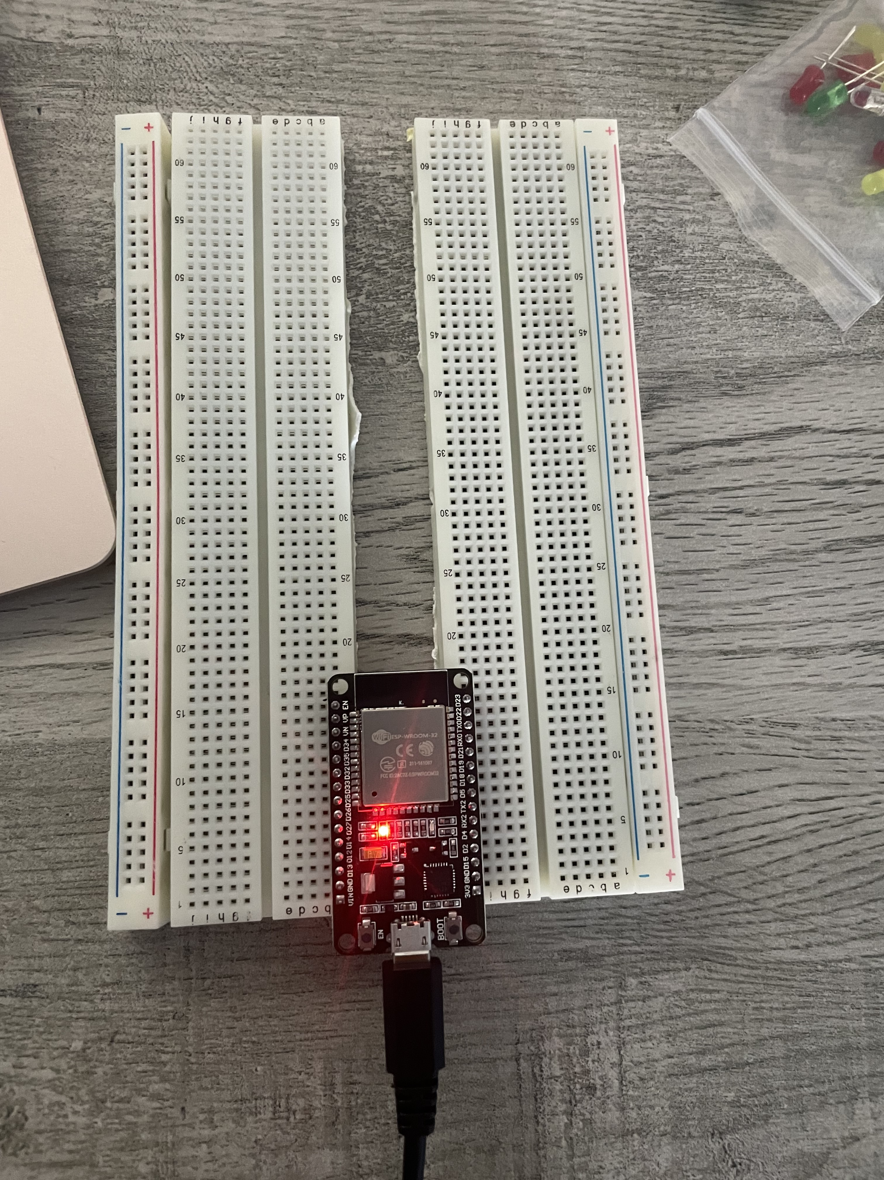
ESP32 (Picture)
-Microcontroller mounted and powered ON
- This picture shows the ESP32 plugged in, working, and ready to go.

Slide 5
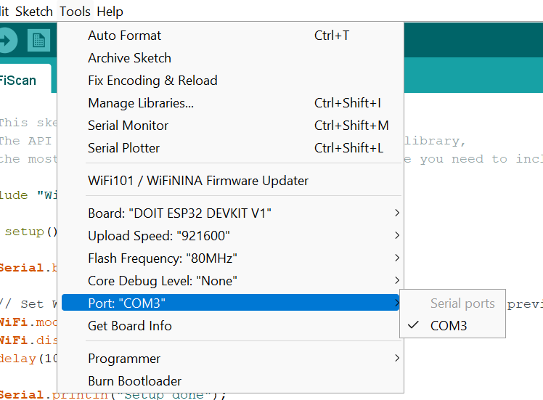
Installation of Arduino IDE
- Screenshot of Arduino IDE with Port selected from Tools menu.
- While using Arduino or any type of program it is important to make sure your device is registering the equipment properly.

Slide 6
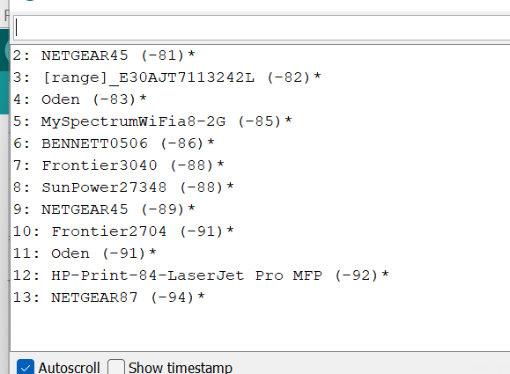
ESP32 WiFi Scan
Screenshot of Serial Monitor in Arduino IDE showing the available networks
Utilizing the Serial Monitor function with the ESP32 WiFi scan we can search for any available Networks we might want to use.

Slide 7

Building the First circuit
Once we have all our parts it is time to create our first circuit.
Preparing everything before hand and making sure it all works properly is a great way to make sure you are ready.
Doing preparation work makes it easier to do the work because you won’t have to look for anything or need to troubleshoot.
This is a simple circuit like a 1 way street with a traditional stop light.

Slide 8
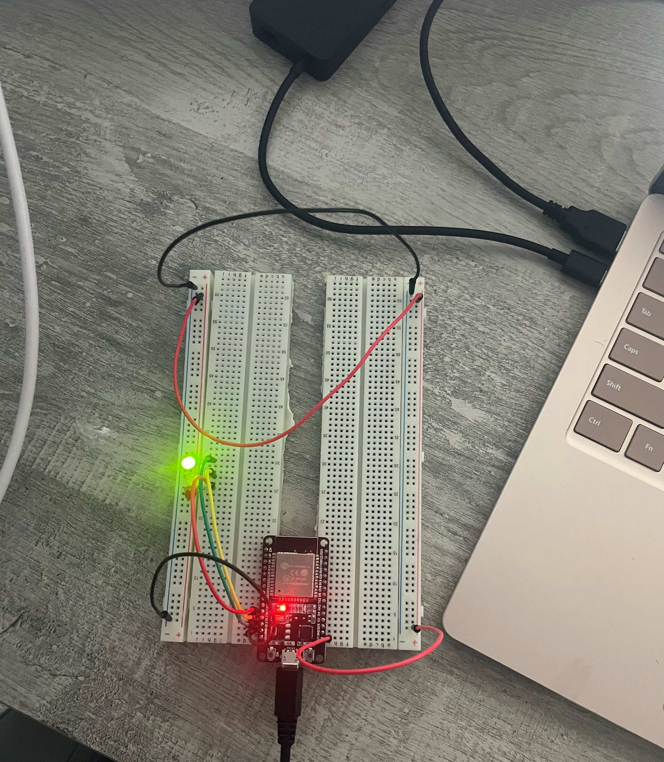
Picture of circuit with working LEDs
ESP 32 Board, Colored LEDs: Red, Yellow and Green, Wires, and 2 Breadboard.
It is always important for any type of work to have good attention to detail.
Paying close attention to what you are doing makes a successful project.
While running the code if your lights are plugged in to the wrong pin the circuit will not perform in the desired way.

Slide 9
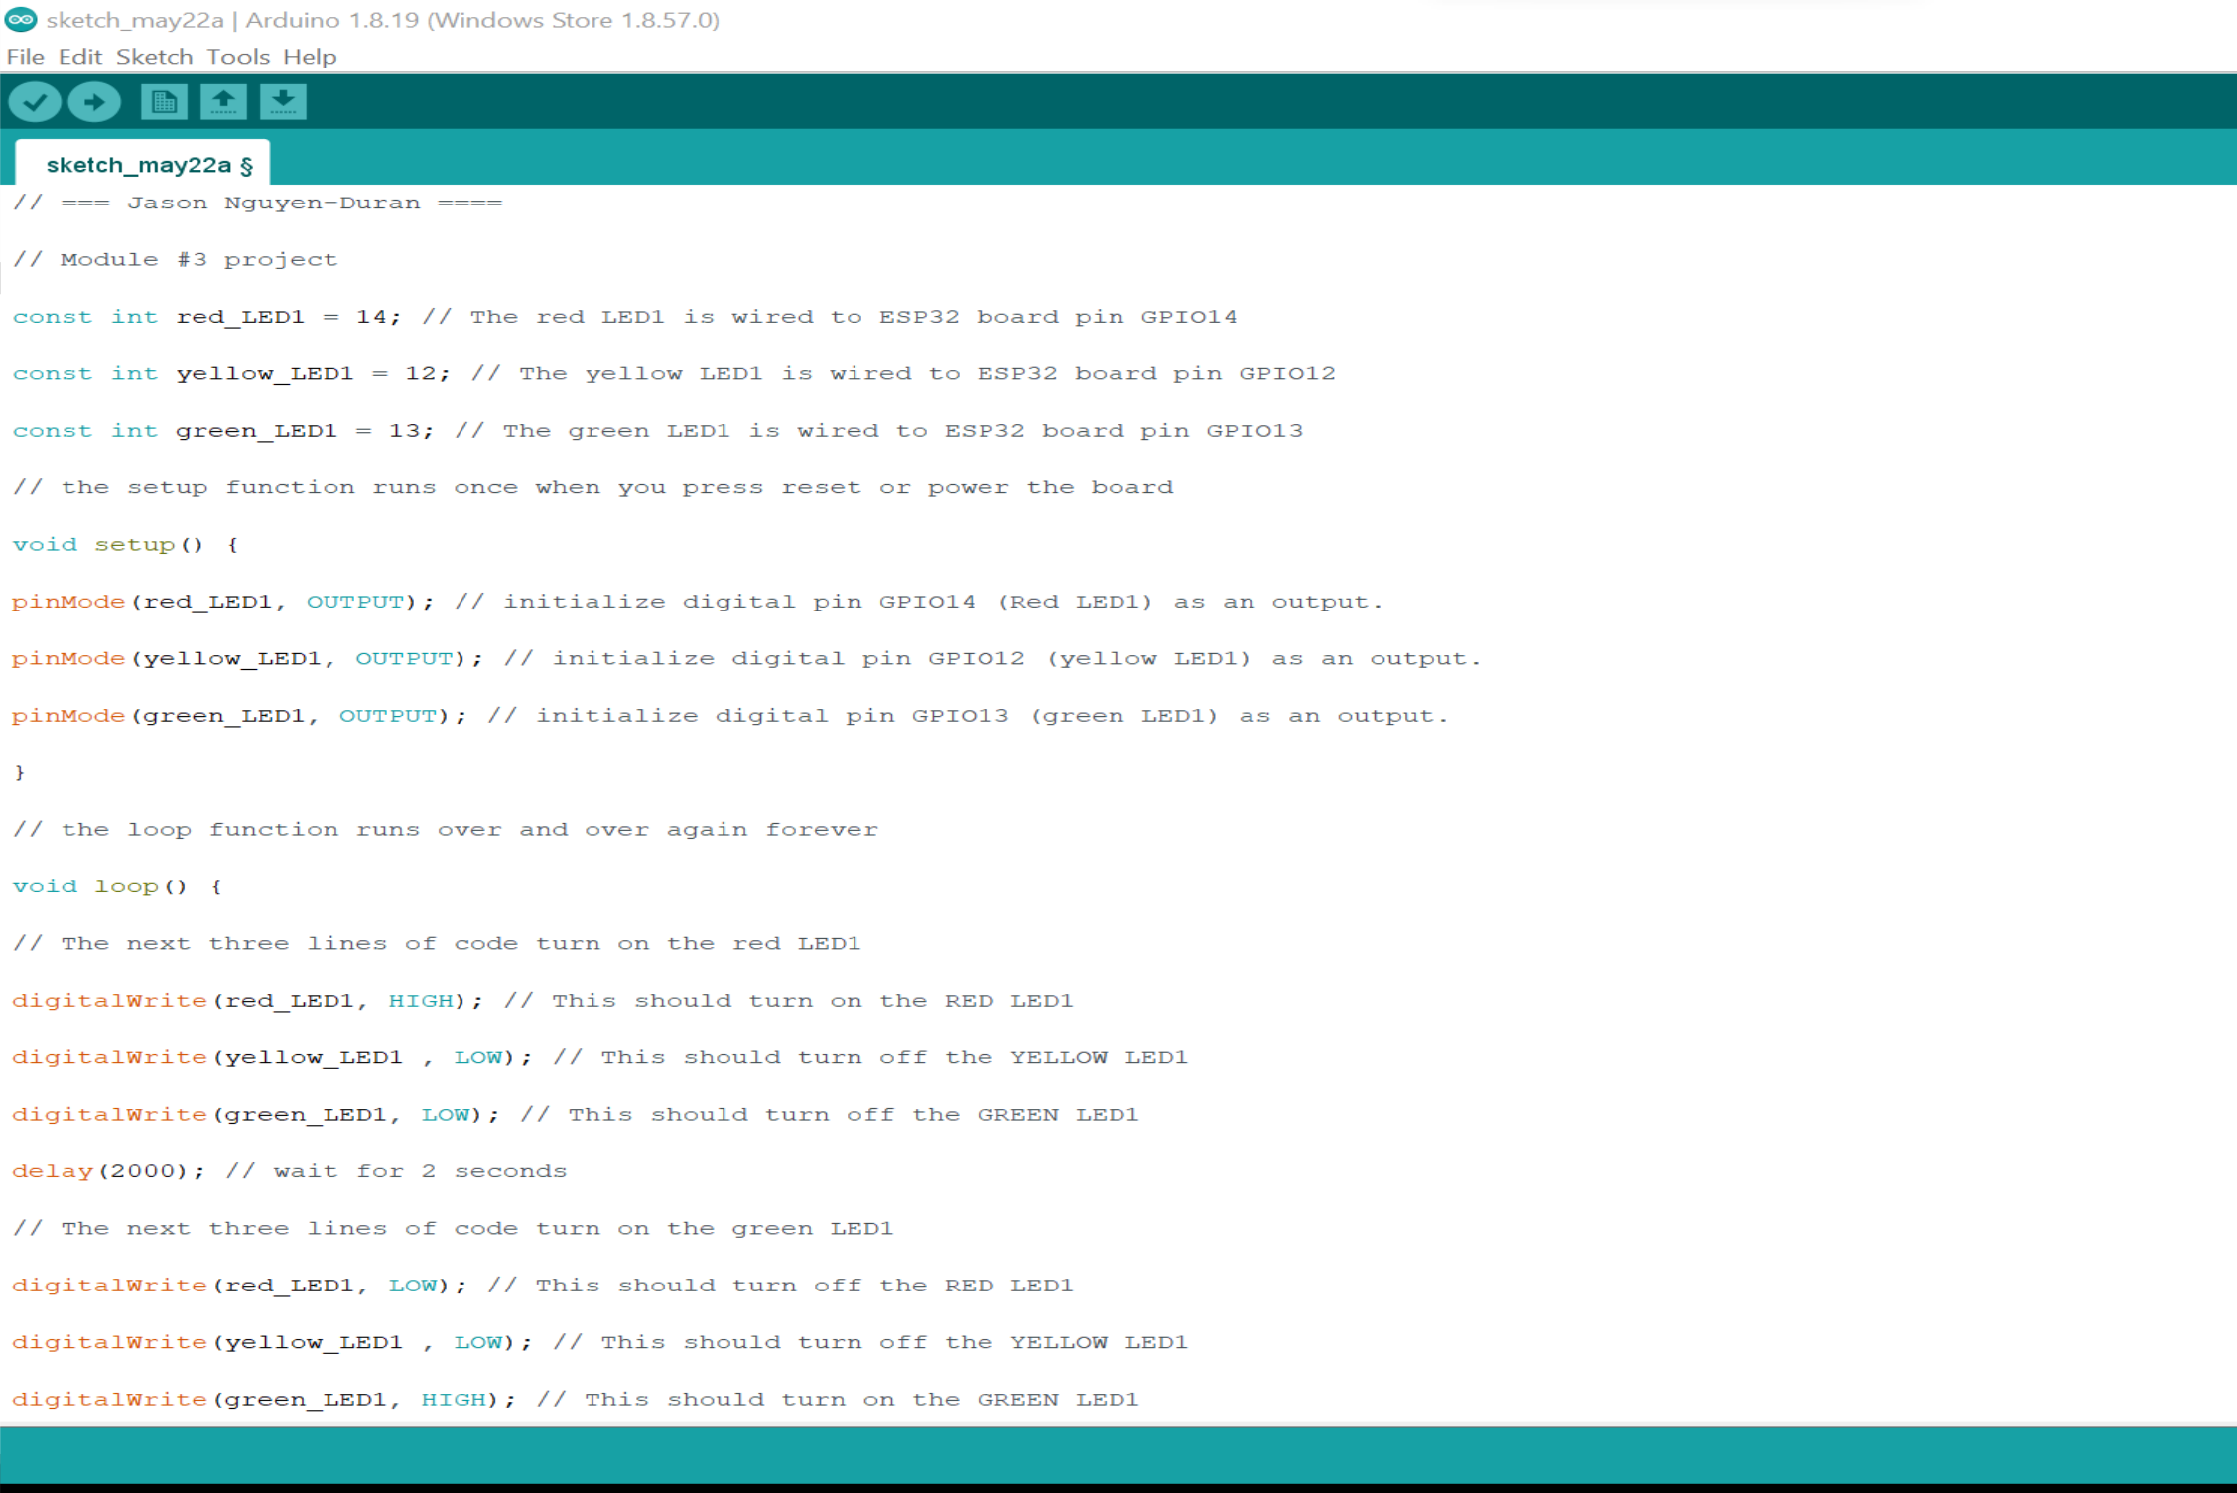
Screenshot of code in Arduino IDE
Screenshot of code in Arduino IDE.
Understanding and checking the code will ensure the proper running of the circuit.

Slide 10
2-way road
Just like the last circuit this one is a traditional road, but now we have 2 sets of lights which indicate an intersection.
The stoplights in this circuit are on timers, in the real world some intersections are on timers or will have sensors/ cameras that will tell the lights to change.

Slide 11
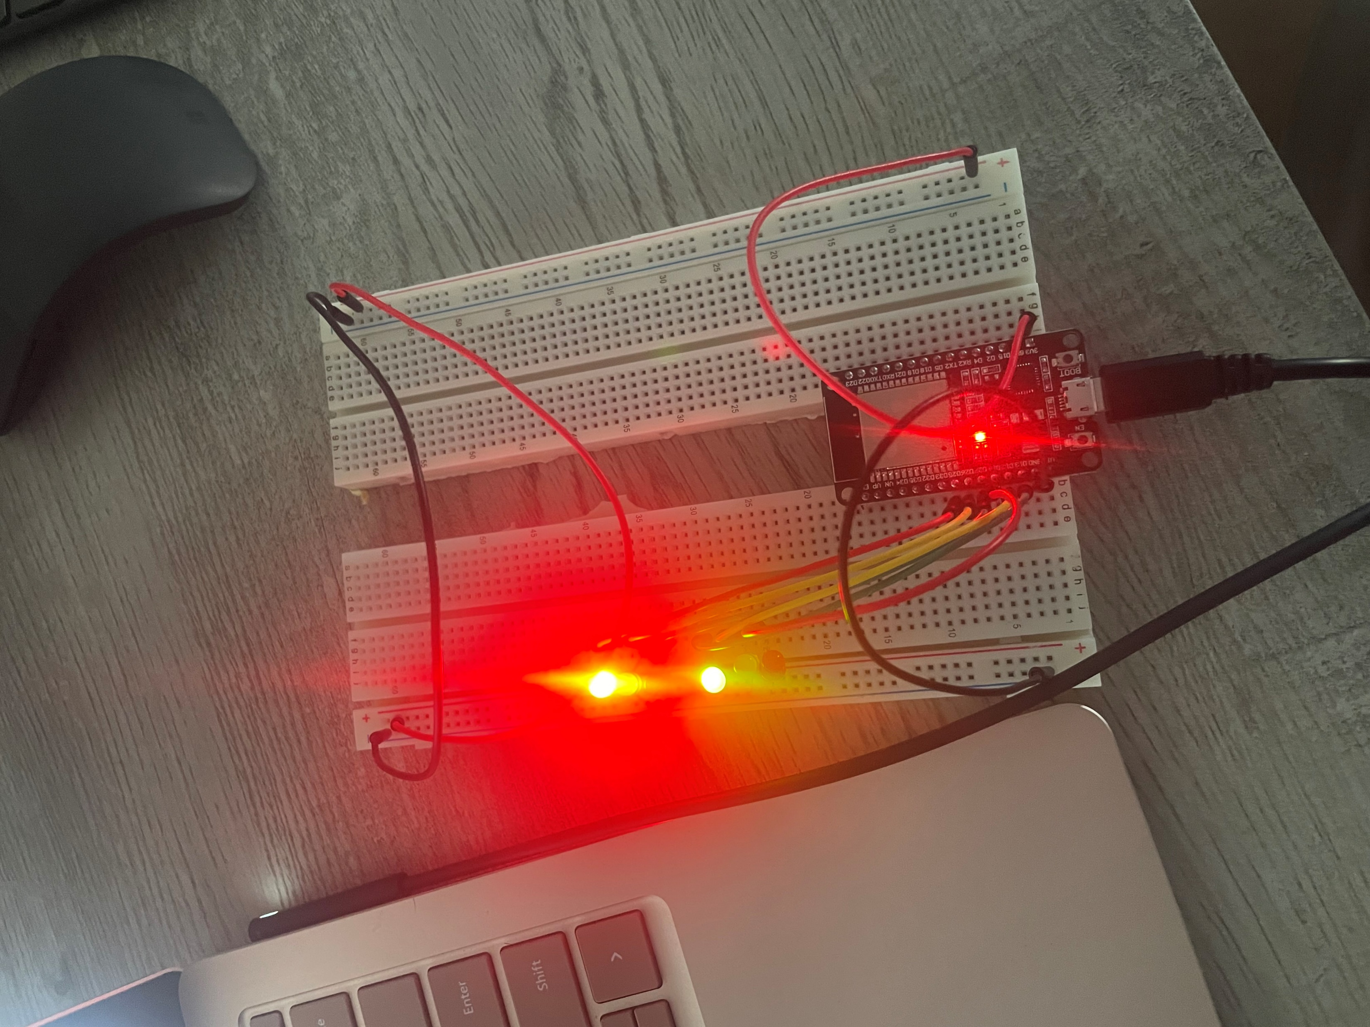
Picture of circuit with working LEDs
ESP 32 Board, Colored LEDs: Red, Yellow and Green (two sets),Wires, and 2 Breadboards.
In this picture we see that one light is red and one is green.
Just like in real life at an intersection.

Slide 12
Adding a crosswalk with timer.
In this part of the circuit I have added a crosswalk.
Just like in real life people need to cross and it is necessary to have a crosswalk integrated into the system.
The integration of the crosswalk will make it so it is safe to walk across the street even while there is traffic.

Slide 13
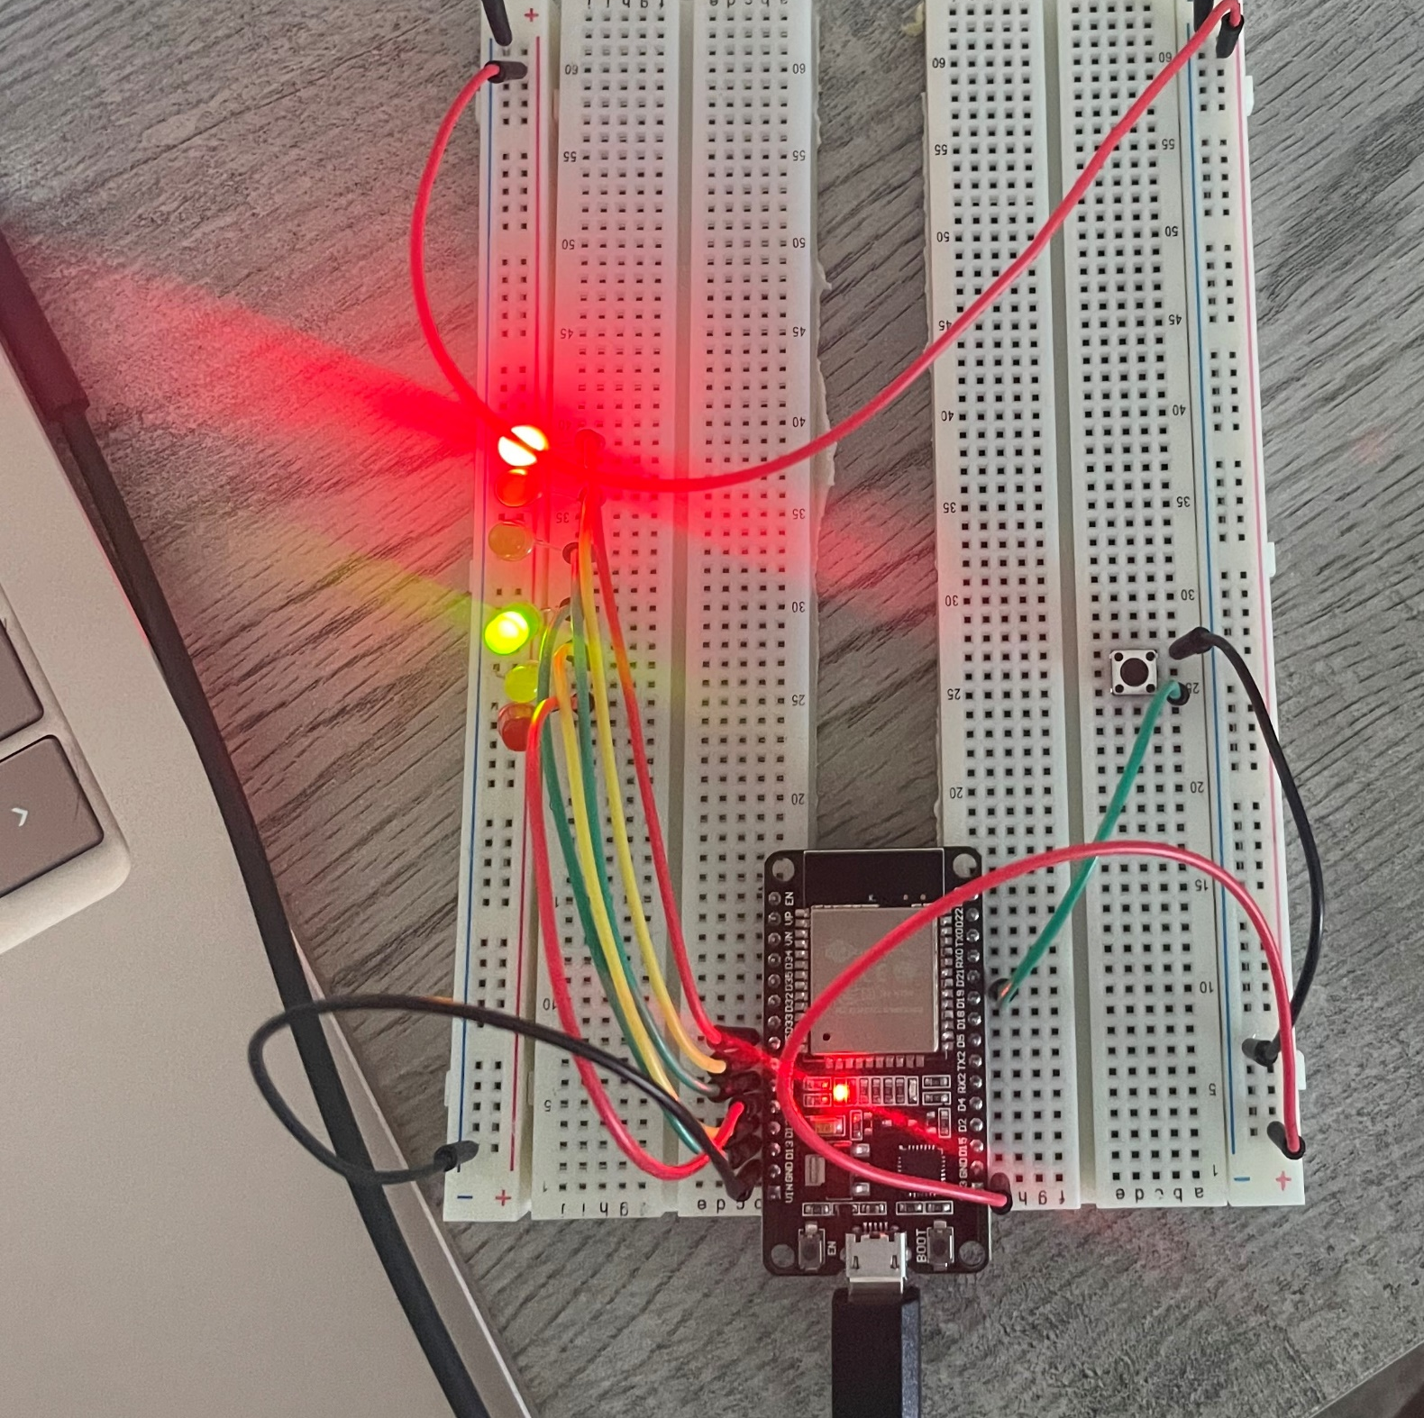
Picture of circuit with working LEDs
ESP 32 Board, Colored LEDs: Red, Yellow and Green (two sets), Push Button, Wires, and 2 Breadboards.
In this picture we added a push button which represents the buttons that are present on a crosswalk.
Once the button is pressed it will cycle both intersections to a red light and tell the pedestrian when it is safe to cross.

Slide 14
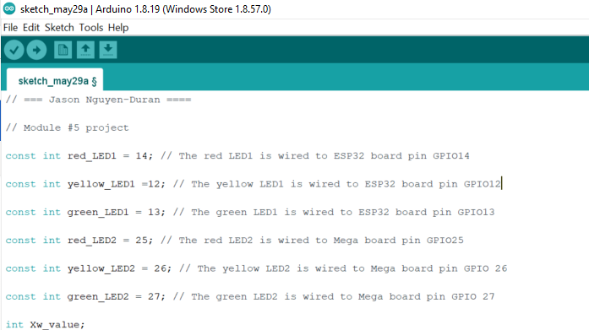
Screenshot of code in Arduino IDE
In this snip-it of code you can see which wires need to go to a specific pin in order to function properly.

Slide 15
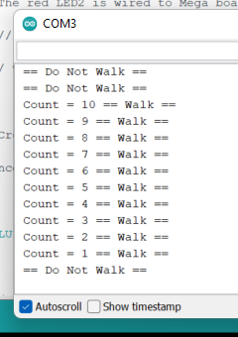
Screenshot of Serial Monitor in Arduino IDE
In the serial monitor it shows how the cross walk will work in theory.
Once the button is pressed it will tell you when to cross and how long you must cross to be safe.

Slide 16

Adding a LCD display.
The integration of the LCD display will tell the pedestrian that it is okay to walk just like in the real world when we have a walk sign or a red stop hand.
In the last circuit adding the button without the LCD display was to just make sure that the circuit worked.
The LCD display is a real world application.

Slide 17
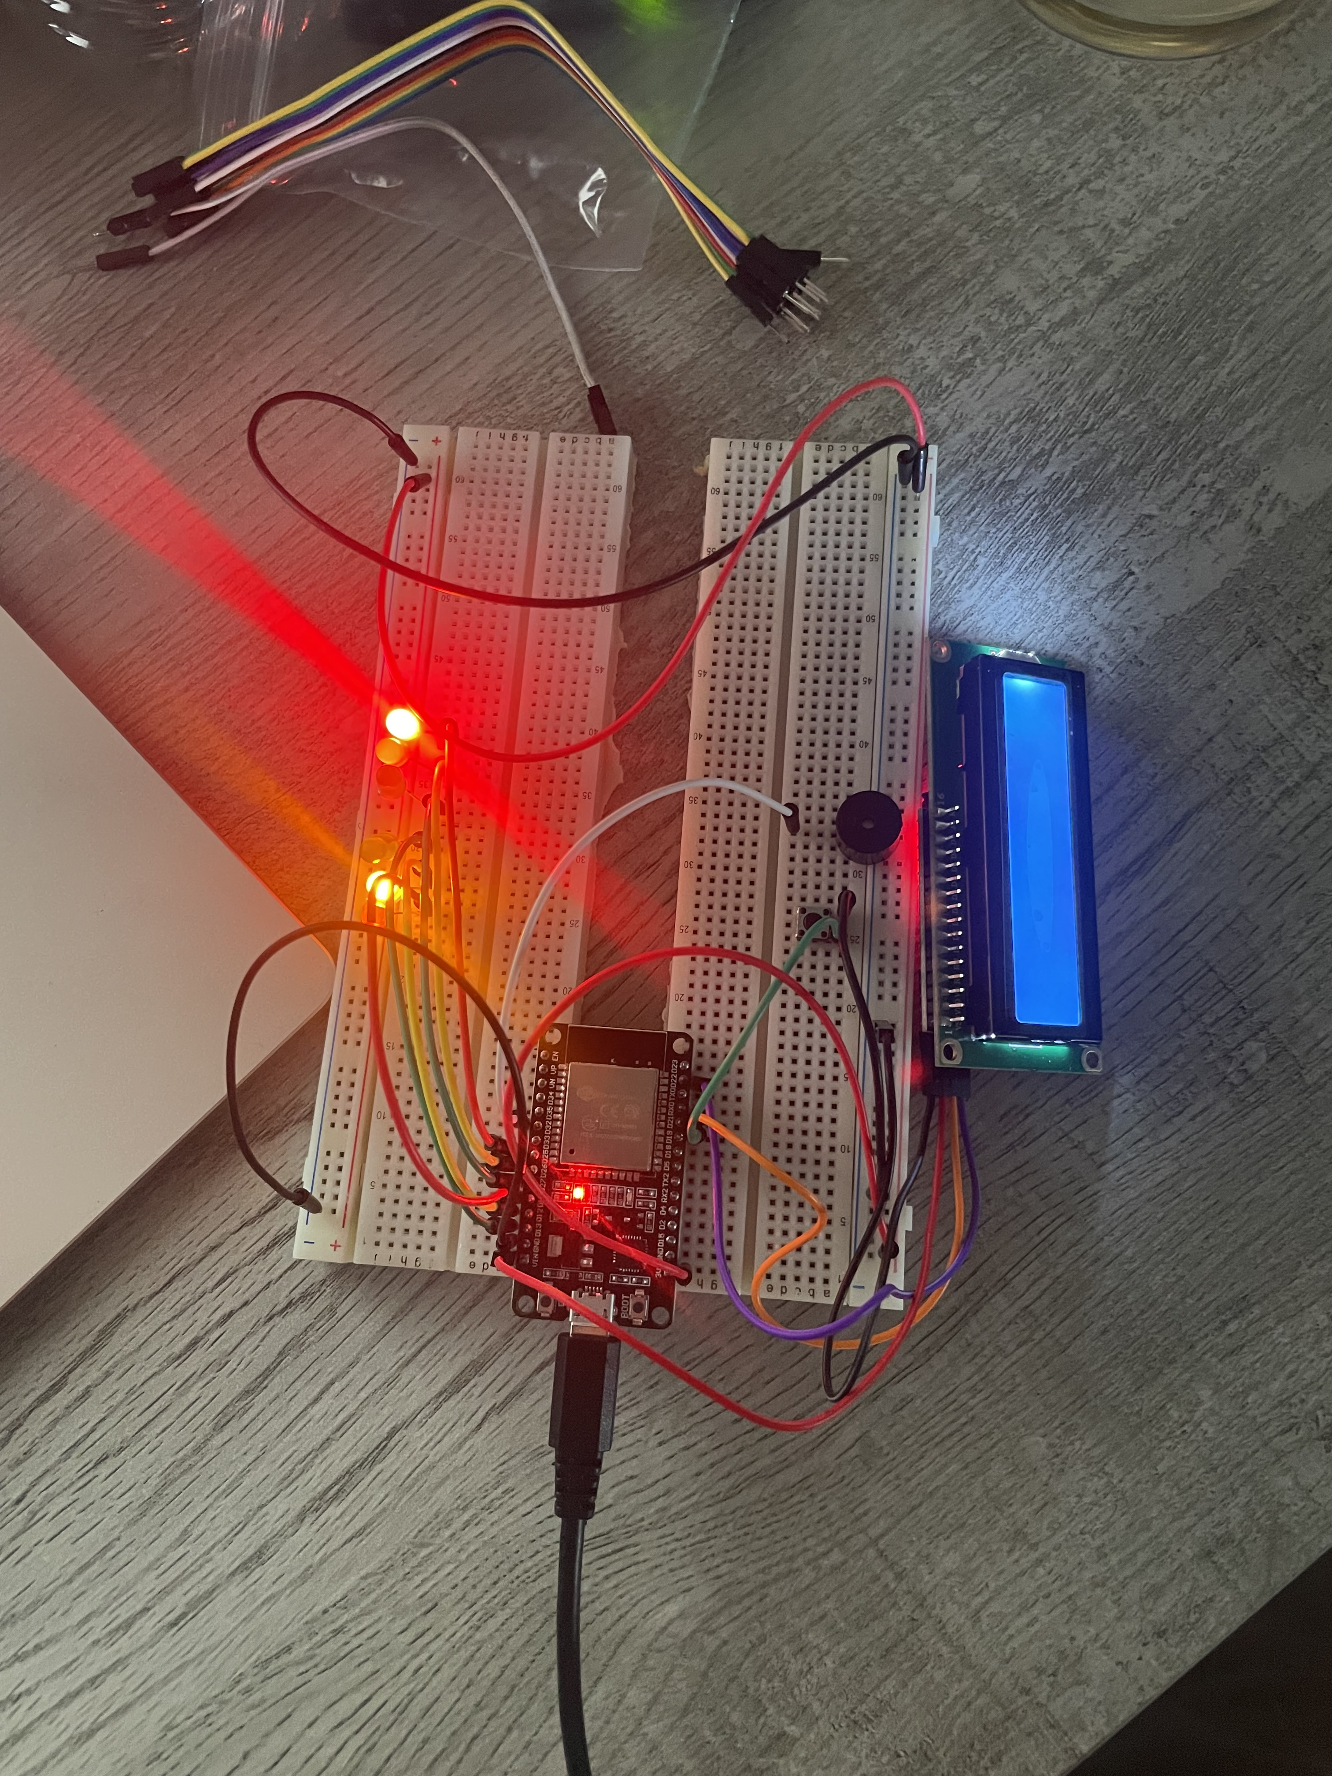
Picture of circuit with working LEDs and LCD display
ESP 32 Board, Colored LEDs: Red, Yellow and Green (two sets), Push Button, LCD Unit with Message Display, Wires, 2 Breadboards.
In a final circuit I found it was best to use the same color for the same parts and use different color wires for different components.

Slide 18
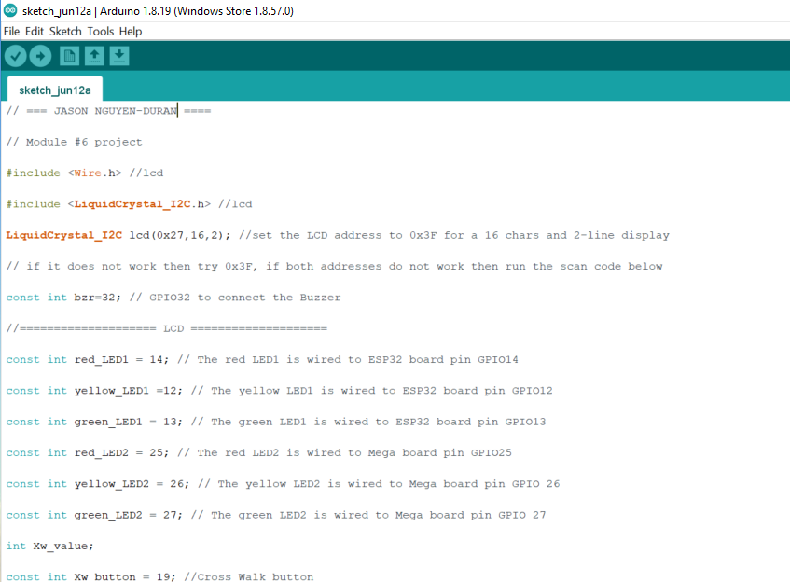
Screenshot of code in Arduino IDE
Screenshot of code in Arduino IDE showing.
Even though we are just building on the circuit it is always good to check all lines of code to ensure everything is proper and up to standard.

Slide 19
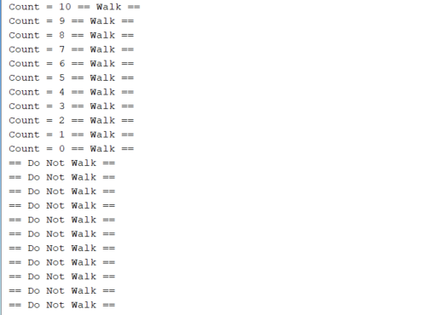
Screenshot of Serial Monitor in Arduino IDE
Screenshot of output in Serial Monitor.
Just like the last the last serial monitor this is what you will see on the LCD display just like in real life.

Slide 20
Challenges I faced.
When I 1st started, I struggled with picturing what the next step was and how it would be wired, This taught me that staying organized and leaving room for future add-ons is essential to being successful.
I also struggled with understanding the code and how it worked. After, reading and checking the different add-on’s, I noticed/ learned that the different lines tell the circuit what to do, how to do it, and when to do it.

Slide 21
Skills I’ve learned
I have learned how to stay organized and the importance of thinking before you do.
I have learned how to check the code and understand the importance of each line.
I have learned how to properly use and wire a different components such as ESP 32 Board, Colored LEDs, Push Button, LCD Unit with Message Display, and Breadboards.
I have learned the importance of using the serial monitor to check the function of different components.
I now know that I have the necessary skills in order to wire, check, run, and troubleshoot circuits.

Slide 22
Conclusion
At the end of this course, I have learned how Streetlights work and communicate with all of the different components of the circuit in order to keep everyone safe.
I have learned that it is important to have very good attention to detail in order to check all components, where they are plugged in and how the code is written.
This was a very good way to learn how real systems work because on a small circuit it is easier to keep track of the components and wires. It is also safer.

