Slide 1

Fundamentals of security
By
Jason Nguyen-Duran

Slide 2
Technical and administrative controls using encryption
After you have basic security set up on your operating system i.e. changing the base passwords, strong passwords, and even 2- form authentication it is a good idea to have secure files.
Secure files can ensure only those who absolutely need access have it.
File encryption is a great way to keep personal files and information secure.
Public and private keys help encrypt and decrypt files.

Slide 3
gpg commands
gpg -- help will present a list of commands to help with encryption, decryption and generating keys
gpg -- generate-key will create a key that is password protected
Keys will help with overall security of the files that you want to be protected.
All keys are password protected, have expiration dates, and can be decrypted/ deleted at any time.

Slide 4
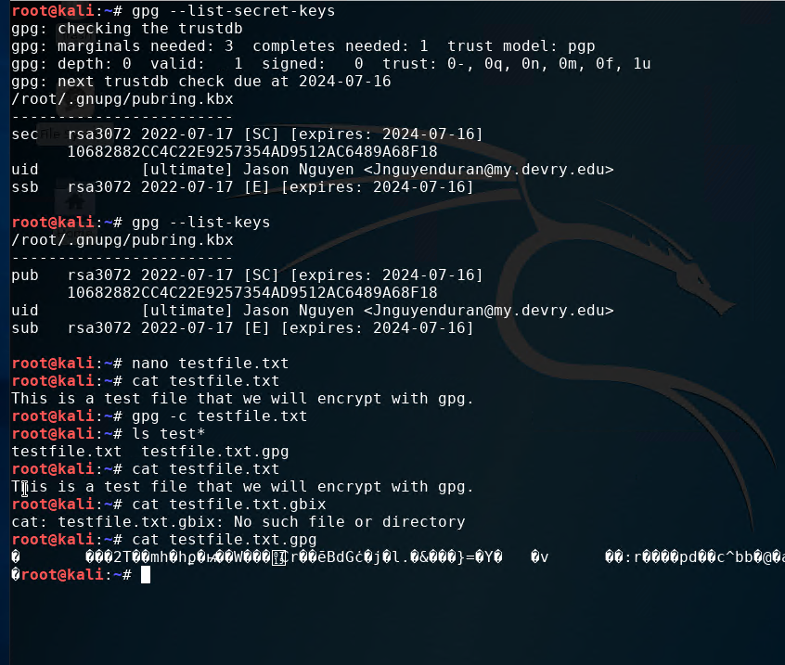
Encryption
Listing this information shows expiration dates, the files that are encrypted, and the host or individual that created the keys.
Encrypted keys are essential to protecting files in any operating system to keep personal information protected.
This screenshot shows an encrypted file and one that is not.

Slide 5
Firewalls
Once you have encrypted files you can also make the system more protected firewalls.
Setting up firewalls can show all incoming traffic and what ports are being used.
You then can determine what systems you do not want to have incoming traffic from and block them using a firewall.

Slide 6

Firewalls continued
iptables --help | more command will show all available options for implementing a firewall.
Using the ifconfig command you can see the current network configuration to see what systems IP address are on the network.
To scan open ports on your system you use the nmap (enter IP address) | more.
To drop all incoming connections to the specific port or system, type sudo iptables --policy INPUT DROP this will block all incoming traffic to a specific server.

Slide 7

Blocking specific incoming traffic
Using Nmap and the list of different commands can tell you what computers, software, OS, and many more items are on your Network.
To find information all you need is the IP address for the device you are looking for.
sudo iptables --policy INPUT DROP command adds a rule for incoming traffic, which drops/ filters all incoming traffic.

Slide 8
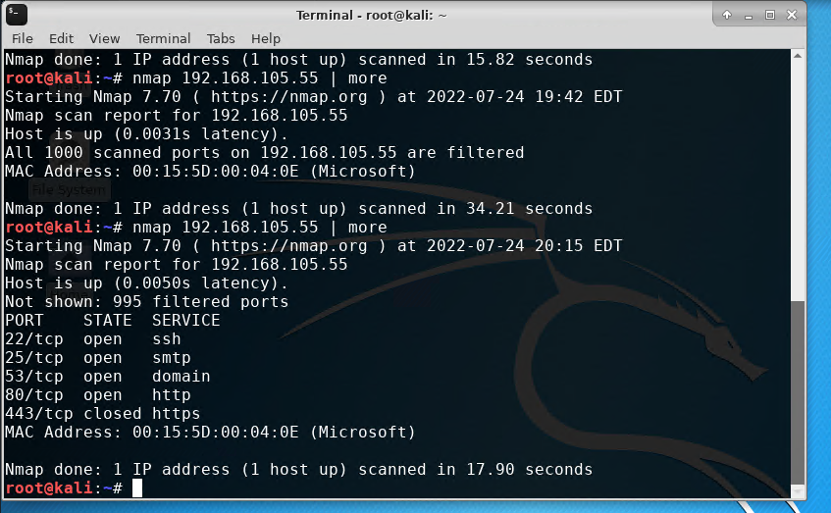
Nmap Ex.
This Picture shows a scan using Nmap and how all ports from this specific Ip address have been blocked.

Slide 9
Security policies
Having a good well thought out security policy is a great way to think about all avenues of approach in order to mitigate and attacks.
Security policies can filter or stop precious data from being stolen from inside the network and outside.
Every step of the policy has a reason on why it should be in place, each function serves a purpose to the overall security.

Slide 10
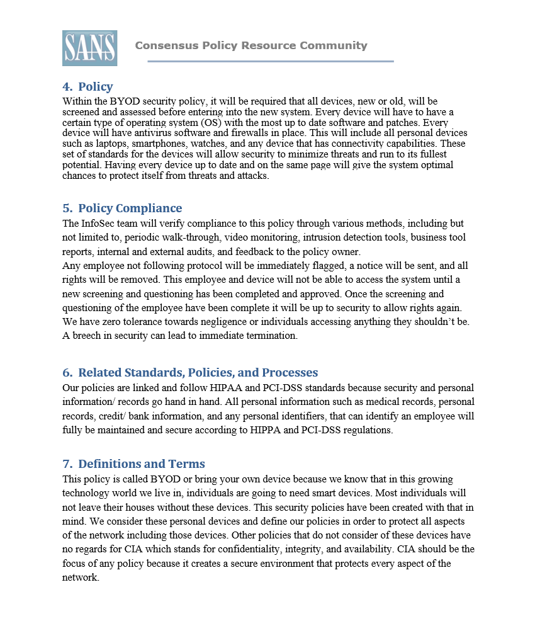
My Security policy example

Slide 11
Multi Factor authentication (MFA)
For sensitive files or personal files sometimes, a strong password isn’t good enough
Having a Multi Factor authentication can make your information even more secure.

Slide 12

Installing Google authenticator
This app is a MFA to help keep multiple forms of authentication.
sudo nano /etc/pam.d/common-auth this command will require the user to have another authentication
auth required pam_google_authenticator.so nullok this command will make it so the app google authenticator is your 2nd form of authentication.
Install Google authenticator on your device and your personal device.

Slide 13
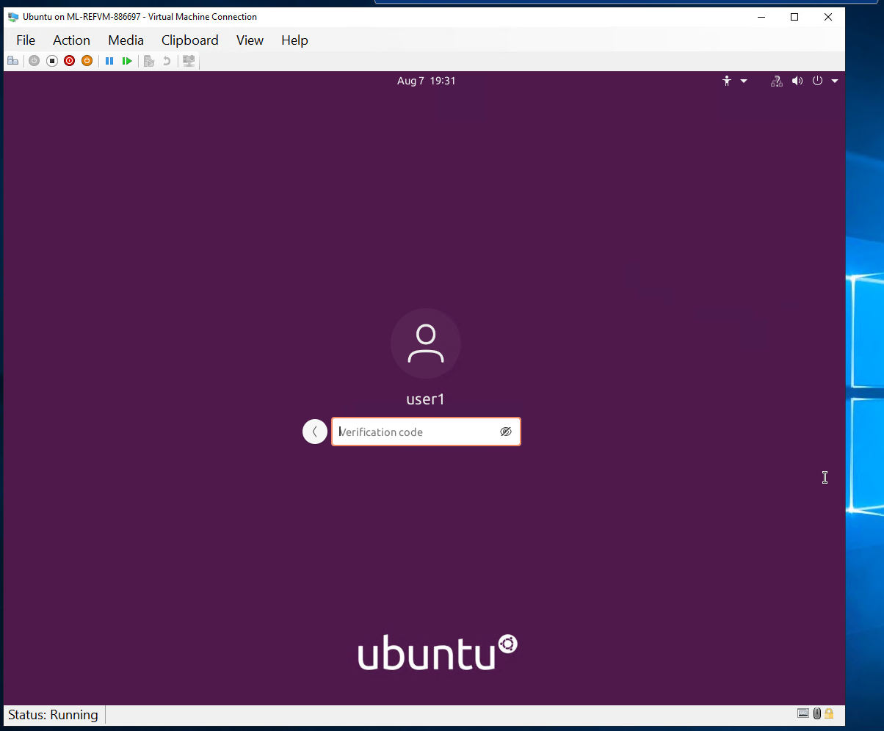
Installing Google authenticator Cont.
Once complete instead of the device log on only asking for a password it will ask for a second form from google authenticator.

Slide 14
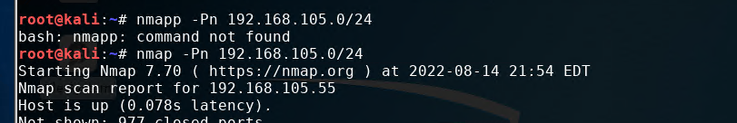
Vulnerability scanning Nmap
We can scan for certain types of vulnerabilities on our network in order to exploit or stop any potential threats.
We can see any threats on the same network if the 2 devices are communicating, to verify we can use the Nmap –Pn followed by the Ip address.

Slide 15
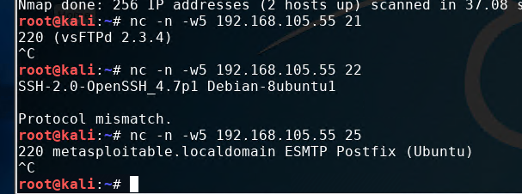
Vulnerability scanning NetCat
NetCat can be used to fins FTP, SSH, and SMTP applications that are discovered in an NMAP scan (called banner grabbing).
nc is net cat command
nc -n -w5 (Ip address) (specified port number) this command will grap the specific banner you are looking for.

Slide 16
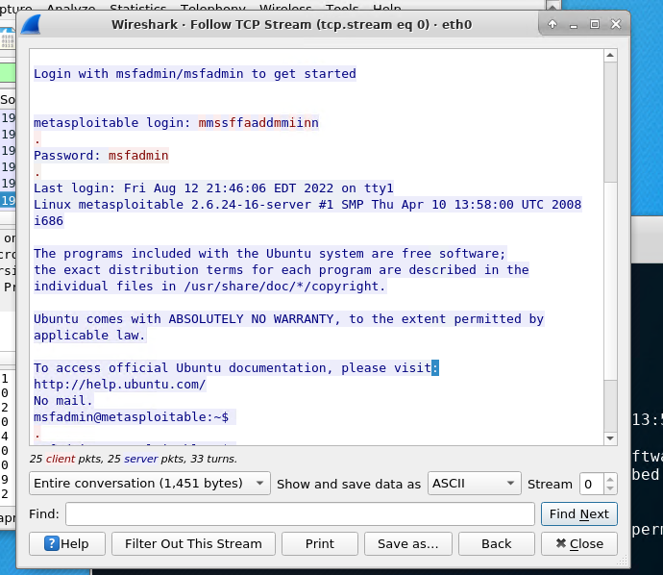
Vulnerability scanning Wireshark
Wireshark is a packet sniffing tool to help scan or analyze network traffic.
Open wireshark and login in order to start the program.
Using eth0 in wireshark followed by Ip and select the filter to display IP packets.
Using telnet command followed by desired IP address to link 2 devices to scan. (must know login and Password).
Telnet gives you access to another device from your home device.

Slide 17
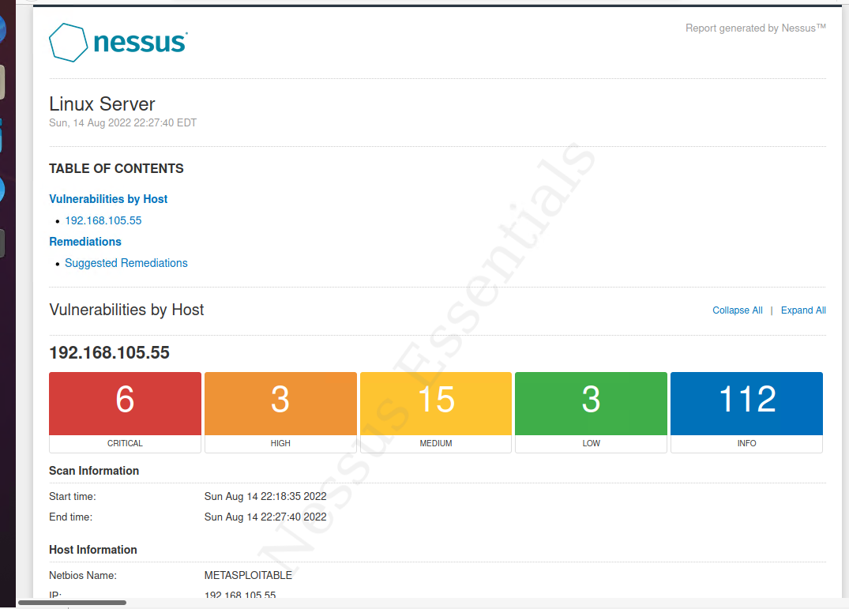
Vulnerability scanning Nessus
Nessus Essentials is a free vulnerability scanner any one can access.
Nessus scans your device for different vulnerabilities.
It will give you different reports and the urgencies of each potential security threat.
Utilizing your own IP address and selecting the desired report you can get a security report.

Slide 18
In conclusion
We have a lot of potential threats or attacks in this world, but we also have a lot of ways to protect ourselves.
We can have firewalls, strong passwords, MFA, Encryption, blocking incoming traffic and much more.
Security is everyone's job in order to protect themselves and the network.
Having a good security policy or just keeping your personal security up to date will keep you and your information safe.

