Slide 1

Linux basics
By
Jason Nguyen-Duran

Slide 2

Navigate Linux filesystem
pwd and cd ~ are the commands you utilize in order to check what path and directory you are in. These commands are used everyday multiple times a day.
A relative path and a absolute path. A absolute path starts with a / as a relative path doesn’t start with a special character. Also, an absolute path is a full path from the root location as a relative path is only specific to the current directory.
Creating and using directories in Linux are very crucial because that is how you get around and save files to certain areas. Just like in windows you have folders.

Slide 3
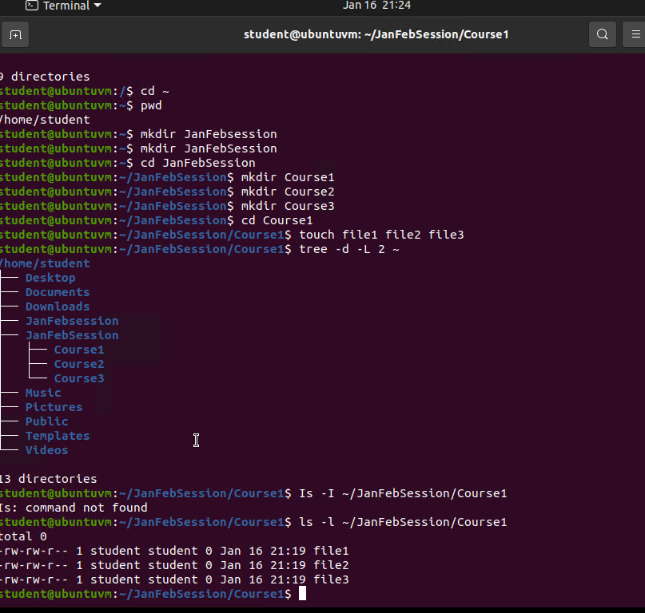
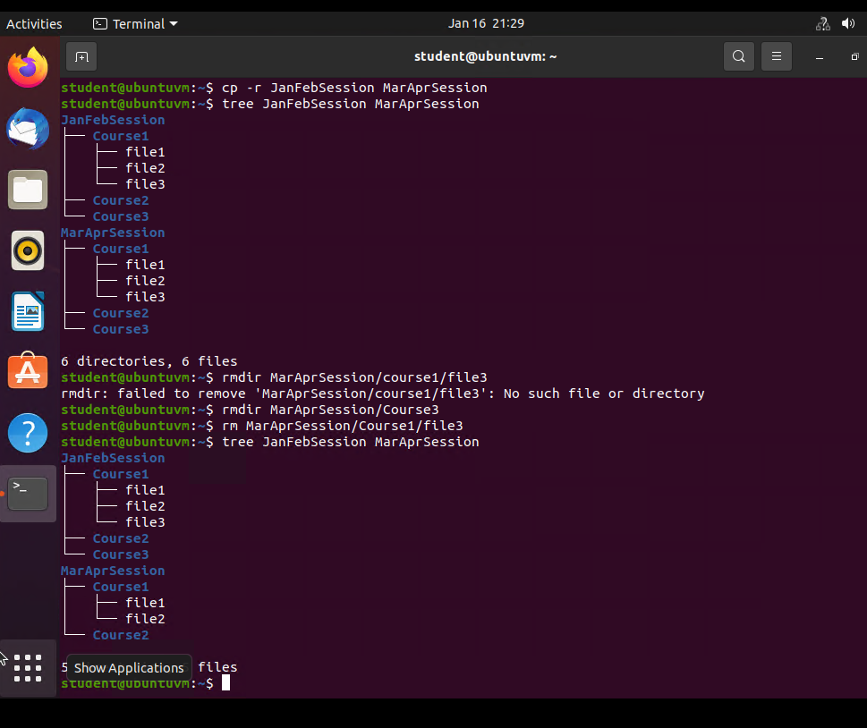
Create/ remove directories and files
mkdir command will create a new directory. Use the cd command to go into that directory( followed by name).Add on subs using the mkdir command inside of the desired directory/ file (picture 1)
Use the rmdir command to delete or remove and files or directories. You can remove specific files or an entire directory with this command.
(pic. 2)

Slide 4
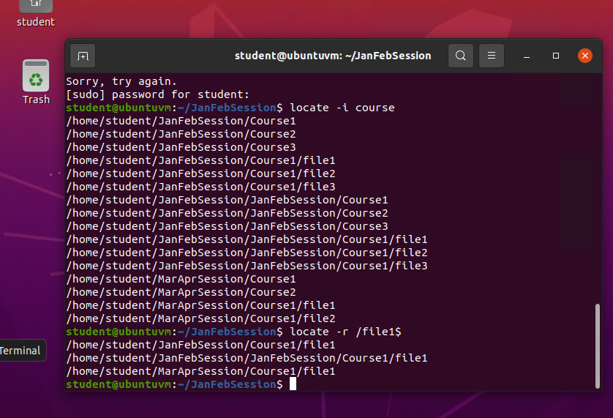
Locate directories and files
Locating files or directories using the locate –I or locate –r command. This is a good way to find files that you don’t remember the full name to or to see what has the same names.

Slide 5
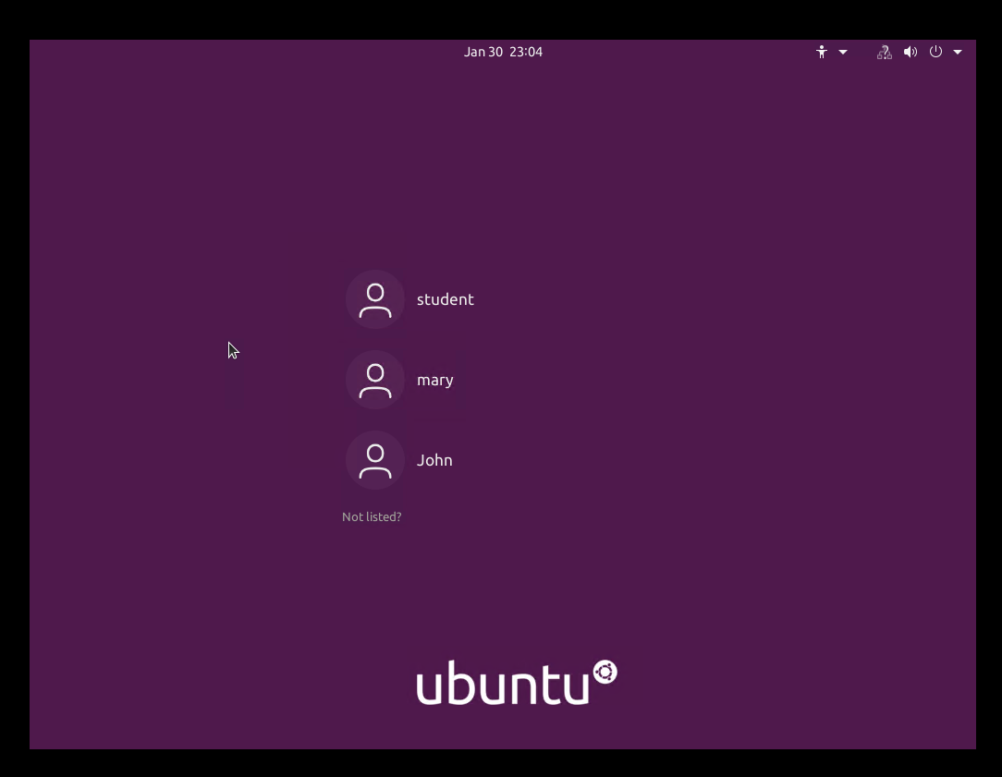
Adding users and groups.
Having multiple users in a workplace can be very helpful. Having multiple users means you can have multiple people work on different task for the same project. Using the sude useradd command is a way to create a new user if you have the right permissions. You can also set groups by using the sudo groupadd command. For each user you can set a password using the sudo passwd command.

Slide 6
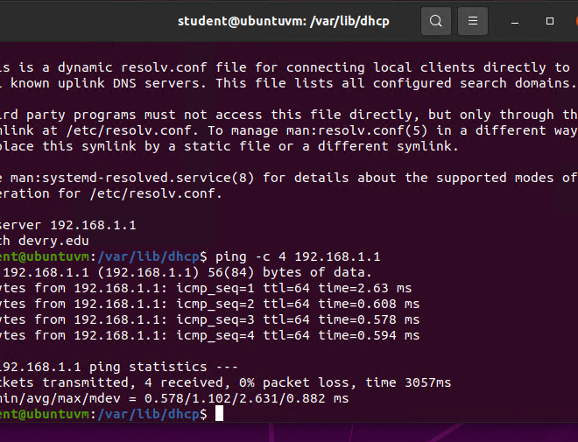
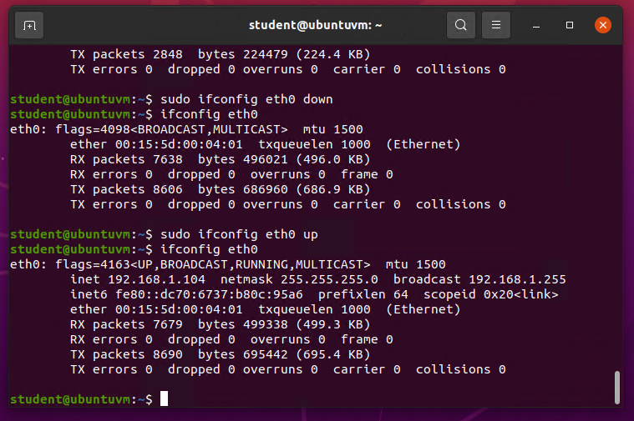
Discover host IP configurations
Utilize the ip addr command to display IP addresses, the Ip route to identify the default gateway. Use the ping –c command to check for network connectivity. Use ip link command to display network interfaces
These commands are good to check what network you are on and how the network is running.

Slide 7
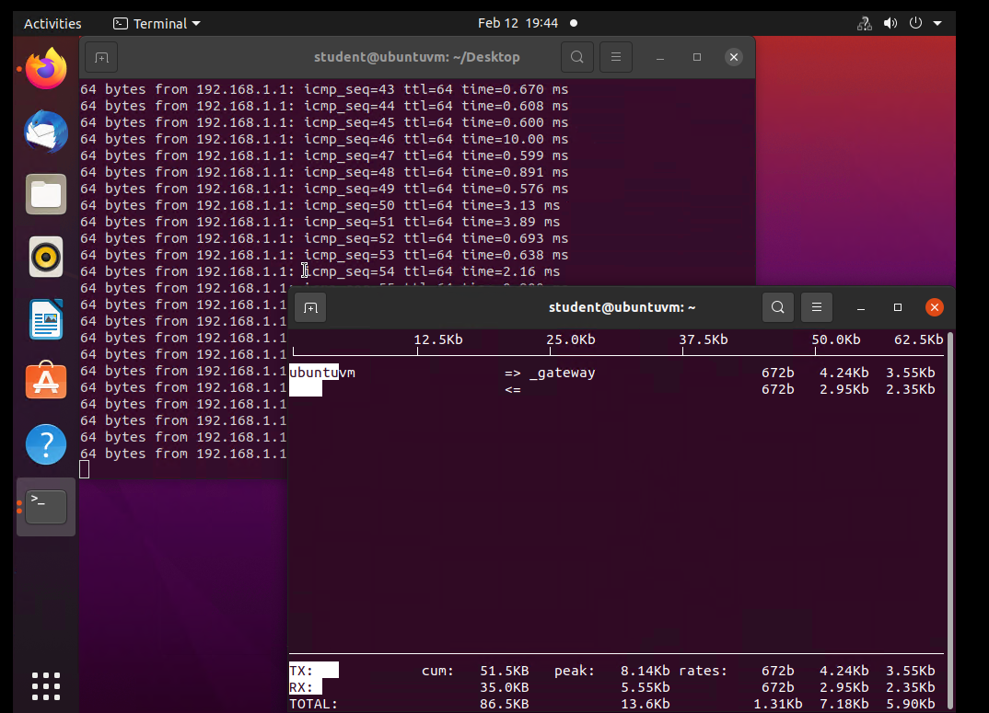
Performance monitoring
Use the htop command to launch the program that monitors process. You can monitor any app or program within the system in real time by searching for the program. To quickly kill a program, use the 15 SIGTERM command. To monitor accounts and users use the ac command. With this command you can view a daily history (-d) of the user. The lastcomm command will display the last executed command for the user. You can use lastcomm to see a list or go further to see how many times a certain command has been executed. This is a good way to see what all of your users and programs are doing from time to time. This is an example of what a basic monitoring page will look like.

Slide 8
In Conclusion
These are very small examples and pictures of what I have learned in this course. I am confident that I can navigate, troubleshoot, and work in a Linux environment. Even if you can’t remember all of the commands and what they do you can always use compgen commands to list certain commands.

