Slide 1
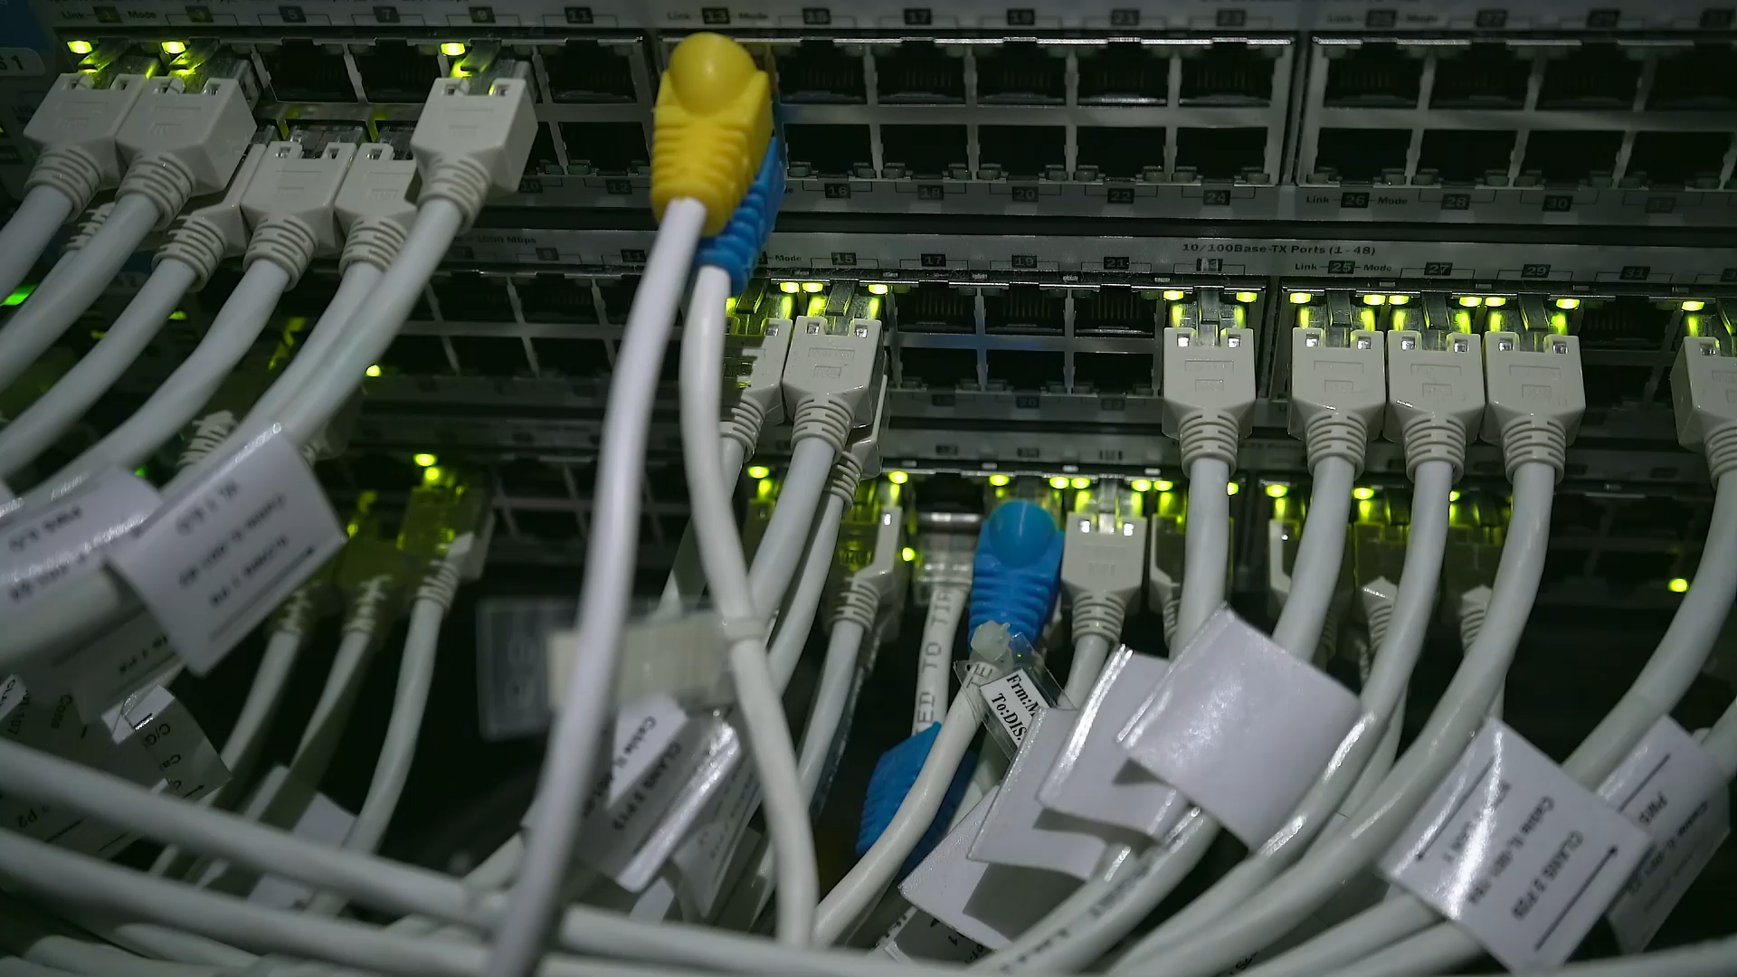
Fundamentals of Networking Technologies
By
Jason Nguyen-Duran

Slide 2

Introduction
Networking in the aspect of technology is the foreground in a developing world. Networking to the root is keeping the IoT interconnected. Not only the hardware but the software as well, in Networking doesn’t just keep our technology connected but it keeps us as humans connected with the rest of the world.

Slide 3
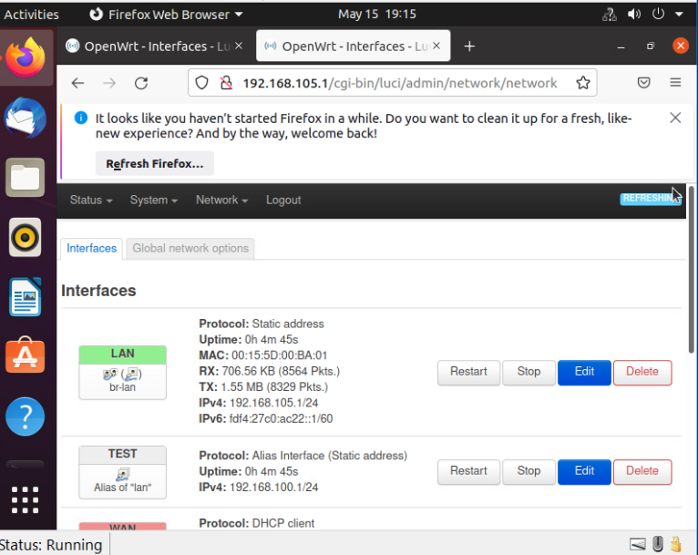
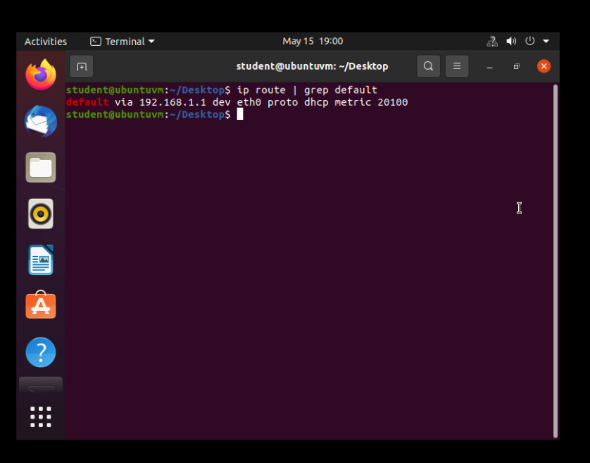
Getting started.
To even get started you need to find out if you are connected to the internet and to what equipment or “gateway’s” you are using. You can do this by opening an in terminal window and using several different commands. For example, “ip route | grep default” this will show you your default gateway IP address.
Typing your IP address into a search bar will pull up a number of useful information that can help you manage your services.

Slide 4
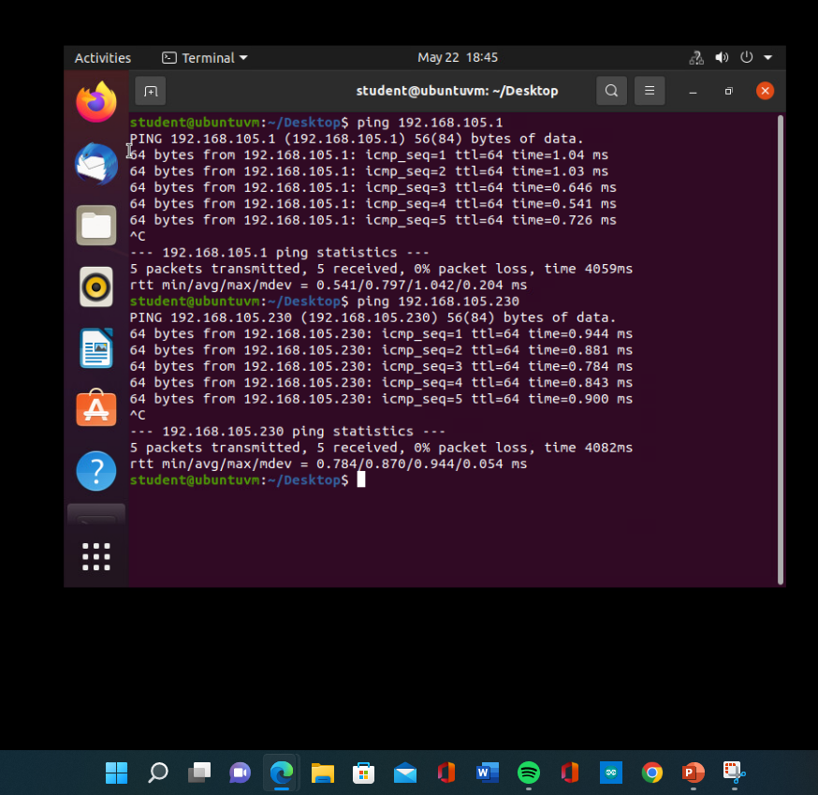
Connectivity test
Once you have your default gateway and everything that is in your topology you can check the connectivity from your device to each of those devices. This is a great way to make sure everything is communicating and communicating properly. All you need is the IP address of the hardware and you can run a ping test using the “ping command followed by the IP address”.

Slide 5
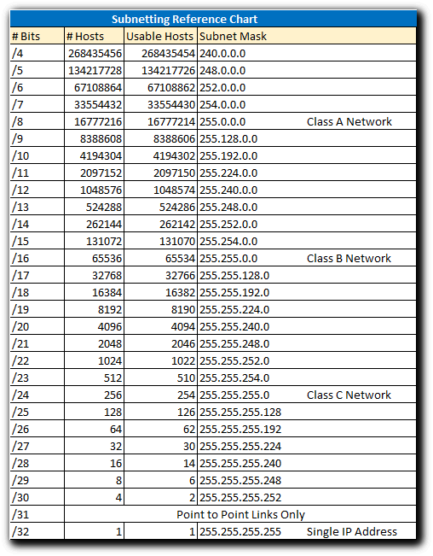
Make it more efficient
If you are on a company or big network, an easy way to make your communication easier and more efficient you can create a subnet within your network. This can section off communication and give a direct path for information within a subcategories in your network.
All you need to know is your IP address and Network mask. This will tell you how many bits and or bytes are being used and how many are available. From there you can divide the remaining bits to divide into the number of subnets you desire.
Picture 1:A quick reference chart to subnetting and subnet masks ~ Bauer-Power Media

Slide 6
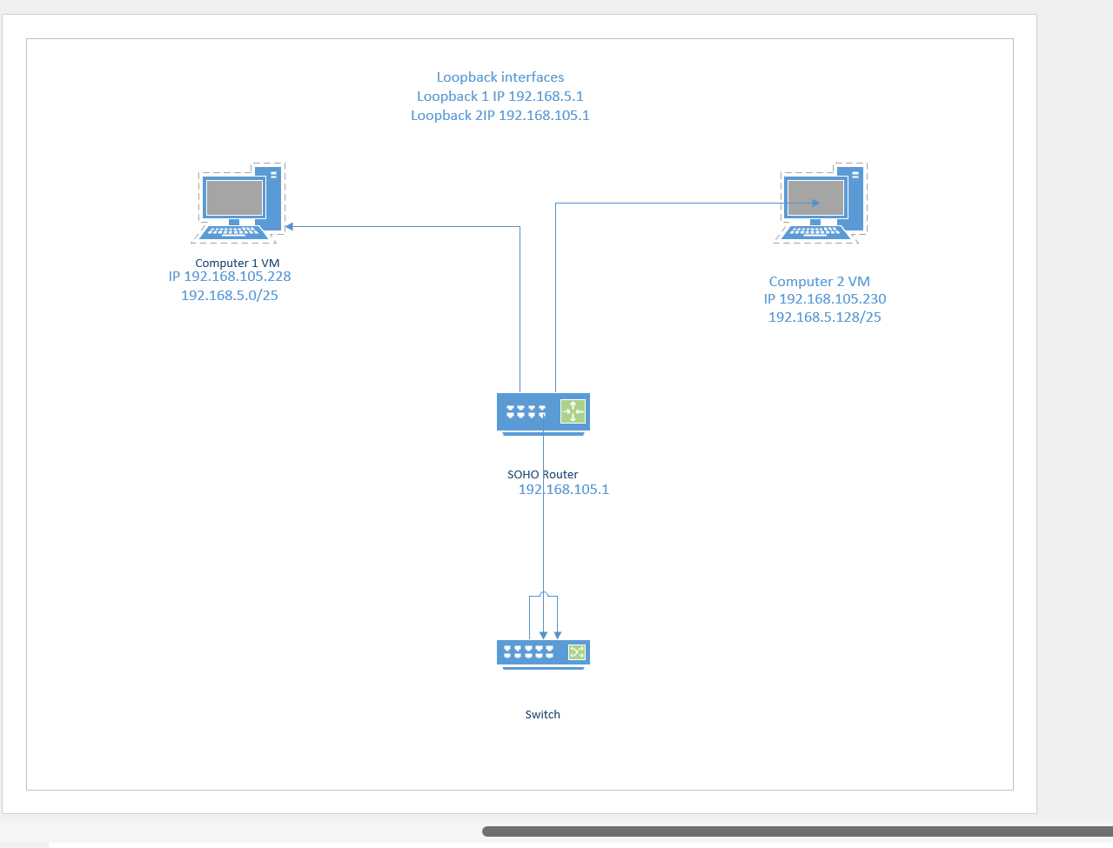
Keep it organized!
Once your network is all put together it is time to create a Network diagram. This diagram will help you keep the Network organized and easier to troubleshoot. Troubleshooting is made easier for the software and for the wiring of the hardware.
For example, this is a simply diagram I made with 2 virtual machines, 1 router, and switch.
This diagram I created is made utilizing Microsoft Visio.

Slide 7

Security
Now that we have a Networking, and it is running properly it is time to think about security. Security will keep everything within your network as safe as possible from the outside world.
Simple steps such as changing the default information on your routers and equipment is one of the best steps you can take.
Adding small adjustments such as MAC filtering, and a Dynamic IP address can help tremendously.

Slide 8

Challenges
Some of the hardest challenges I faced were learning how IP address and subnets worked because before this course I had no idea what a bit and byte were. Once you understand how bits and bytes work is is just simple math to help with networking.
I also struggled with remembering the different vocabulary, It is almost like learning a new language. The best advice I could recommend is to take notes and provide examples such as pictures.

Slide 9
Conclusion
Building a Network start to finish, virtual or physical, is not an easy task. Understanding the fundamentals is the best way to work, build, troubleshoot and fix any network. It is very important to consider all aspects and parts of the network in order to stay organized, running and secure. After this course I am no professional, but I know I can begin my career in the Networking field.

