Slide 1

ECT315
IoT Factory environment monitoring system Using TinkerCad, MATLAB and ThingSpeak
Student Name: Jason Nguyen-Duran
Session: May 2023

Slide 2
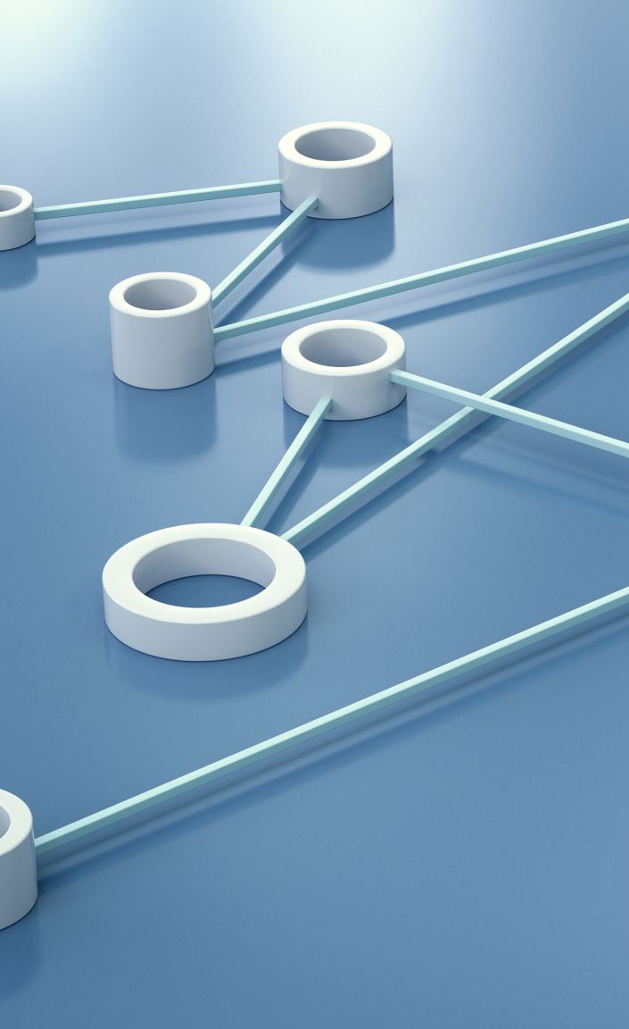
Introduction
Utilizing Tinkercad, ThingSpeak and MatLab I am going to be designing and implementing factory access control and environment monitoring systems in a cloud environment.
These sensors will be able to send status updates alerts and warning messages.

Slide 3

Setting Up ThingSpeak Environment
Before starting any major project it is essential to plan and have a ood set up.
Setting up the ThingSpeak environment will allow us to have a main dashboard to monitor all of our sensors and applications

Slide 4
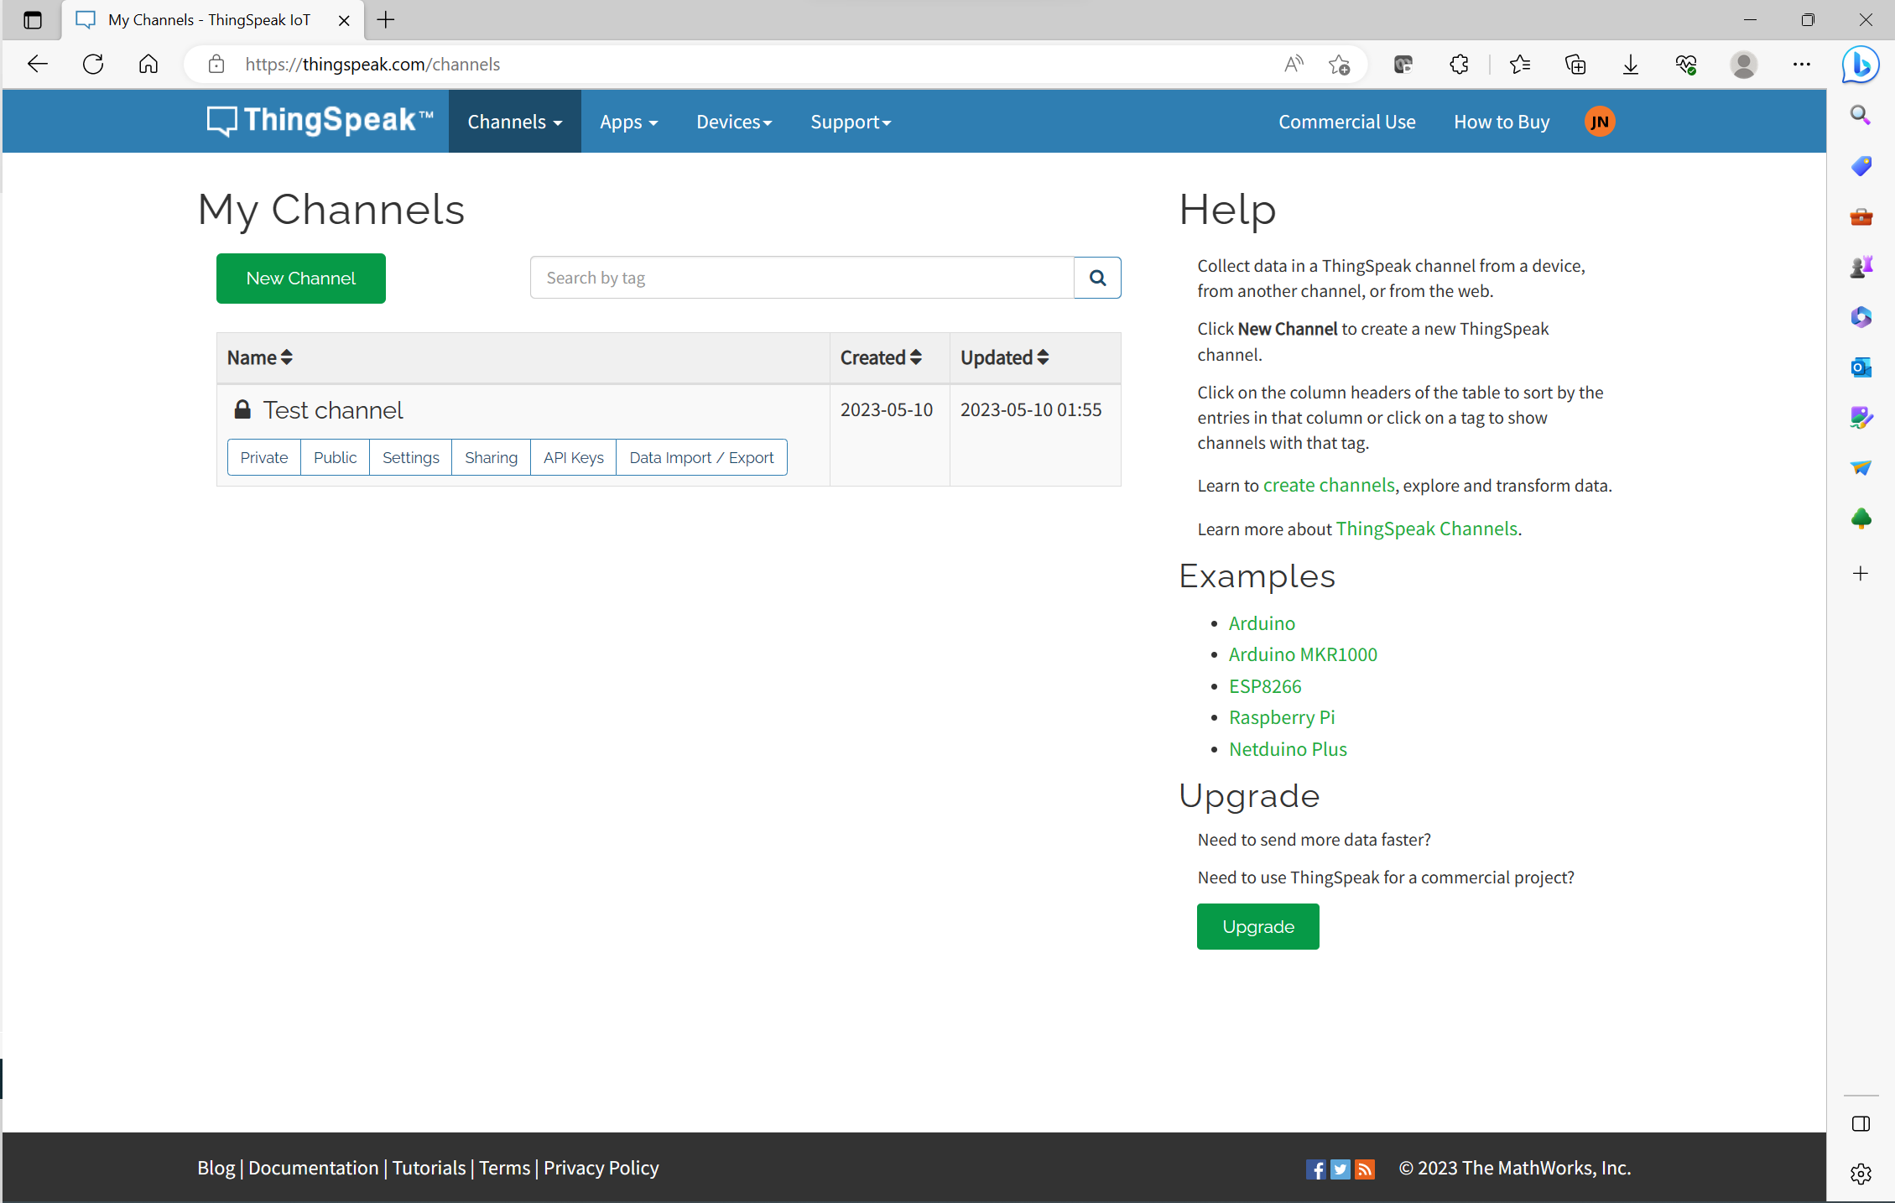
Thingspeak Cont.
In this screenshot we can see the dashboard and this area is where we are going to see all of our different channels to monitor and check for alerts.

Slide 5
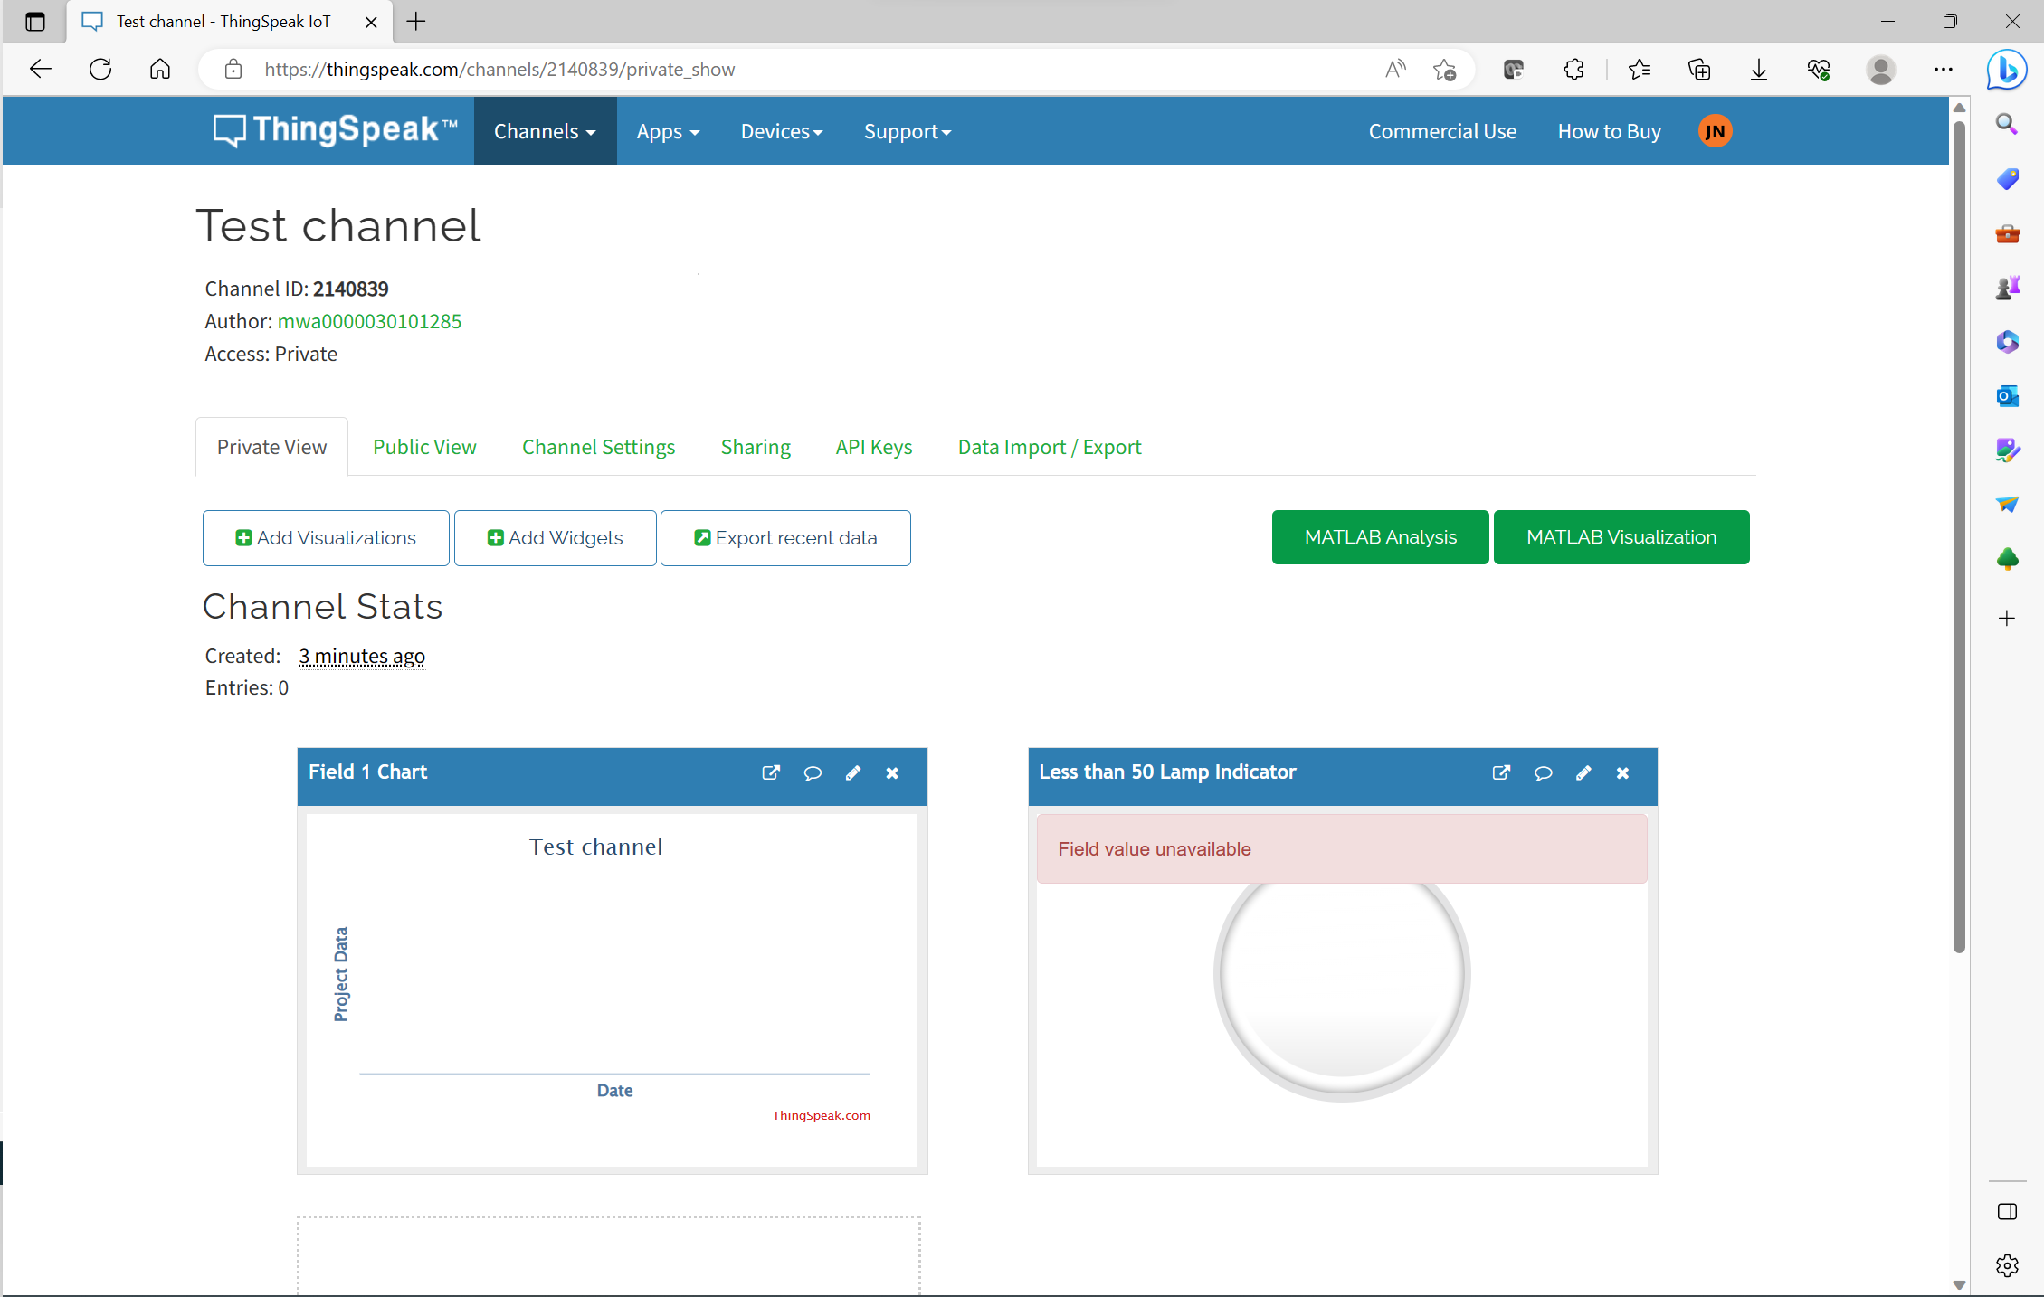
Widegts and test channels in Thingspeak
Before we move into any project we want to make sure our set up works.
We can have many different widgets to check for alerts and monitor our sensors.
Testing our different channels for functionality is a key component before we deploy an actual system.

Slide 6
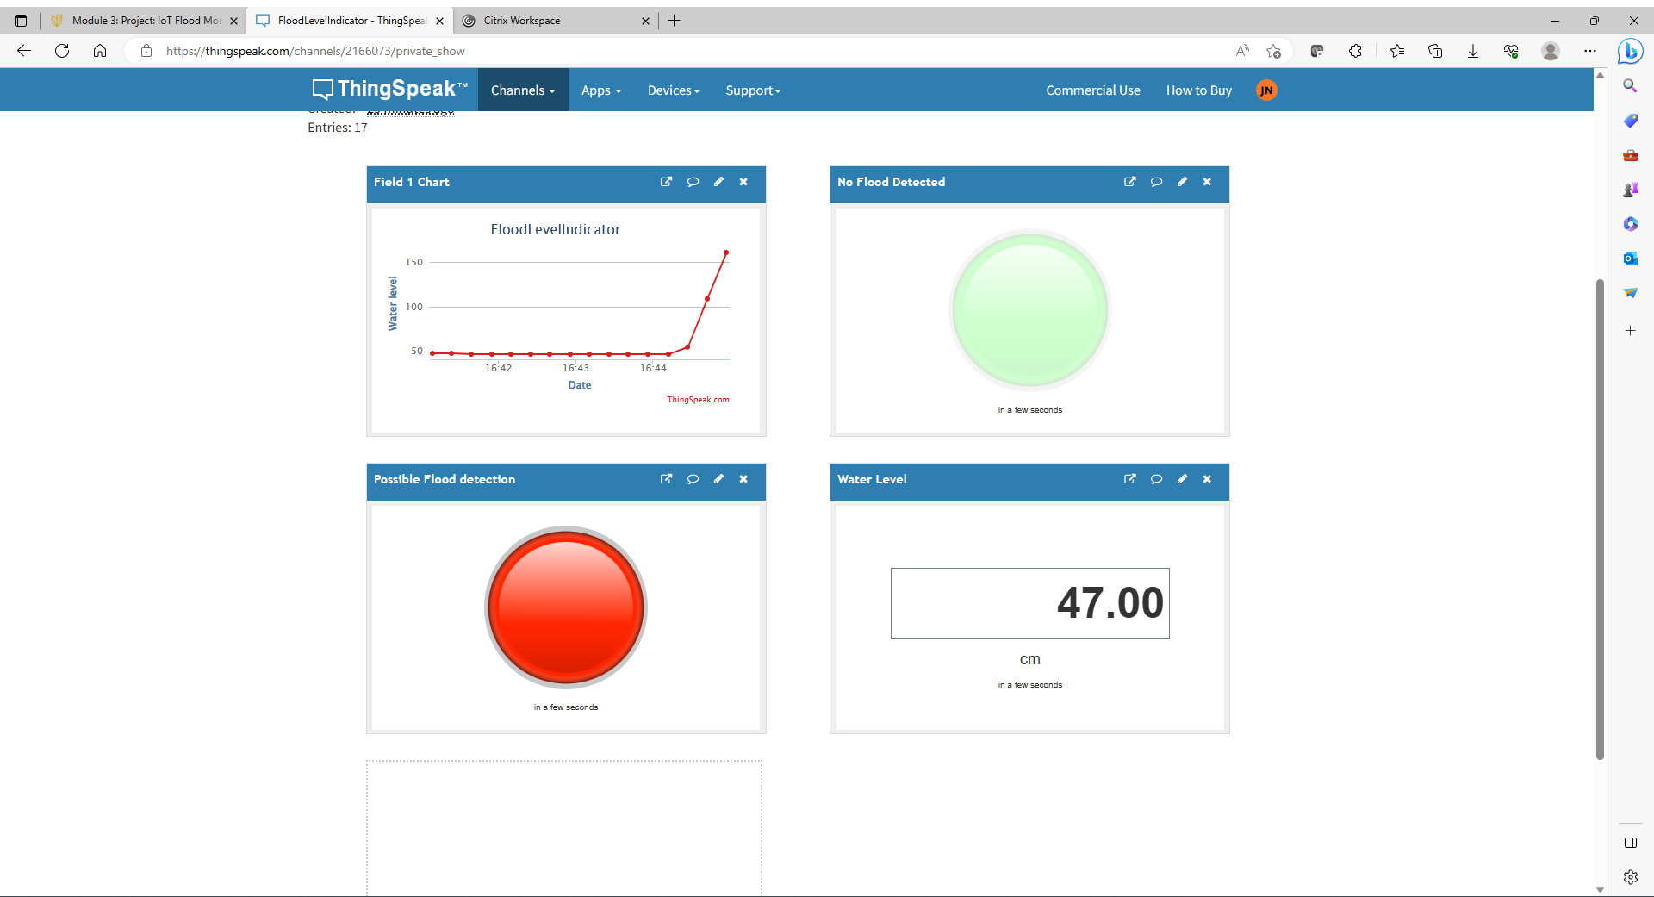
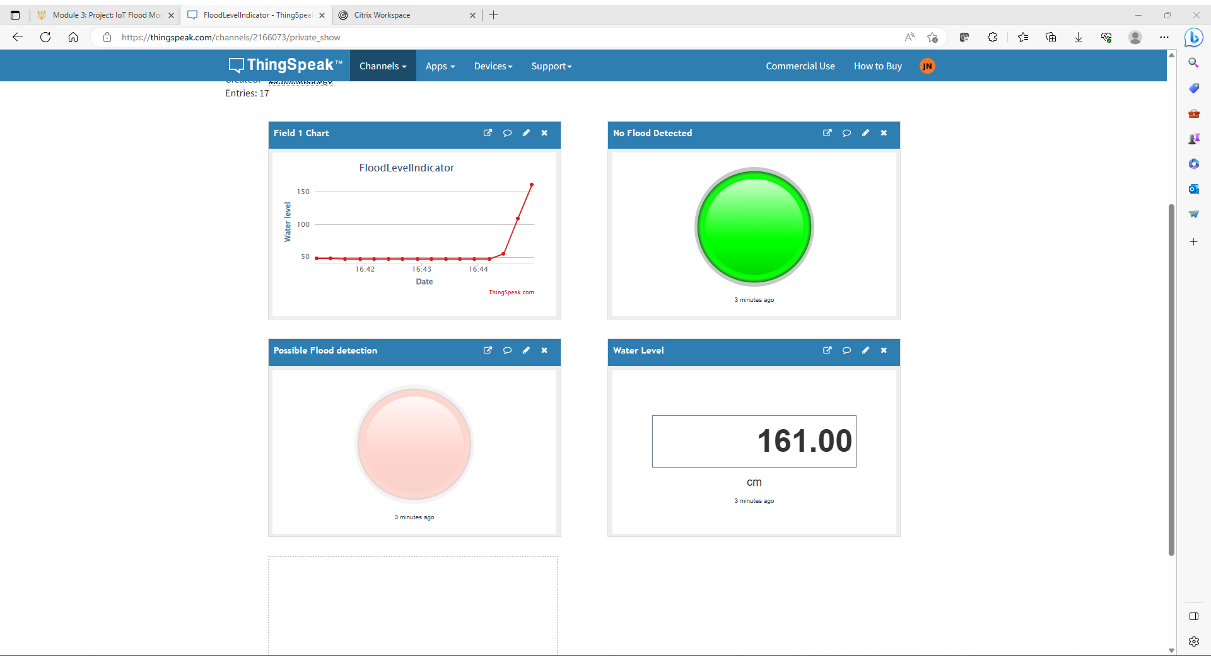
IOT Flood Monitoring Systems
After we set up our channel we are ready to deploy our system.
Utilizing different sensors and widgets we can see how the flood monitoring system works in real life.
The green widet is lit up when the water levels are “Good”, and the Red light is lit up when the water levels are to high.

Slide 7
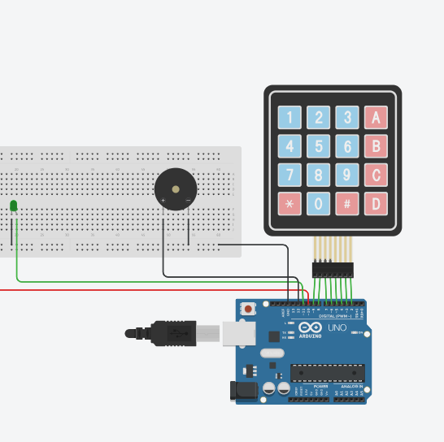
Factory Access Control System Using Keypad
Utilizing Tinkercad we can design a system with a sensor and keypad to simulate a real world monitoring system.

Slide 8
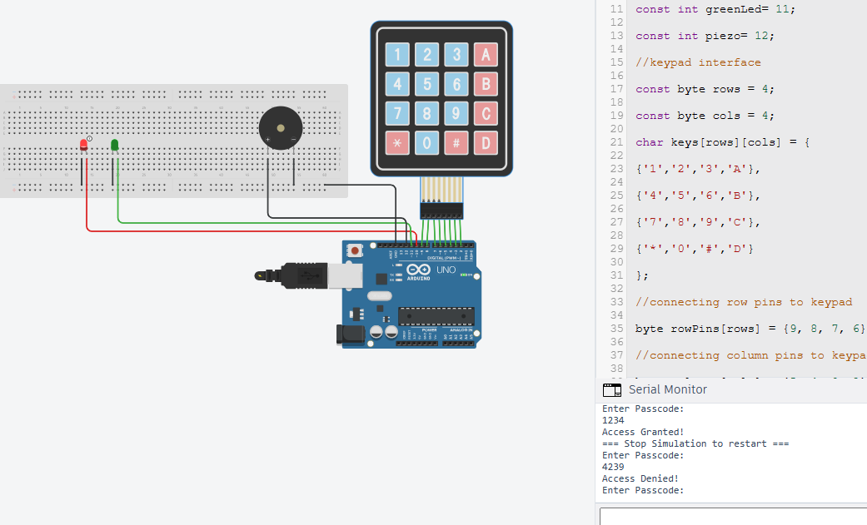
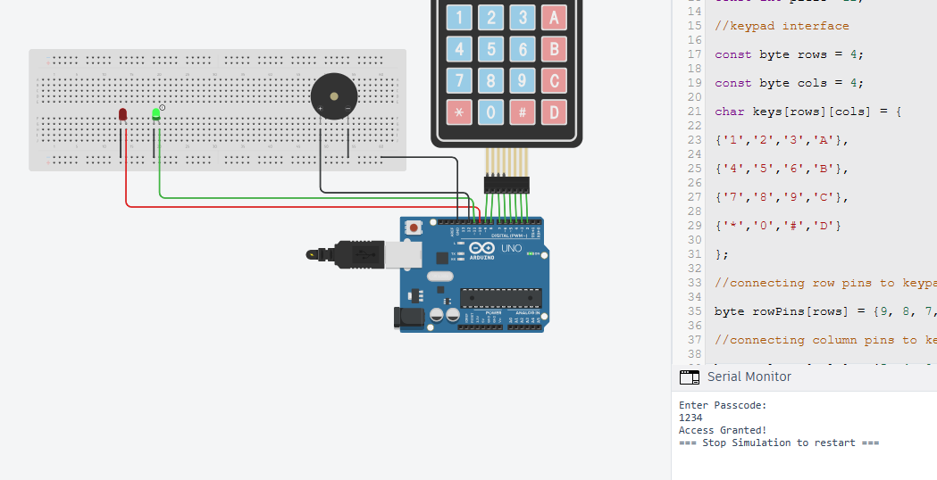
Factory Access Control System Using Keypad
Being able to design different systems in tinkercad we can simulate real world applications.
Being able to design and add different components we are simulating different needs in the real world.
The sensors simulated in tinkercadcan show real time data of a working system

Slide 9
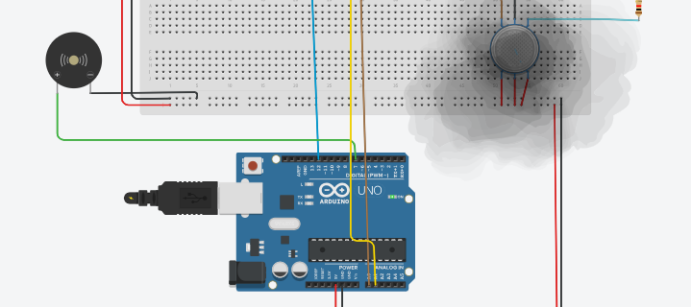
Finished circuit with live applications.
In this screenshot we can see a circuit in tinkercad with a smoke detector
The smoke around the sensor simulates different levels of smoke around the sensor.
The smoke in this screenshot would alert the user that there is smoke in the system and something is wrong.

Slide 10
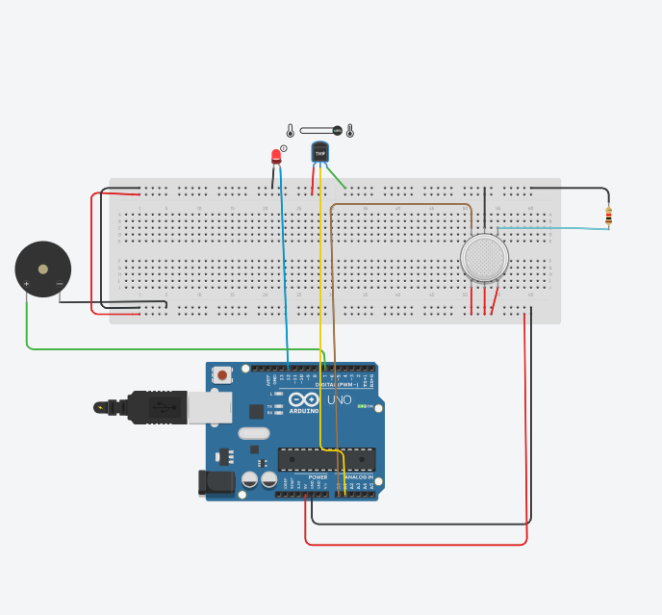
LED’s on sensor system
We can see the redlight LED is on meaning the temperature is to high and is alerting the system.
The actual circuit has a red LED but on our monitoring system we will see a red widget indicating the system is to hot.

Slide 11
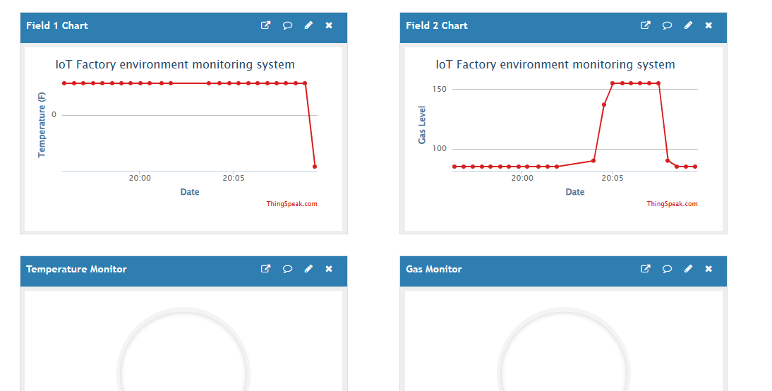
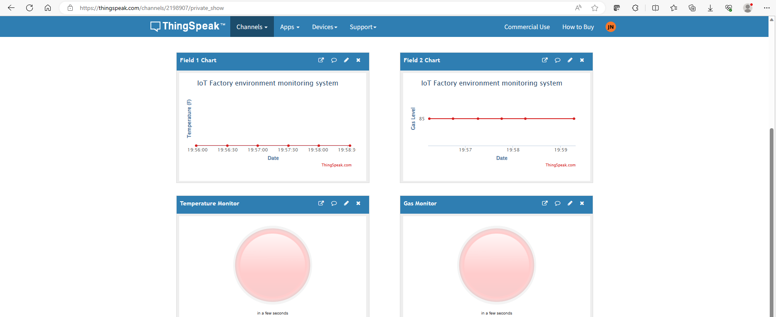
Thing Speak Dashboard/ Remote monitoring service.
- In these 2 screenshots we can see the red lights are on and the different graphs showing temperature and smoke levels
- The red widgets are on indicating something is wrong in the actual circuit we would see the Red LED is on.

Slide 12
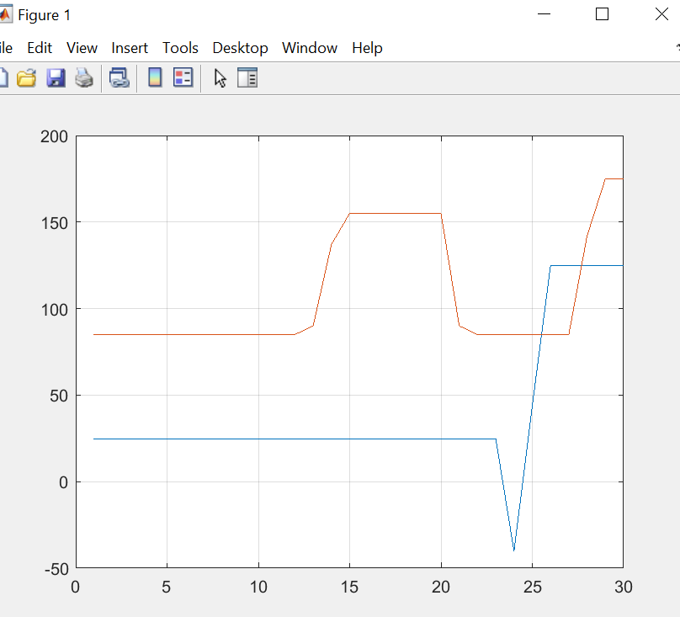
Graphical Data
The graph shows past and historical data which can help with making adjustment to the system as needed
Having different graphs and historical data is crucial in any real world application.

Slide 13
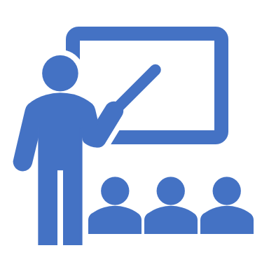
Career Skills Developed
Being in a simulated environment I have learned that planning is a key role when trying to deploy any type of system.
Utilizing TinkerCad ThingSpeak and other online applications I can design, test, and monitor different systems.
Testing and designing different sensors and systems has taught me that having historical and live data are important to keep any system running properly.

Slide 14

Challenges.
Working to design a IoT monitoring system has many different challenges such as planning, execution, and deployment.
If there is no proper planning when you go to deploy the system it can be hard to make sure the system is working properly.
These challenges taught me that having key attention to detail are crucial and to test as you go in order to make the best possible product.

Slide 15
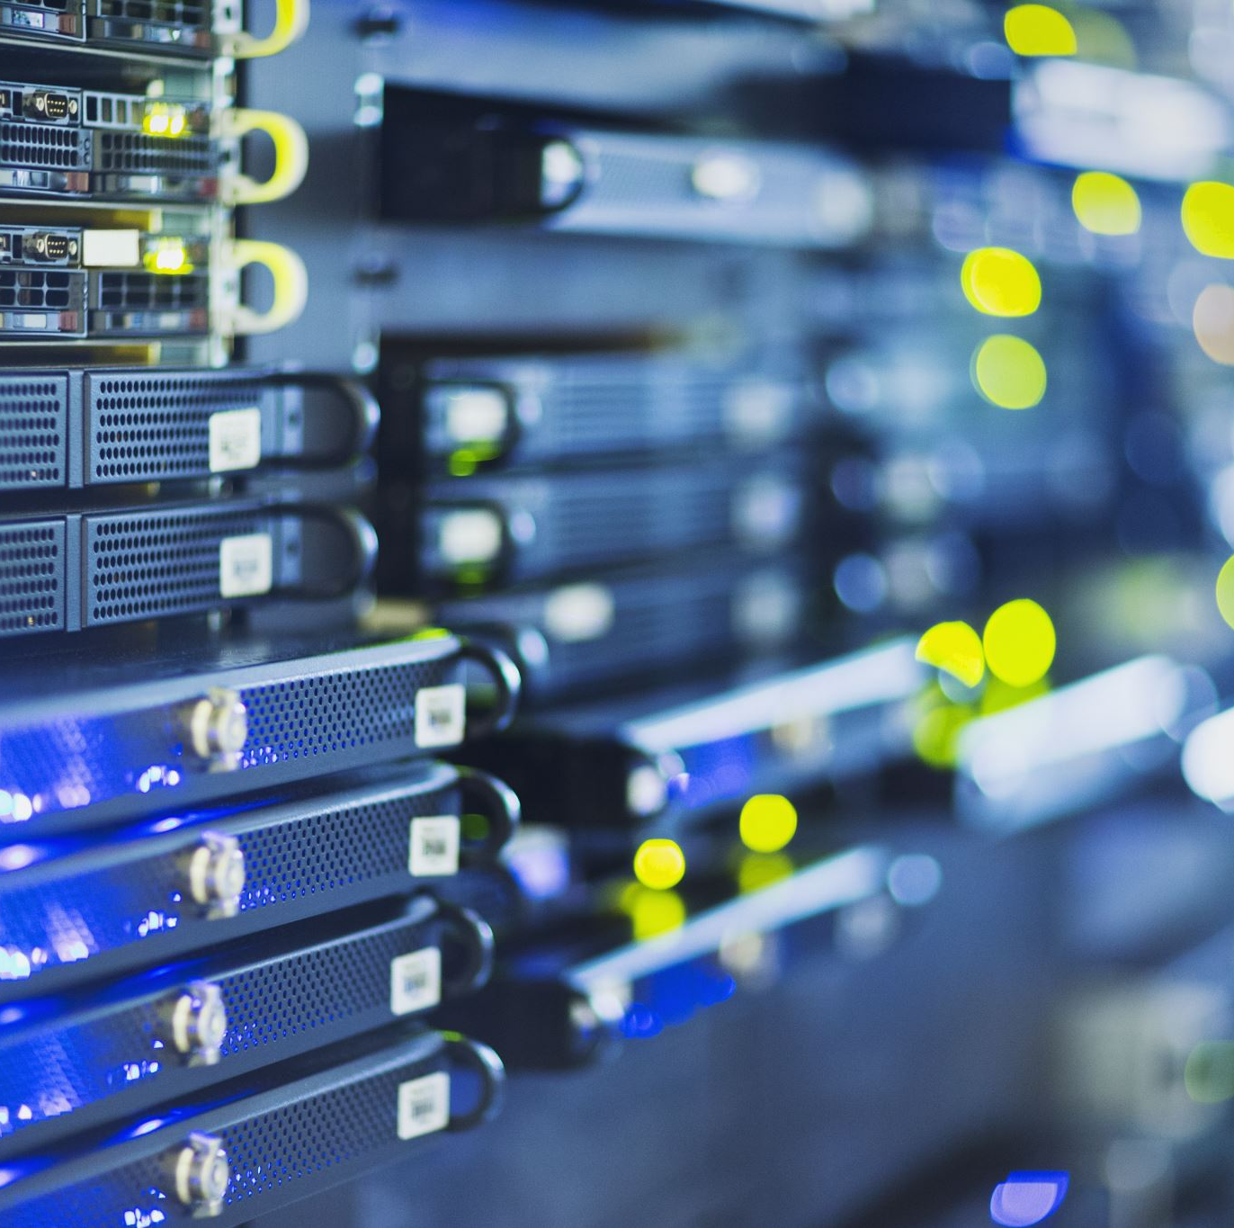
Conclusion
The IoT’s world is a vastly growing need in the real world. Being able to deploy systems from around the world and monitor these systems with ease is very important.
Utilizing different sensors and systems in a online world can help deploy the real world systems.
IoT with industrially applications are always going to be needed.
Industrial applications are crucial to keep manufacturing needs running.
The IoT allows users to monitor and keep systems running from a remote location.

