Slide 1
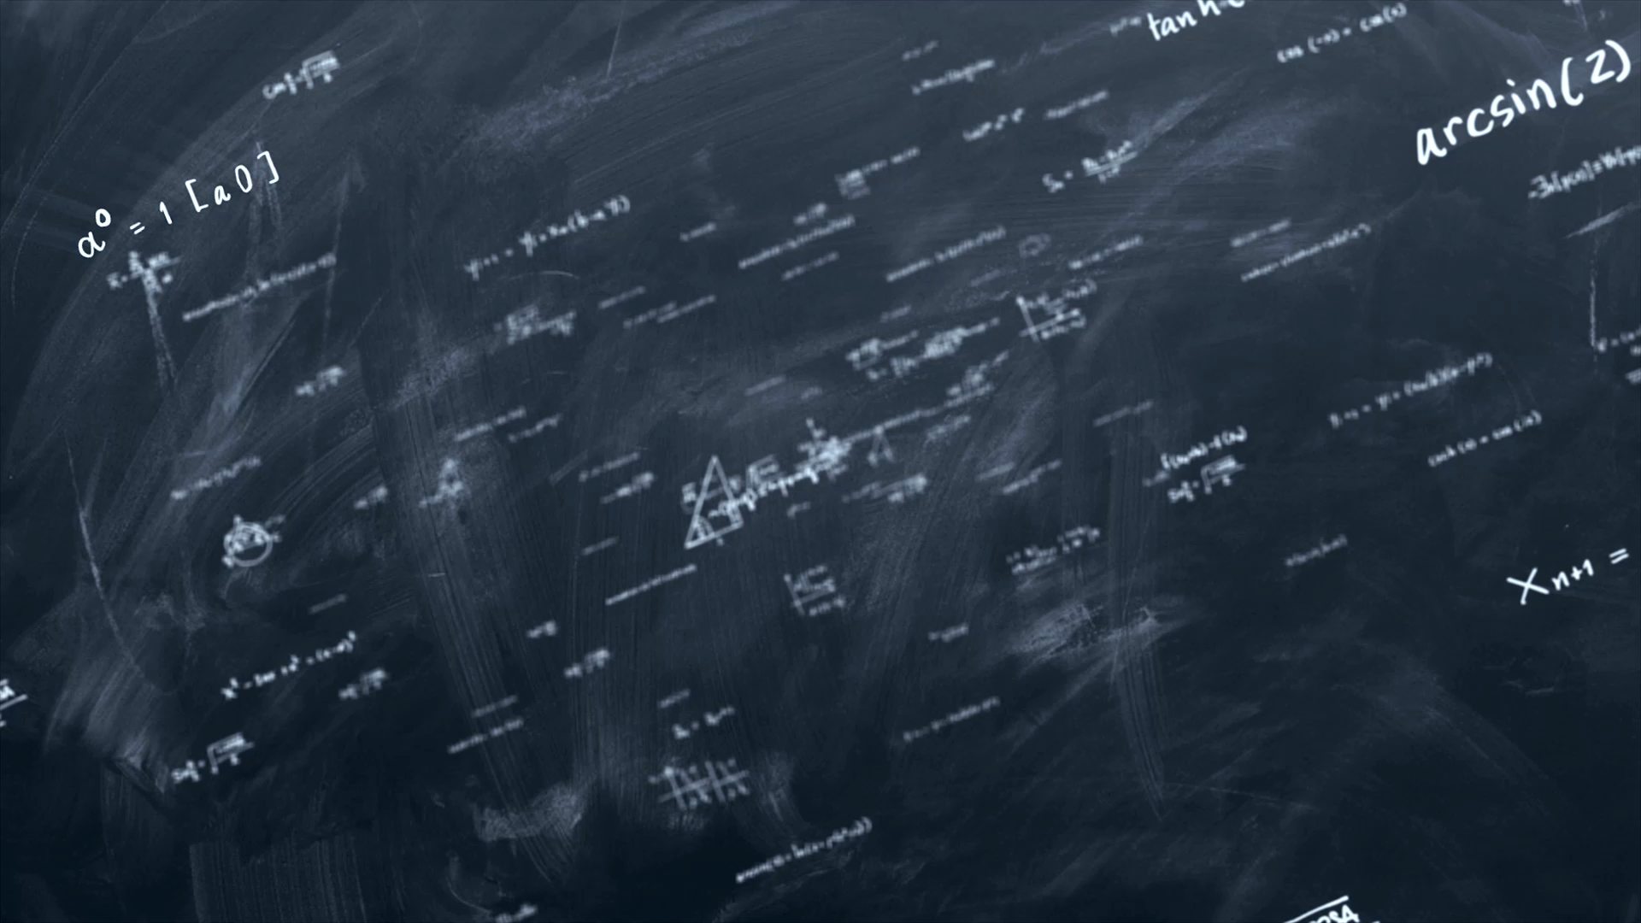
Applied Physics
By
Jason Nguyen-Duran

Slide 2
Introduction
Physics concepts including the fundamental laws of mechanics.
Topics include force and motion, energy and energy conversion, magnetism, and light.
Exploration of physics concepts is accomplished through practical application utilizing multiple components such as breadboards, Mega boards, ESP32 boards and so much more.

Slide 3
Project 1. inventory of parts.
It is a very essential to take inventory of parts before you start any project.
If you do not have something you can plan to get it if needed.
Prior planning is great for starting something in the right direction.

Slide 4
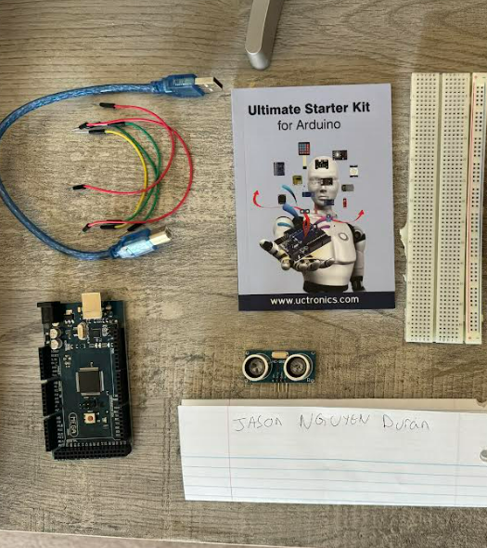
Project 1. inventory of parts. Cont.
Materials list: Arduino Mega 2560, Ultrasonic sensor HC-SR04, Male to Male Wires, Breadboard, USB cable to connect Arduino, Ruler or tape measurer ,Object to act as obstacle and/or undergo free-fall

Slide 5
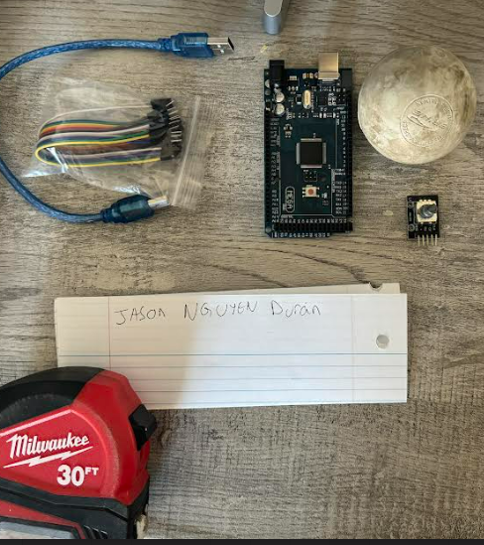
Project 1. inventory of parts. Cont.
Material list:
Arduino Mega 2560
Rotary Encoder Part KY-040
Male to Female Wires
USB cable to connect Arduino
Object to attach onto rotary encoder
Ruler or tape measurer

Slide 6
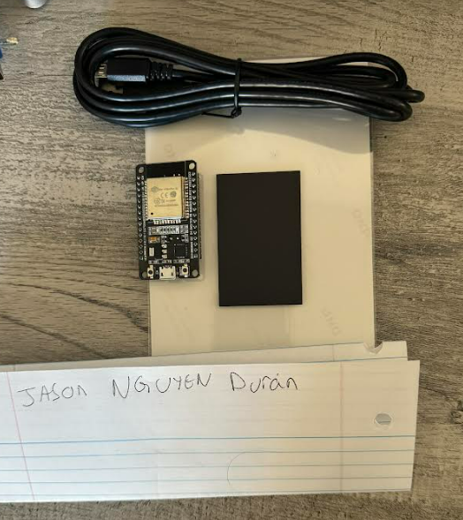
Project 1. inventory of parts. Cont
ESP32 microprocessor
Micro-USB cable
Magnet

Slide 7
Project 2: Precision of the ultrasonic sensor.
Using a Mega 2560 board, an ultrasonic sensor, wires, a breadboard, a ruler, and a large object. We are going to test to see how accurate our sensor is. We will be recording raw data in microseconds and cm to see how long it takes for the sensor to get a round-trip measurement.

Slide 8
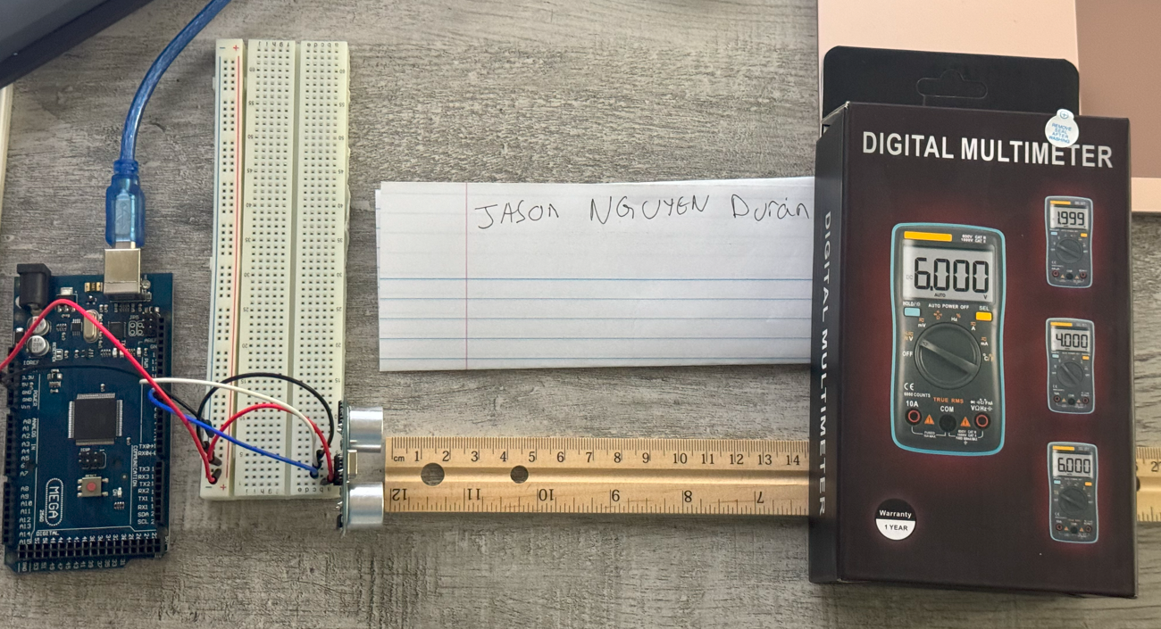
Project 2: Precision of the ultrasonic sensor.
Materials List:
Mega 2560 Board
Ultrasonic sensor HC-SR04
Male to Male Wires
Breadboard
Ruler or tape measurer
Large and flat object to act as obstacle

Slide 9
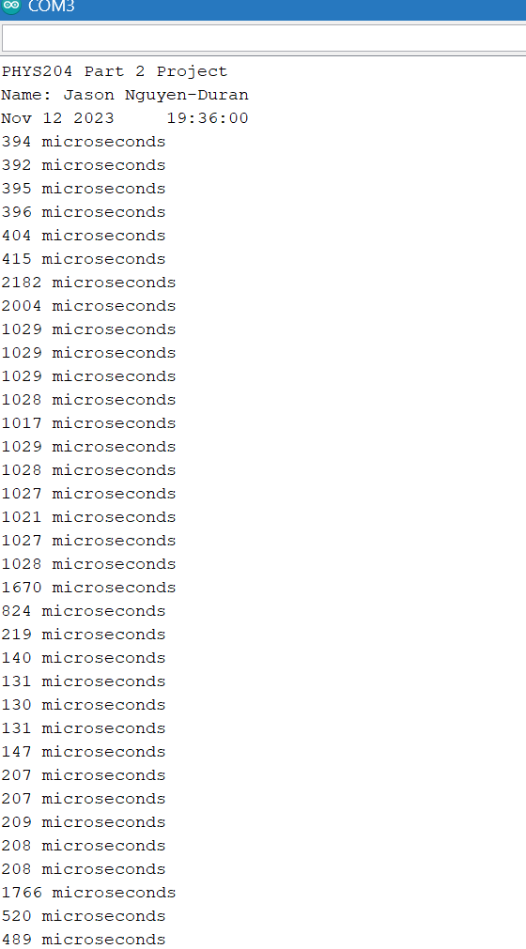
Project 2: Precision of the ultrasonic sensor.
Getting good raw data even if you have to do it multiple times will be worth it in the end. Having accurate raw data can make a project or experiment improve.

Slide 10
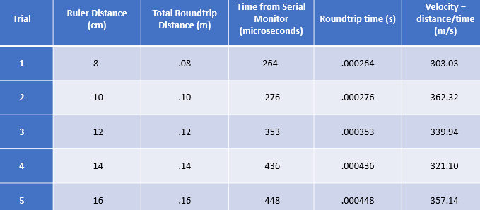
Project 2: Data collection
It is very important to have organization when you are collecting multiple sources of data. Using a table like this one is a good way to stay organized.

Slide 11
Project 2 Conclusion.
Discuss the results and comment on the source of errors.
Answer: After seeing the results, and looking at all the things I could have done differently, I feel like the results might have come out differently. Each time I moved my “object” it slid my ruler which could have affected my end results. That among a few small changes could give more accurate readings.
What is the dependence of temperature, humidity, and atmospheric pressure on the speed of sound? How does it affect the results?
Answer: Temperature, humidity, and pressure all effect sound because it affects the density of the air. Sound passes through hot air faster than it passes through cold

Slide 12
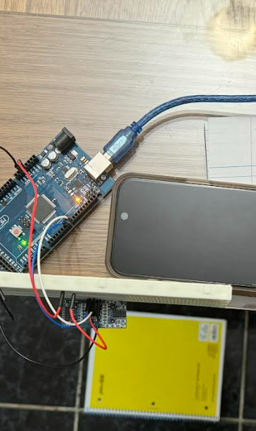
Project Part 3: Gravitational Acceleration of a Free-Falling object
Utilizing a flat object such as a notebook and an ultrasonic sensor we can find the acceleration of a free-falling object.
Project set Up:

Slide 13
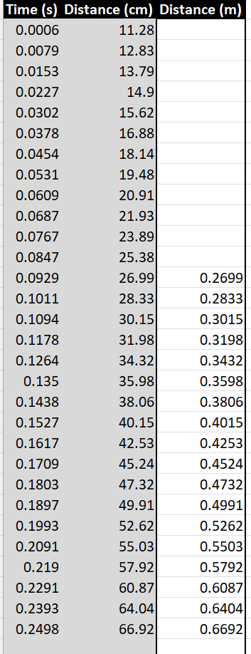
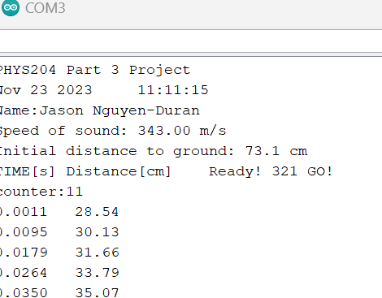
Part 3 Cont.
These pictures show the Serial Monitor data collection and excel table data organization.
After collecting raw data from the serial monitor it is imperative to organize the data into excel for further processing.

Slide 14
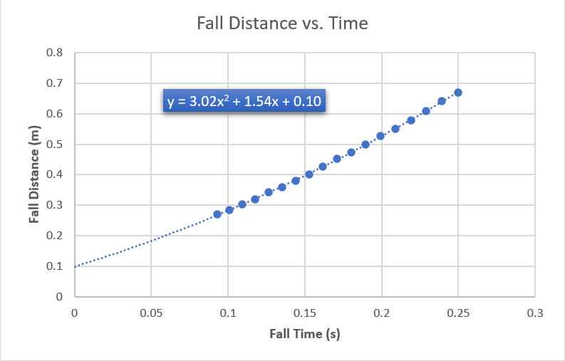
Part 3. Excel Graph

Slide 15
Part 3 Conclusion
Discuss the results and comment on the source of errors.
  Answer: The biggest error I seen was my own user error. Having to redo the experiment over and over to get good readings was all user error.
How much variation is there from trial to trial? What does this indicate about the uncertainty of the result?
  Answer: I had to do a lot of different trials to get good data. But I feel like the results I did put in are close enough together to be called accurate. I only had one outlier other than that everything was okay.

Slide 16
Project Part 4: Conservation of Energy of a Free-Falling Object
Going off of part 3 we are using the raw data and data we collected to find how energy is effected in a free falling object

Slide 17
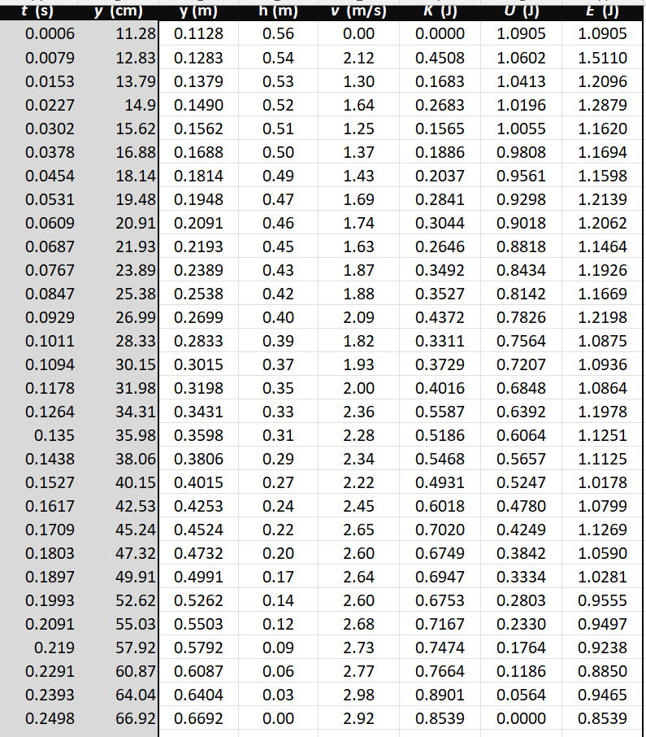
Part 4: Data collection

Slide 18
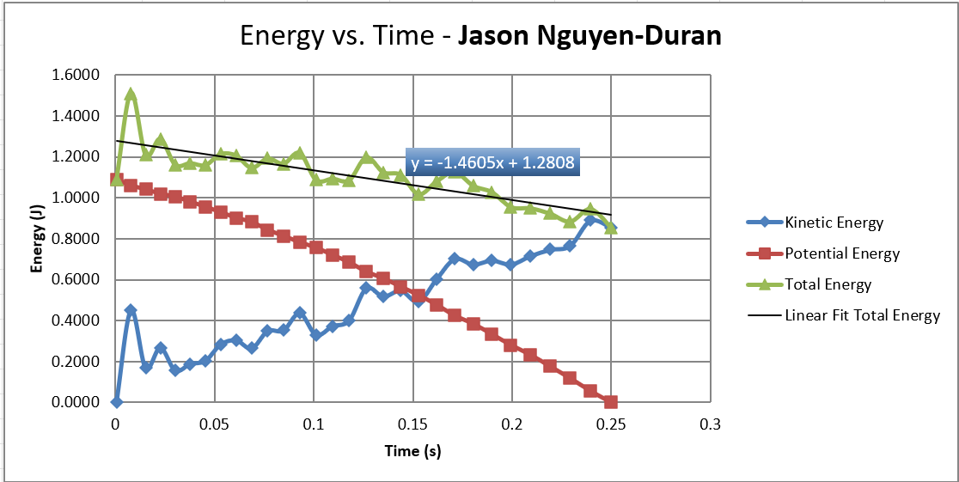
Part 4 energy graph

Slide 19
Part r Conclusion
Discuss the key characteristics of the plot. Consider the points when potential energy U is maximum, U is minimum, kinetic energy K is maximum, K is minimum and when U and K are the same value. What is the significance of these points?
  Answer: Potential and kinetic energy will always be opposite. As Potential is high and will be low as the object moves these 2 will start to swap in an X pattern. As time goes on and the object is falling the total energy will always decrease.

Slide 20
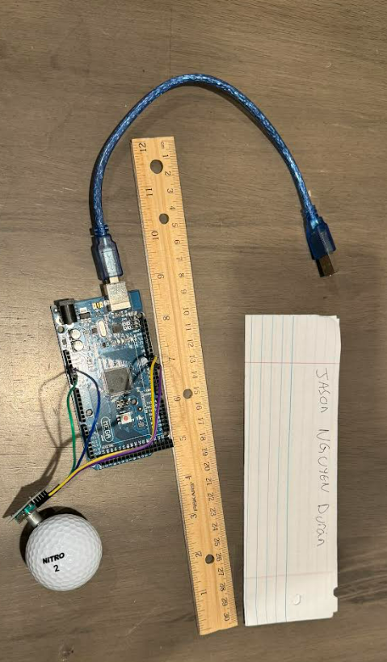
Project part 5: Relationship between Linear and rotational motion
Utilint a rotart encoder and a gold ball we can see how many “rotations” are in a certain distance. This can allow us to measure things that are not flat.
Set up photo:

Slide 21
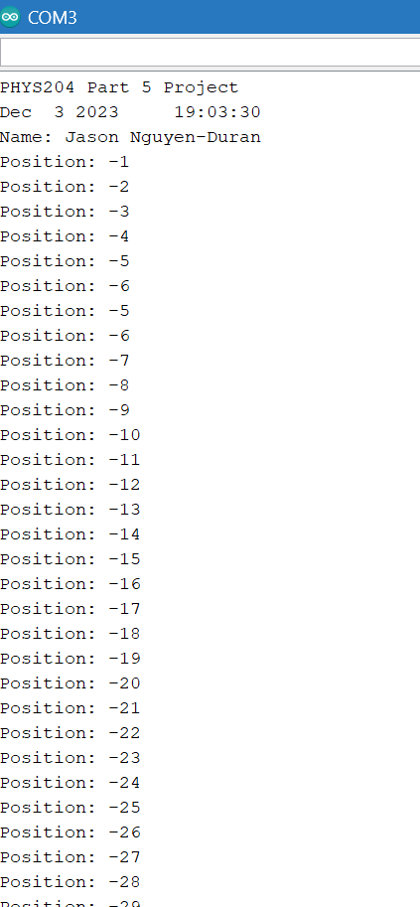
Collection of data.

Slide 22
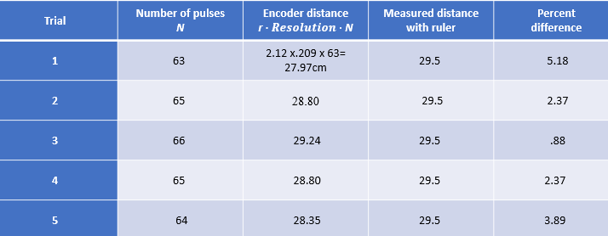
Data analysis

Slide 23
Conclusion
Discuss the results and comment on the sources of error.
Answer: My data compared with the percent difference is surprisingly accurate. The biggest change I would make is to use longer wires or a longer cable connecting to the mega board. The short wires would get caught and I would have to drive the laptop at the same time as trying to roll the object.
What are some applications of this measuring technique? Could this measuring system be used to measure surfaces that are not flat?
Answer: I think this would be perfect to measure round or uneven objects. We can’t use a ruler to measure dips and bumps but this technique would work pretty well for that

Slide 24
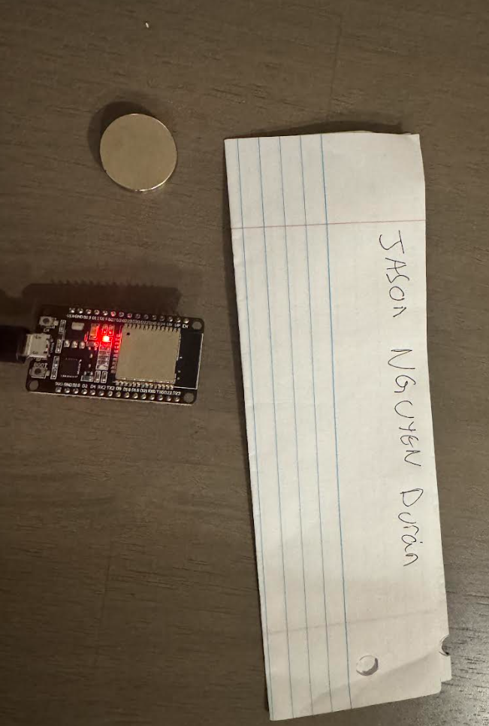
Part 6.Observing the hall effect.
Utilizing a magnet and a sensor we can see the forces and electrical field around a magnet.
Set Up:

Slide 25
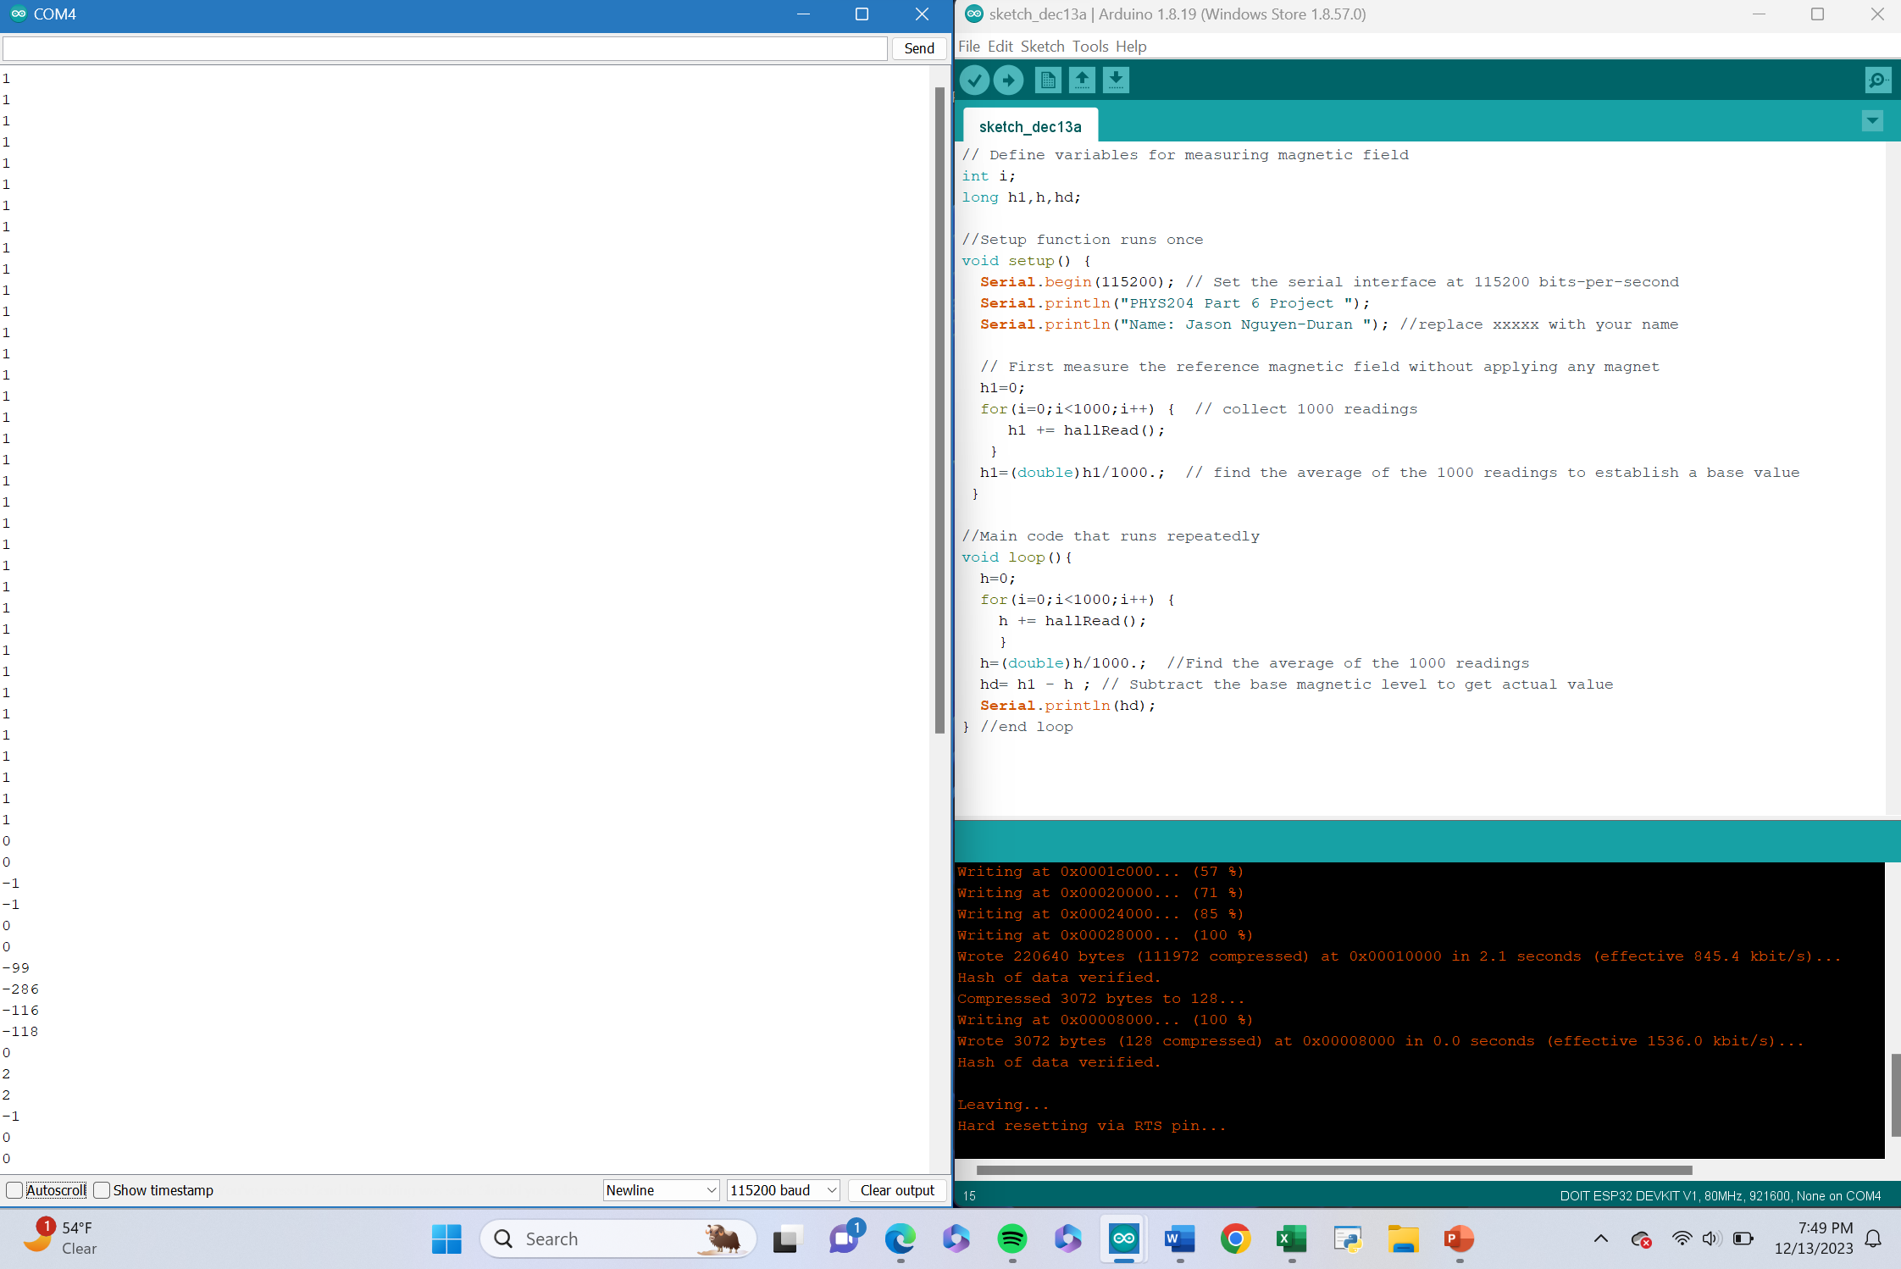
Raw Data

Slide 26
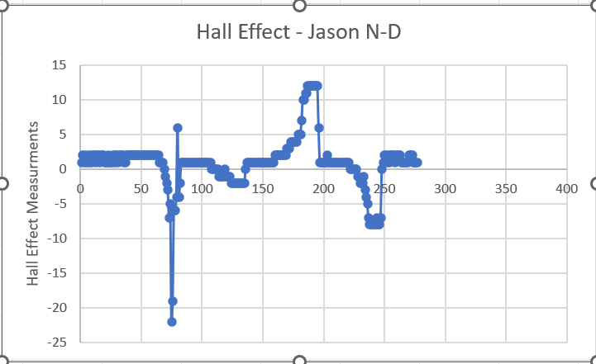
Excel Graph

Slide 27

Conclusion
Discuss the results and comment on the sources of error.
  Answer: It was interesting to see how the polarity of the magnet would give you either a positive output or a negative output. You would think the sensor would just read how strong the magnet is not its actual polarity
Describe how the Hall sensor works. What are some applications for the Hall effect sensor?
  Answer: The sensor works by sending an electrical signal out into the world and can sense a magnet or a magnetic field in the area. I feel like these sensors can be used to detect medals or other objects in the real world. The first example I thought of was the sensors in roads that detect when a car is close to or over it.

Slide 28
Project Challenges
What challenges did you face and overcome?
Having different parts and collecting data is hard to do unless you plan ahead and make sure you are ready before you start.
What parts of the project created the most difficulty?
Having the kit I got supplied from Devry the wires and USB’s were slightly short for how I wanted to conduct my project. But I was able to adapt and overcome.

Slide 29

Career skills
What skills were developed that will benefit your career?
  I obtained the skills of organization and critical thinking. If you are not able to stay organized it is hard to complete a project.

